Slide 1
Pour yourself some of the beautiful Mount Claire Porter while we wait for later arrivals! It’s leading off the lineup.

Slide 2
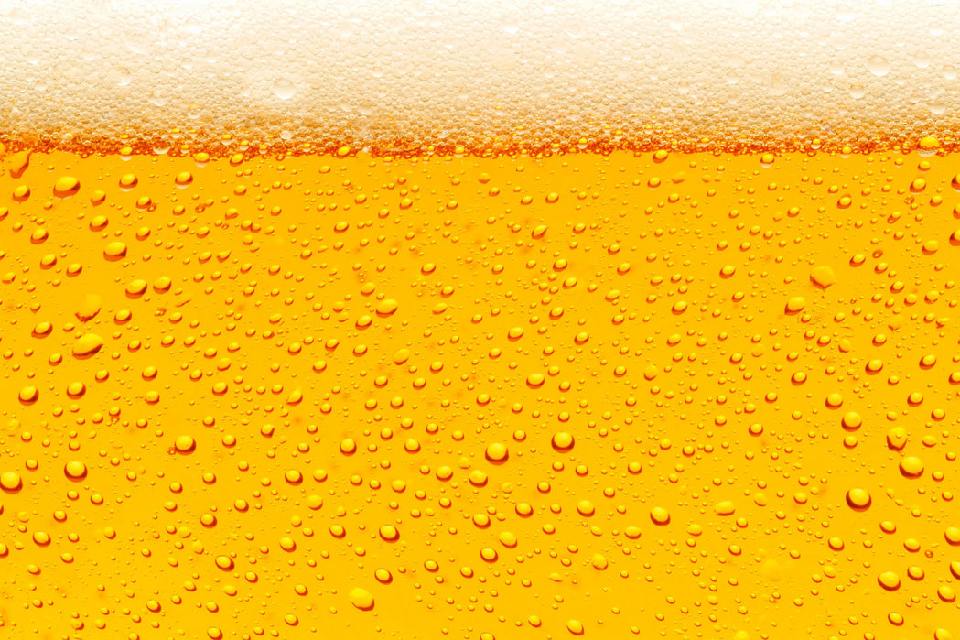
Meet the Beers
 | Mount Claire Porter | Pilsner Urquell | Ameri-Cannon | Foxy | Big Time Stuff | Golden Monkey
Brewer | Peabody Heights Brewery | Plzeňský Prazdroj | Heavy Seas Beer | Union Craft Brewing | Checkerspot | Victory Brewing Company
Location | Baltimore, MD | Pilsen, Czechia | Halethorpe, MD | Baltimore, MD | Baltimore, MD | Parkesburg, PA
Cerevisaphile | Reeser | Nelson | Todaro | Moyes | Greer | Tomasino
Style | American Porter (20A) | Czech Premium Pale Lager (3B) | American Pale Ale (18B) | Specialty IPA: Red (21B) | American IPA (21A) | Belgian Tripel (26C)
ABV | 6.2% | 4.4% | 5.8% | 6.5% | 7.0% | 9.5%
IBU | (25-50) | 40 | 40 | 75 | 42 | 25

Slide 3
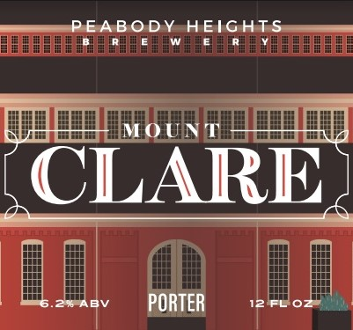
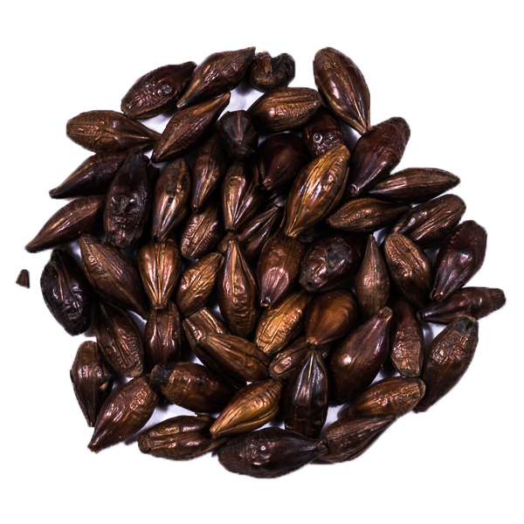
American Porter: A substantial, malty dark beer with a complex and flavorful dark malt character.
From the Brewer: A big, bold porter filled with chocolate, chicory, and coffee flavors that's even a little thicker than some would consider a "normal" porter.
What to look for:
Dark Chocolate Malt
The dark roasted malt bill should be complex. Things to avoid: any acrid, burnt, or harsh tastes, or clashing with citrusy hops.

Slide 4
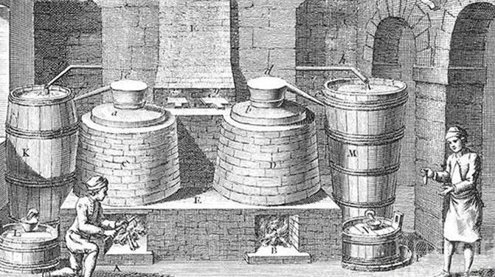
In the Beginning there was dark, hazy beer…
But then, the steam-powered industrialization of the early 19th century British Isles combined with the Bavarian technique of cave-brewing using cool-fermenting Saccharomyces pastorianus yeast and the soft, clean waters of Bohemia to make something new under the sun…
LAGER!

Slide 5
Czech Premium Pale Lager: Rich, characterful, pale Czech lager, with considerable malt and hop character and a long, rounded finish. Complex yet well-balanced and refreshing. The malt flavors are complex for a Pilsner-type beer, and the bitterness is strong but clean and without harshness, which gives a rounded impression that enhances drinkability.
From the Brewer: In 1842, our first Brewmaster Josef Groll brewed a beer unlike any other. His crisp, refreshing golden lager was made with local ingredients: sweet Moravian barley, delicately bitter Saaz hops, soft Pilsen water, and bottom-fermenting H-strain yeast. Groll named this special beer after the city where he brewed it, Pilsen, where we still brew the same beer today. Over the last 178 years, pilsner-style lager has become the world’s most popular beer, with seven out of 10 beers in the world imitating Groll’s innovation. There are many pilsner-style beers out there, but only one original.
What to look for:
Beer as we know it
The original drink that begins beer’s modern era. Featuring “noble” old-world Saaz hops, light but flavorful malts, and crystal clarity, it is a balanced, flavorful, highly drinkable beer that changed the world… forever.

Slide 6
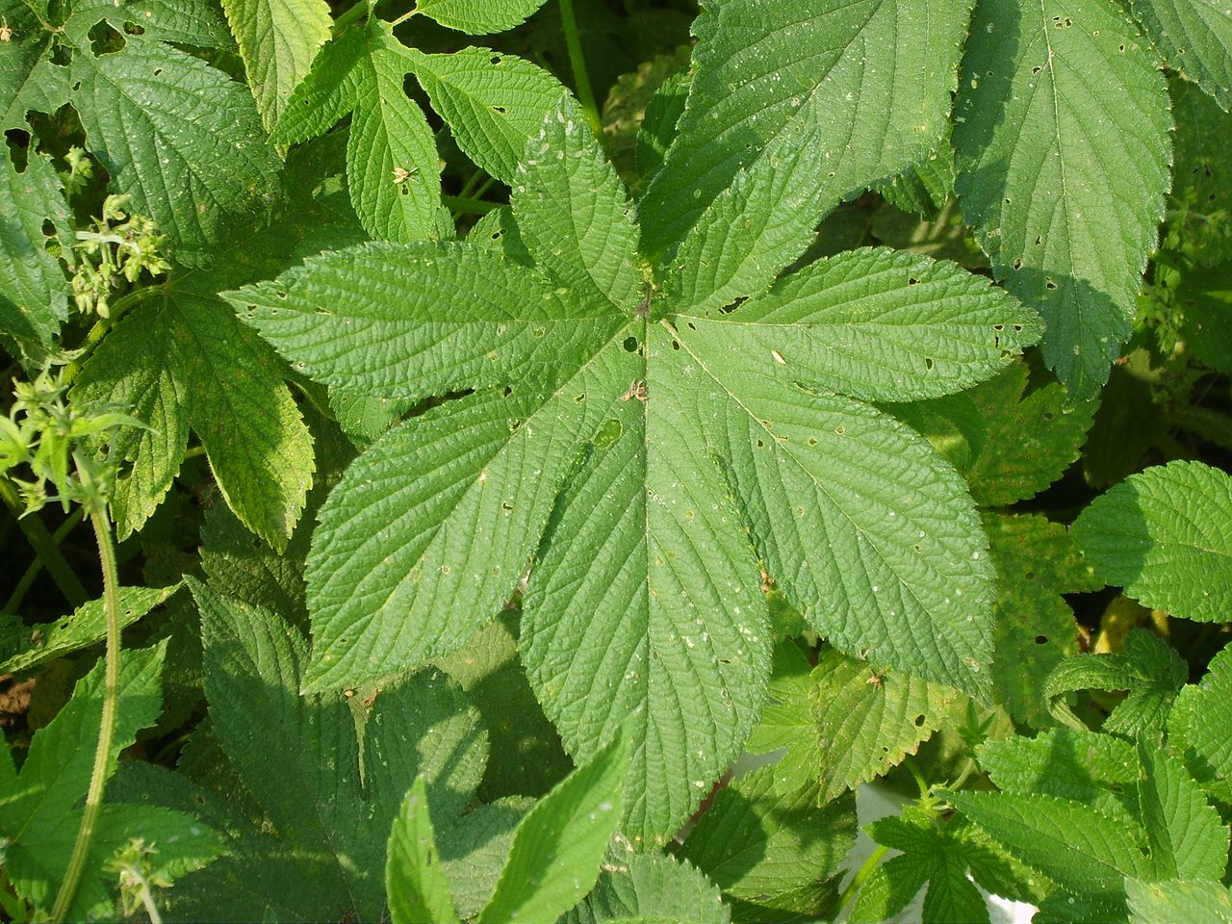
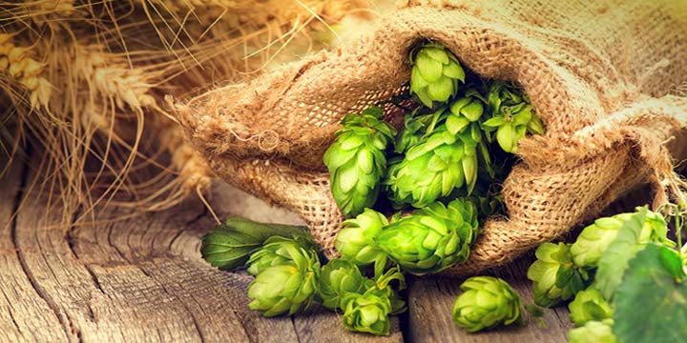
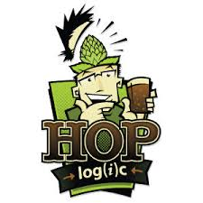
Meet The Hops: Family: Cannabaceae Genus: Humulus
Columbus | Centennial | Simcoe | Sultana
Pungent, resiny, earthy, spicy | floral, citrus, grapefruit | passion fruit, pine, berry, earth | pineapple, pine, citrus
1974, US | 1990, US | 2000, US | 2006, US
AmeriCannon | Foxy | Big Time Stuff
Centennial | Centennial | Centennial
Simcoe | Columbus | Simcoe
 |  | Sultana
Foxy = AmeriCannon - Simcoe + Columbus
BTS = AmeriCannon + Sultana

Slide 7
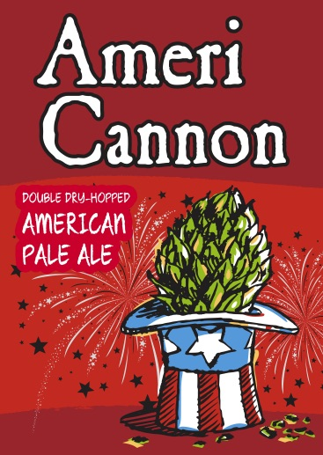
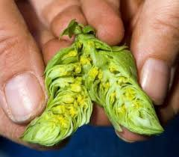
American Pale Ale: A pale, refreshing and hoppy ale, yet with sufficient supporting malt to make the beer balanced and drinkable. The clean hop presence can reflect classic or modern American or New World hop varieties with a wide range of characteristics. An average-strength hop-forward pale American craft beer, generally balanced to be more accessible than modern American IPAs.
From the Brewer: AmeriCannon boasts intense flavor with a bright, light body. Its satisfying, piney finish makes it the pleasantly drinkable porch beer of our dreams, and yours. We utilize Simcoe lupulin powder to make the hop aromas pop.
What to look for:
American Hop Flavor
Aggressively hopped for the style, the pine notes from both Centennial and Simcoe (American bred) hop varieties should be apparent, but not overwhelming.

Slide 8
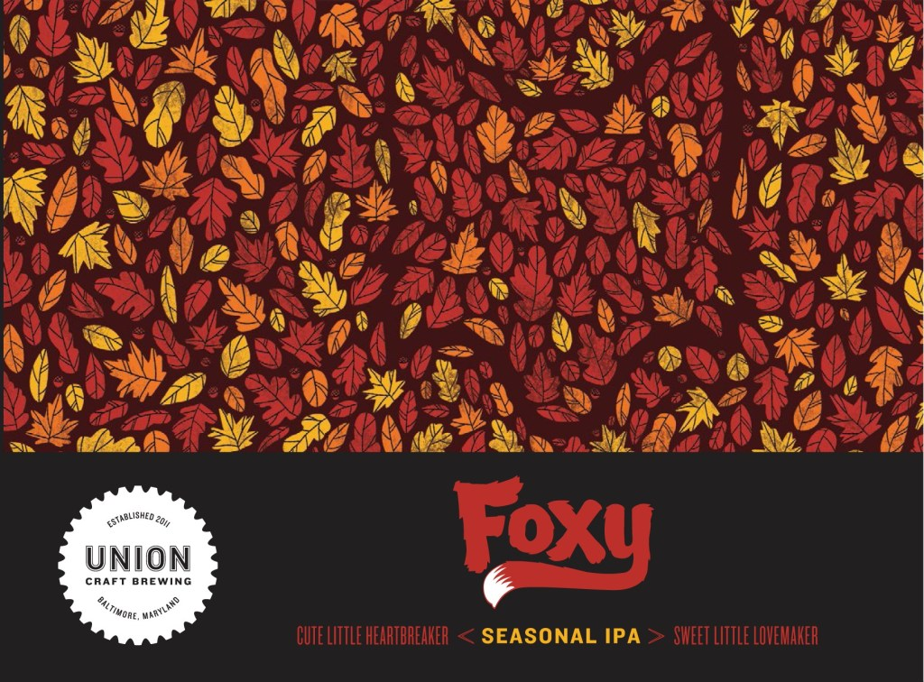
Specialty IPA, Red: Hoppy, bitter, and moderately strong like an American IPA, but with some caramel, toffee, and/or dark fruit malt character. Retaining the dryish finish and lean body that makes IPAs so drinkable, a Red IPA is a little more flavorful and malty than an American IPA without being sweet or heavy.
What to look for:
A Maltier IPA
Darker, more flavorful malts than other pale ales.
Depending on how it is used, Columbus hops can yield a pungent, dank, earthy aroma… is it apparent, or a note?
From the Brewer: Northern Native American tribes believed that the Red Fox was a wise and noble messenger. Other tribes saw her as a dangerous prankster. Foxy Red IPA is a bit of both. This sly girl creeps out of her den when the night air gets just a little chill and the Autumn leaves begin to turn. Don’t be fooled by the color as Centennial & Columbus hops, bursting with their piney and fruity resins, combine with this rich, red ale to create a perfect balance of juicy hops and bready malt to usher you gently into the colder months. This seasonal IPA won’t be around long, so catch her if you can.

Slide 9
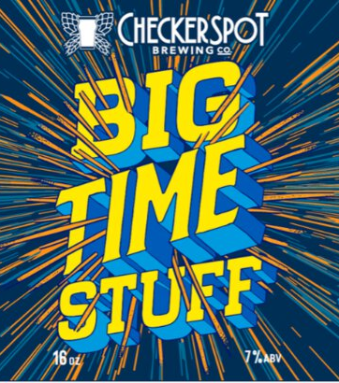
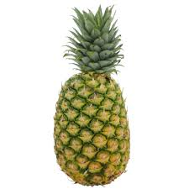
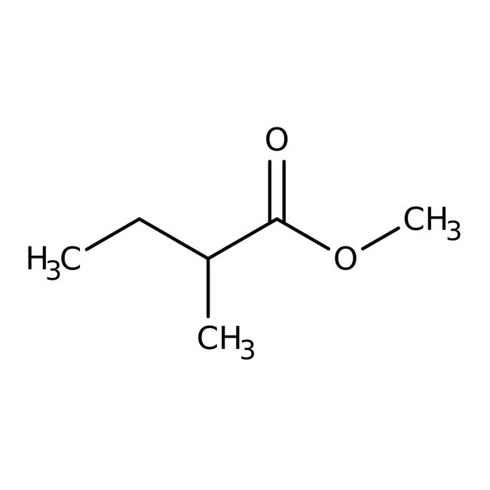
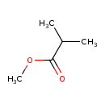
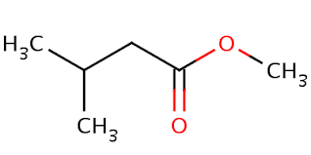
American IPA: A decidedly hoppy and bitter, moderately strong American pale ale, showcasing modern American or New World hop varieties. The balance is hop-forward, with a clean fermentation profile, dryish finish, and clean, supporting malt allowing a creative range of hop character to shine through.
From the Brewer: An IPA with big time citrus, hoppy flavor brewed with a lot of Simcoe, Centennial and Sultana hops. Brewed with the Norwegian HotHead yeast
The esters shown below are unique among hops described as “pineapple,” including Sultana
The molecular biology of fruity and floral aromas in beer and other alcoholic beverages, FEMS Microbiology Reviews, fuy041, 43, 2019, 193–222
What to look for:
The “Big Pineapple” Sultana Hops
The Sultana hops (US, 2006) should pack a powerful pineapple citrus aroma that distinguishes this from the similarly-hopped AmeriCannon.

Slide 10
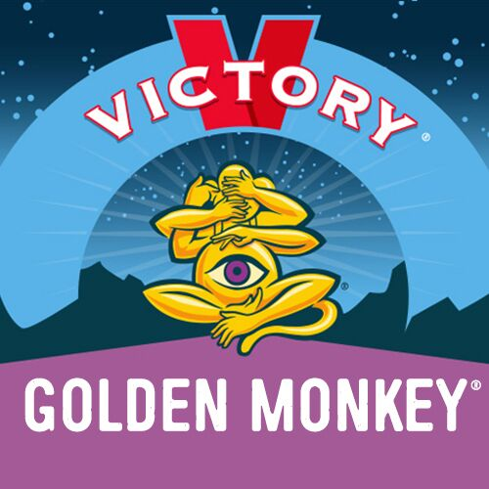
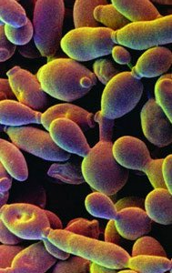
Belgian Tripel: A pale, somewhat spicy, dry, strong Trappist ale with a pleasant rounded malt flavor and firm bitterness. Quite aromatic, with spicy, fruity, and light alcohol notes combining with the supportive clean malt character to produce a surprisingly drinkable beverage considering the high alcohol level.
From the Brewer: Meet the most curious of all the monkeys. His journey to discover the truth about life lead him to meditate with monks, wrestle with lions and study the stars. Golden Monkey crafts an ale with imported malts, Belgian yeast, and a mix of magical spices resulting in mystical flavors that will enlighten your senses.
What to look for:
Belgian Yeast Esters (and alcohol)
Banana and citrus flavors, also clove from added spice (frowned upon for the variety). Warming alcohol flavor apparent, but not overwhelming

