Slide 1
How to Solve Hardy-Weinberg problems (5.17)
Do Now: Objective: Solve Hardy-Weinberg problems
Task: Copy the following problem solving steps into your notes:
Find f(aa) or f(AA) from the information about the population’s characteristics in the problem.
Use f(aa) = Q² , or f(AA) = P² to FIND P OR Q.
Use P + Q = 1 to find the other allele frequency.
Find the genotype or phenotype frequencies asked for in the question by using
  f(AA) = P²
  f(Aa) = 2pq
  f(aa) = Q²

Slide 2
What the terms mean
f(AA) = frequency of homozygous dominant individuals
f(Aa) = frequency of heterozygous individuals
f(aa) = frequency of homozygous recessive individuals.
P = allele frequency of dominant allele
Q = allele frequency of recessive allele

Slide 3
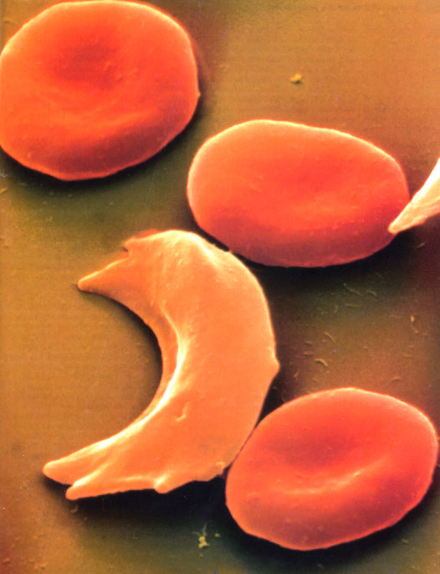
Example Problem
If 9.0% of an African population is born with a severe form of sickle-cell anemia (ss), what percentage of the population will be more resistant to malaria because they are heterozygous(Ss) for the sickle-cell gene?

Slide 4
Step 1: Find f(ss)
We are told 9% of the population is ss, the homozygous recessive genotype.
Therefore, f(ss) = .09

Slide 5
Step 2: Find P or Q
Since f(ss) = Q²
.09 = Q²
Q = .30

Slide 6
Step 3: Find the Other Frequency
Since P + Q = 1
P + .30 = 1
P = .70

Slide 7
Step 4: Find Unknown Phenotype or Genotype Frequency
The question asks you to find the % of heterozygotes.
Since f(Ss) = 2PQ
  P = .70
  Q = .30
f(Ss) = 2(.70)(.30)
f(Ss) = .42
42% of the population is heterozygous (Ss) for the trait.

Slide 8
Practice.
Complete the 2 practice problems – I’m here to help.
We’ll go over them in a few minutes.

Slide 9
Practice Problem 1: Pigeons
Step 1: Find f(BB) or f(bb).
  Since we know the red birds are recessive, we must solve for Q first (a blue bird may be BB or Bb)
f(bb) = 2/50 = .04

Slide 10
Practice Problem 1: Pigeons
Step 2: Find P or Q
  Since we know f(bb) = .04, we can solve for Q
f(bb) = Q²
.04 = Q²
Q = .20

Slide 11
Practice Problem 1: Pigeons
Step 3: Find the other allele frequency
  Since we know Q = .20, we can solve for P
P + Q = 1
P + .20 = 1
P = .80

Slide 12
Practice Problem 1: Pigeons
Step 4: Find what the question asks
  Since we know P = .80 and Q = .20, we can solve for f(Bb), the frequency of heterozygotes
f(Bb) = 2PQ
f(Bb) = 2(.80)(.20)
f(Bb) = .32
32% of the pigeon population is heterozygous.

Slide 13
Practice Problem 2: Dogs
Step 1: Find f(BB) or f(bb).
  We are given this step in the problem
f(BB) = 15% = .15

Slide 14
Practice Problem 2: Dogs
Step 2: Find P or Q
  Since we know f(BB) = .15, we can solve for P
f(BB) = P²
.15 = P²
P = .39

Slide 15
Practice Problem 2: Dogs
Step 3: Find the other allele frequency
  Since we know P = .39, we can solve for Q
P + Q = 1
.39 + Q = 1
Q = .61

Slide 16
Practice Problem 2: Dogs
Step 4: Find what the question asks
  Since we know P = .39 and Q = .61, we can solve for f(bb), the frequency of white dogs
f(bb) = Q²
f(bb) = .61²
f(bb) = .37
37% of the dogs are white (bb)

Slide 17
Practice Problem 2: Dogs
Step 4: Find what the question asks
  Since we know P = .39 and Q = .61, we can solve for f(Bb), the frequency of spotted dogs
f(Bb) = 2PQ
f(Bb) = 2(.39)(.61)
f(Bb) = .48
48% of the dogs are spotted (Bb)

Slide 18
Check
If we add up the 3 percentages, we should get 100%:
  15% black + 37% white + 48% spotted = 100%
  Sometimes, because of rounding to 2 decimal places, you may get a total of 99-101%

Slide 19
Homework
Complete the Hardy-Weinberg problem set. Due in 1 week (Friday 5.10)

