Slide 1
Do Now 5.12
OBJECTIVES:
Define natural selection, and describe 3 conditions required for it to occur.
Identify 5 major lines of evidence and other support for the theory of evolution by natural selection.
TASK: Which of the following is NOT true of a non-fatal autosomal recessive disease?
An equal number of males and females get the disease.
(B) If both parents have the disease, 50% of their offspring will have the disease.
(C) If both parents are heterozygous, 75% of their children will not get the disease.
The genes for the disease are not located on the sex chromosomes.
Unaffected parents can produce affected offspring

Slide 2
Syllabus in Limbo…
HW tonight: 13.2, 13.3
Optional 13.1, 13.4
Update forthcoming

Slide 3
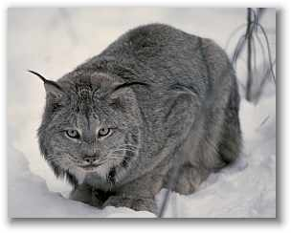
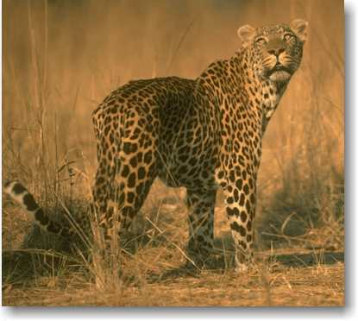
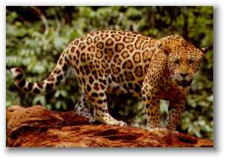
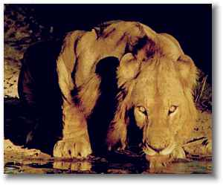
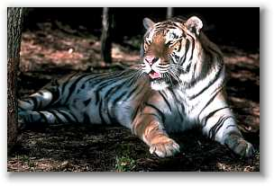
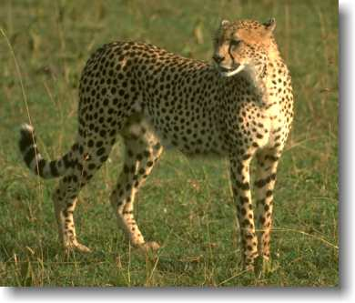
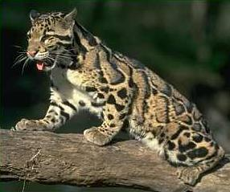
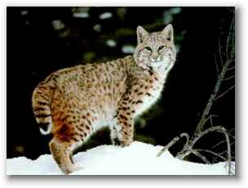
Observation: There are 36 different species of cats. (Species = organisms able to reproduce together)
Question: Where did all of these cats come from?

Slide 4
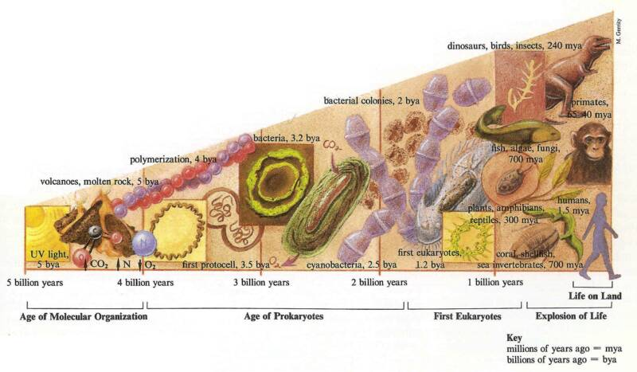
Evolution: A Definition
Biological evolution is the change in the characteristics of a population over time.

Slide 5
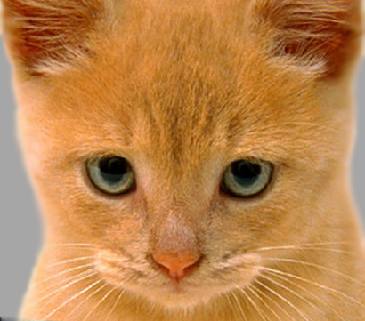
Possible Hypotheses: Why do all cats have homologous features? e.g. cute wet nose, retractable claws, etc.
Each species of cat has an independent origin from one another, and it is only by coincidence or design that they have such similar characteristics.
All cats are descendants of a single common ancestor, with the differences seen in each species being a result of the adaptive evolution of one ancestor species.

Slide 6
Which Hypothesis is Correct?
Occam’s Razor: The least complex explanation of a phenomenon is the most likely to be correct.
However a cat species came to be, the independent development hypothesis requires it to have happened 36 times.
The evolution hypothesis only requires the development of 1 ancestor species, which then changes over time.

Slide 7
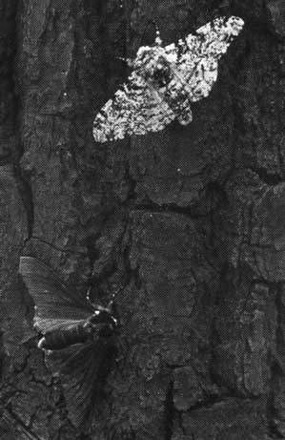
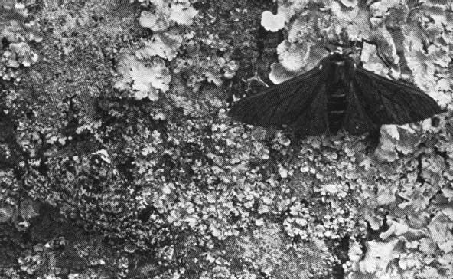
Peppered Moths
Are the moths with the dark phenotype
easier to see in the polluted or
unpolluted ecosystem?

Slide 8
Kettlewell’s Data
Kettlewell released moths with a variety of phenotypes in 2 locations, one near the industrial city of Birmingham, and the other in the countryside near Dorset.
Next, he trapped moths on the following days, and recorded the numbers of each phenotype.

Slide 9
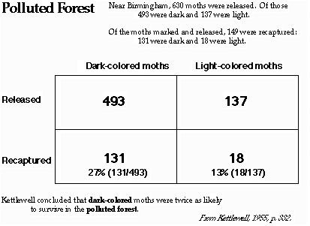

Slide 10
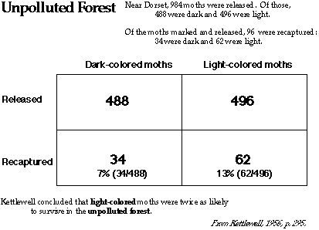

Slide 11
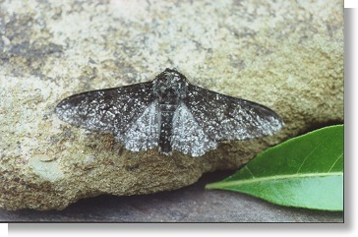
Results?
As you might expect,
things weren’t so clear
cut. For example, do
You think the moth at
right is more black or
more white?
Because Kettlewell did
all of the classifying and
ignored the large number
of phenotypes “in between” black and white, his study has been
criticized.
Regardless of those concerns, it has been demonstrated that,
as you might expect, darker moths survive better in darker forests.

Slide 12
Simulation of Natural Selection I
http://www6.district125.k12.il.us/~nfischer/Moth/
Google “peppered moth game” if you want to play later

Slide 13
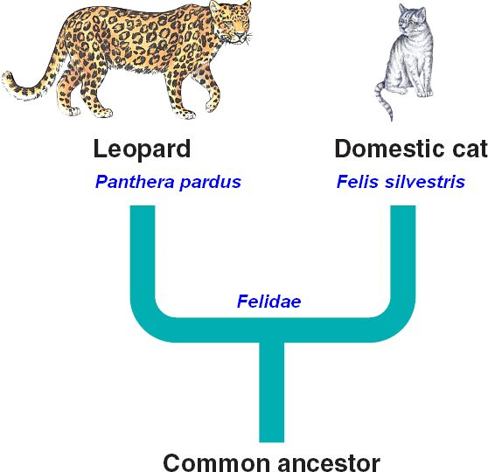
Common Ancestors
Any 2 species share a common ancestor.
The more similar they are, the more recently it lived.

Slide 14
Evolution is Parsimonious
Parsimonious solutions are less complex and require less chance than non-parsimonious ones.
That fact alone however, is not enough to completely support the evolution hypothesis.
For a solution to be based in science, there must be a logical hypothesis for (and supporting observational evidence for) the mechanism by which something happens.
In other words, there needs to be evidence of how all of these cats came from 1 ancestor cat species.

Slide 15
Natural Selection
Natural selection is the mechanism by which biological evolution happens.
We’ll get a good definition in a minute… but first, how it works…
Natural selection requires 3 conditions:

Slide 16
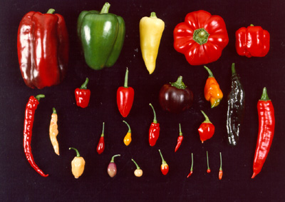
1: Variation
For natural selection to work, there must be a range of characteristics in a population.

Slide 17
2: Differential Mortality
Some characteristics or variations allow an organism to survive and/or reproduce more than others.

Slide 18
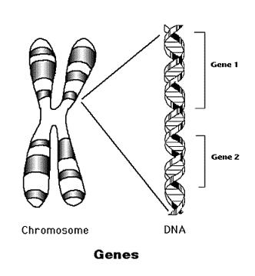
3: Heritability
The characteristics that lead to increased survival and reproduction must be able to be passed on to subsequent generations

Slide 19
Definition
Natural selection is the process by which heritable traits that make it more likely for an organism to survive and successfully reproduce become more common in a population over successive generations.

Slide 20
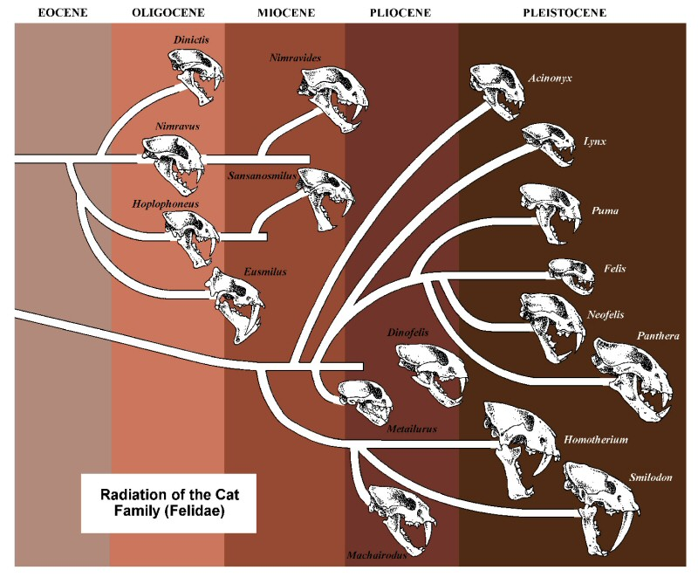
Evidence Natural Selection made 36 Cat Species: 1 - Fossils

Slide 21
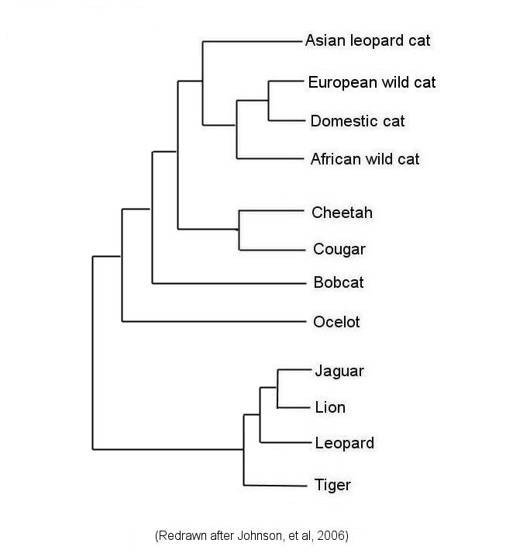
Evidence Natural Selection Made 36 Cat Species 2: Genetic Similarities (aka molecular homology)

Slide 22
More On Genetic Analysis

Slide 23
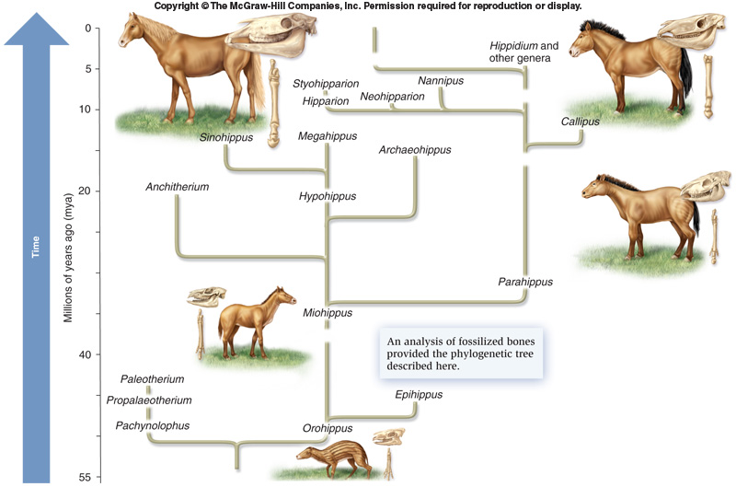
It’s not just Cats… evolution by natural selection gets the job done every time…

Slide 24
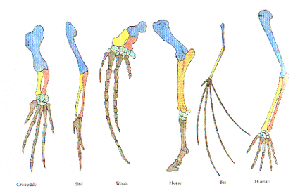
Evidence #3: Anatomical Homology
Homologous structures are alike in structure and origin

Slide 25
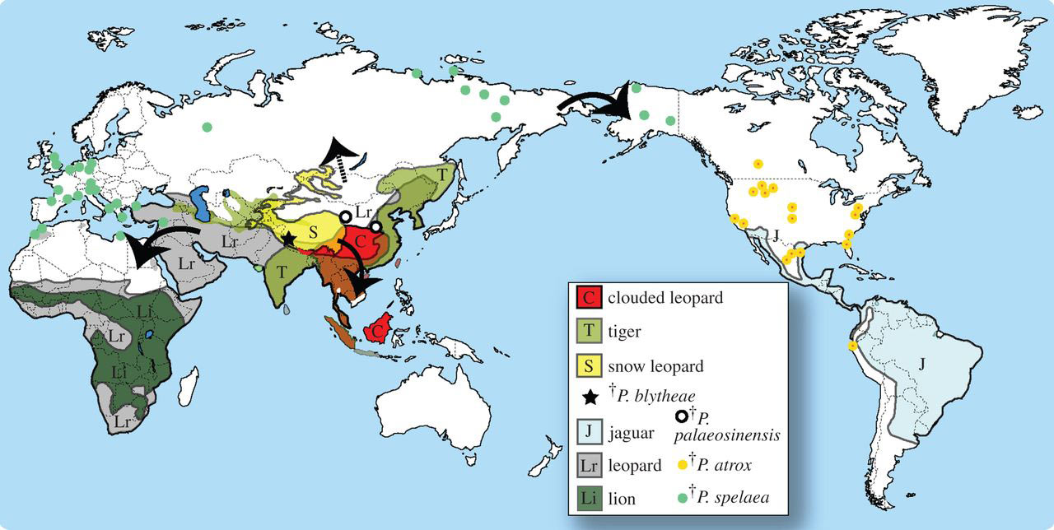
Evidence, part 4: Biogeography, Where they Live
A common ancestor for all “Big Cats” lived in Tibet 4-5 MYA; species migrated, adapted, and speciated from there.

Slide 26
Evidence #5: Embryology & Development
Ontology (development) recapitulates phylogeny (relatedness)

Slide 27
Any Evidence for 36 Independent Developments of Cat Species?
No new cat species has arisen since the domestication of Felis silvestris catus, 10s of thousands of years ago. In other words, we haven’t seen it happen in recorded history.
Remember the fallacious argument of negative proof?
We can’t PROVE the Flying Spaghetti Monster didn’t create 36 cat species… but WWFSMD?

Slide 28
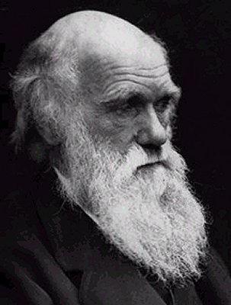
That’s the Basic Idea
Populations of organisms change over time, driven by the pressure of natural selection.
Natural selection has 3 basic requirements.
Although evolution by natural selection can’t be PROVEN*,
It is supported by several well-established lines of observable evidence.
Fossil Record
Homology
Molecular, anatomical, and developmental
Biogeography
It is the most parsimonious explanation of observed facts.
It can be (and has been) used to make testable predictions.

Slide 29
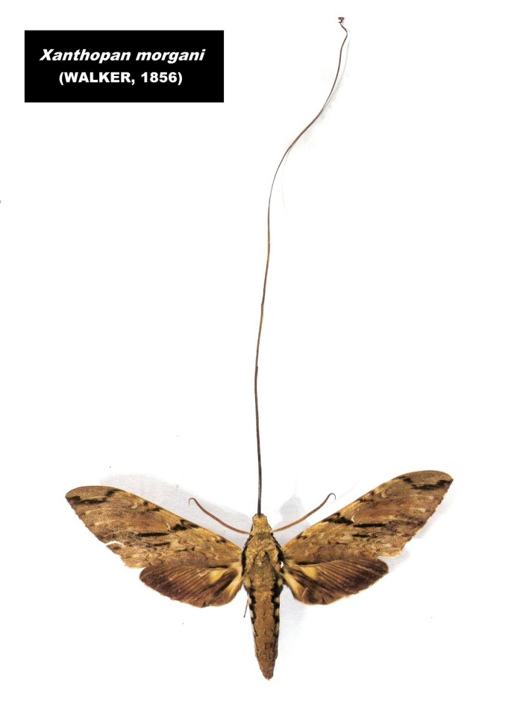
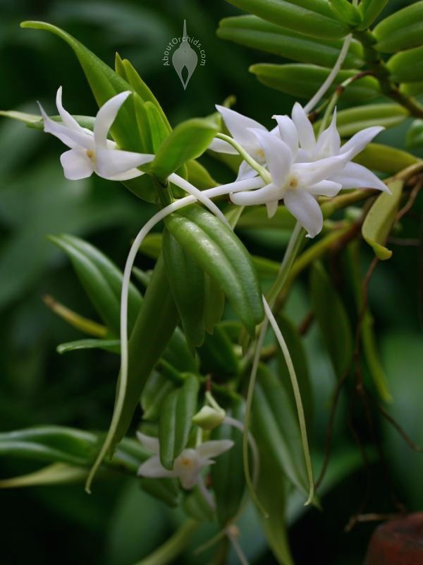
Darwin’s Moth, The Haley’s Comet of Biology
The predictive power of SCIENCE…
Edmund Haley correctly predicts the 1758 return of“Haley’s” comet in 1705…
Darwin predicts the moth must exist in 1862… it was discovered in 1905
Both men died before their predictions were validated.
Tested predictive ability is a hallmark (and the useful consequence of)a robust theory or hypothesis.

