Slide 1
The Bakuba account of creation is as follows. Originally, the Earth was nothing but water and darkness. Mbombo, the white giant ruled over this chaos. One day, he felt a terrible pain in his stomach, and vomited the sun, the moon, and the stars. The sun shone fiercely and water steamed up in clouds. Gradually, the dry hills appeared. Mbombo vomited again, this time the trees came out of his stomach, and animals, and people , and many other things: the first woman, the leopard, the eagle, the anvil, monkey Fumu, the first man, the firmament, medicine, and lightning.
Is this story about where Earth, the Universe, and life began based on evidence? Can you PROVE that it’s not true? What makes science different from other ways of understanding our world?
Origins

Slide 2
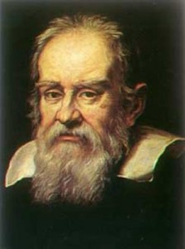
How is Science Special?
1. OBJECTIVITY. (measurement)
Science assumes a real, measureable Cosmos in which all matter and energy exists.
If it can be measured reproducibly, it must exist.
Galileo Gallilei:
“Measure what is measurable, and make measurable what is not so.”

Slide 3
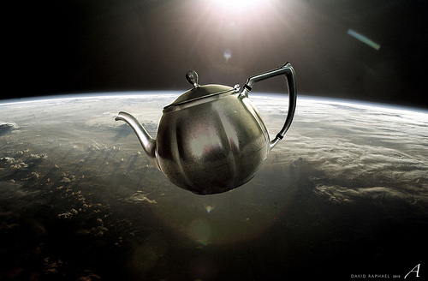
2. Testable Hypotheses
A hypothesis is a potential solution to a problem or explanation of a phenomenon.
To be scientific, a hypothesis must have two important characteristics:
Testable
Falsifiable

Slide 4
3. Parsimonious Evaluation of Hypotheses.
If it’s not working, make sure it’s plugged in and turned on first.
Parsimony = simplicity.
Occam’s Razor / Lex Parsimoniae: the least complex solution to a problem has the highest likelihood of being correct.

Slide 5
4. Strict Logic
Although not unique to science, an adherence to the rules of logical conjecture is required.
Examples of Fallacious Logic:
Argument from Ignorance / Incredulity
Negative Proof (IMPOSSIBLE)
Teleological Arguments
Allowed logic:
Deductive (from previously established theories)
Inductive (from data)

Slide 6
So What is Pastafarianism?
In 2005, the Kansas State Board of Education considered (and adopted) science curriculum standards that would teach students “that evolution could not rule out a supernatural or theistic source”
Proof? There is no proof (other than in mathematics)
“…could not rule out ______…”
Anything inserted in that blank is true! Yes, it is true that evolution theory cannot rule out a supernatural source

Slide 7
“…Could not rule out a ______...”
Bobby Henderson noticed this fallacy, and sarcastically (hilariously?) pointed out that if one were to insert “Flying Spaghetti Monster,” the claim would still be valid.
He authored a letter to the board describing his belief that the Flying Spaghetti Monster was in fact responsible for evolution, and should therefore also be included in the new standards.
“I think we can all look forward to the time when these three theories are given equal time in our science classrooms across the country, and eventually the world; one third time for Intelligent Design, one third time for Flying Spaghetti Monsterism, and one third time for logical conjecture based on overwhelming observable evidence.
—Bobby Henderson”

Slide 8
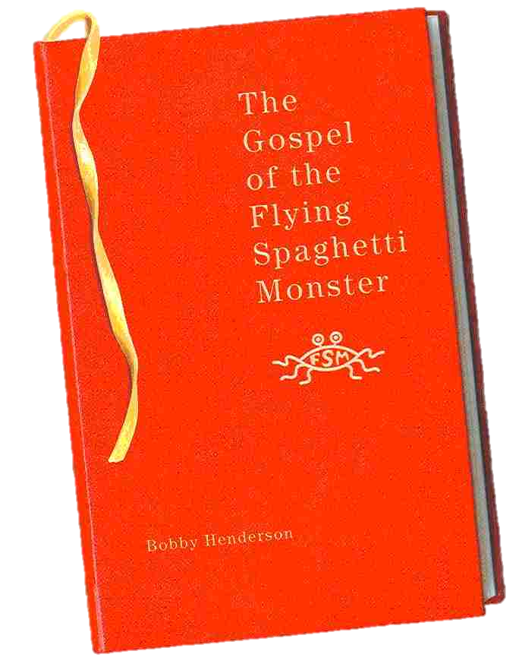
The Flying Spaghetti Monster

Slide 9
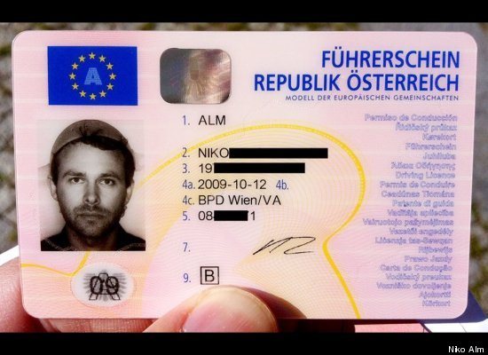
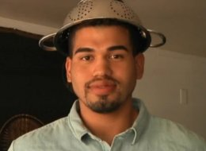
Austrian Law Recognizes Pastafarian Religion
2011: Niko Alm legally allowed to wear his Pastafarian religious head gear (a pasta strainer) in his driver’s license photo after a 3 year legal battle.
2013: First US Pastafarian driver’s license issued in TX.

Slide 10
Other Fallacies of Negative Proof
Russell’s Teapot
Carl Sagan’s Dragon
The Invisible Pink Unicorn

Slide 11
What is Intelligent Design? Not Science!
Intelligent design (ID) is “the pseudoscientific view^{[1][2]} that "certain features of the universe and of living things are best explained by an intelligent cause, not an undirected process such as natural selection."^{[3]} Educators, philosophers, and the scientific community have demonstrated that ID is a religious argument, a form of creationism which lacks empirical support and offers no testable or tenable hypotheses.”
-Wikipedia

Slide 12
Kansas School Board Trial 2005: Kitzmiller v. Dover Area School District : Intelligent Design Rejected By Courts

Slide 13
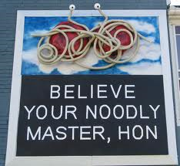
RECAP: What Makes Science Science
Requirement of Objective Measurement.
Testable, Falsifiable Hypotheses.
Parsimonious Evaluation of Hypotheses.
Adherence to the Rules of Logic

Slide 14
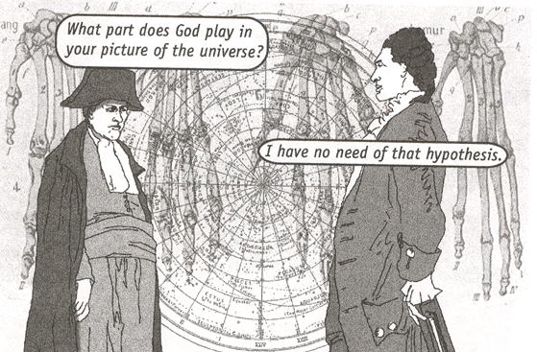
Napoleon Vs. Laplace c. 1814
'M. Laplace, they tell me you have written this large book on the system of the universe, and have never even mentioned its Creator.'
‘I had no need for that hypothesis.’

Slide 15
Theory vs. Hypothesis
In science, theory has a strict definition:
Theories are facts, consisting of multiple related hypotheses supported by many observations, rigorous experiments, and tested predictive ability.
Hypothesis:
Often, when unscientific people say “theory,” they mean hypothesis:
Hypotheses are POSSIBLE explanations for a problem or phenomenon that may or may not be well-supported evidence.

Slide 16
Theories are supported by Hypotheses
In science, theory has a very different meaning than in common parlance
Theory
Scientific theories are supported by many different tested hypotheses and observations.
A theory describes a broad set of related observations
S H
U Y
P P
P O
O T
R H
T E
E S
D I
S
S H
U Y
P P
P O
O T
R H
T E
E S
D I
S
S H
U Y
P P
P O
O T
R H
T E
E S
D I
S
S H
U Y
P P
P O
O T
R H
T E
E S
D I
S
S H
U Y
P P
P O
O T
R H
T E
E S
D I
S

Slide 17
Questions Answered by Evolution Theory
There are two big questions that evolution theory provides answers to:
How did the diversity of life on Earth come to be?
How do species change over time and sometimes produce new species?
There is one big question evolution theory doesn’t attempt to answer, though many people mistakenly think it does:
1. How did life first arise on planet Earth? (There are several good hypotheses about abiogenesis on early Earth, but none nearly as robust as evolution theory.)

Slide 18
Did you Know…
There’s a dragon in my garage…

