Slide 1
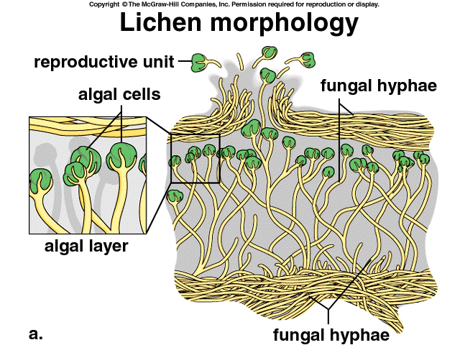
Do Now 4.24 week 33
OBJECTIVES: 1. Define biodiversity, explain its effect on ecosystems, and describe two ways to measure it.
TASK:
1. What is a lichen? What
Kind of interspecific
Interaction is this?

Slide 2
Notes Are Yours Today
Practice using Cornell Notes for a lecture presentation.
During lecture, record notes as you usually would (outline?)
Pay attention to slide titles
Define key terms, etc.
Leave space for parts II (key ideas / questions) and III (summary) to be completed later.

Slide 3
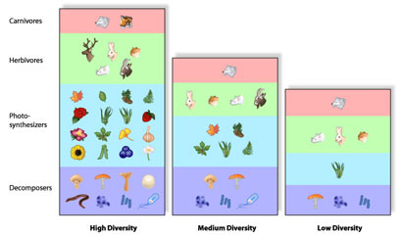
Biodiversity: The Diversity of an Ecological Community
More biodiversity causes increased stability of an ecosystem

Slide 4
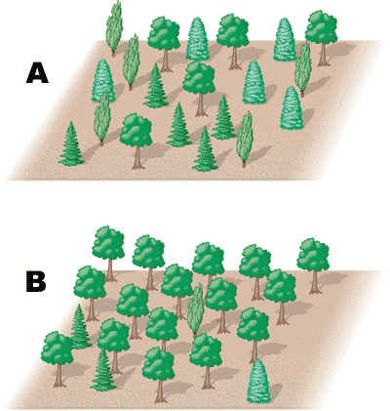
Two ways to Measure Biodiversity: Species Richness and Species Diversity
Species Richness is the number of different species.
Species Diversity measures both richness AND relative abundance
Example: Forests A and B have the same species richness (4), but Forest A has a higher species diversity because the relative abundances of species are more similar.

Slide 5
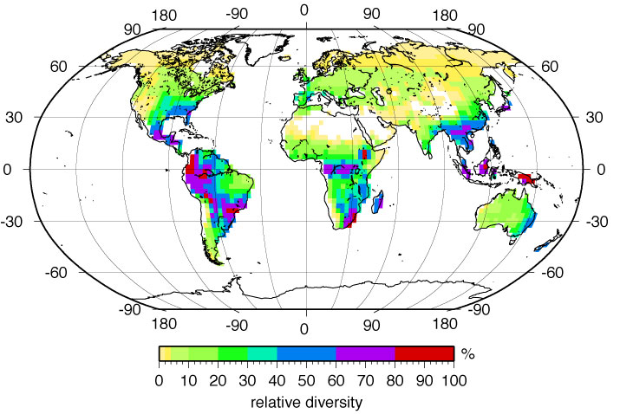
Biodiversity on Earth is Concentrated in Hotspots, Especially in the Tropics

Slide 6
The Value of Biodiversity
More Biodiversity → more stability / resilience (ability to adapt to disruptions) in an ecosystem.
Other reasons to value biodiversity:
Ecosystem services (water filtration, erosion prevention, waste treatment, etc.)
Aesthetic / recreational value
Potentially useful products (drugs, food, etc.)

Slide 7
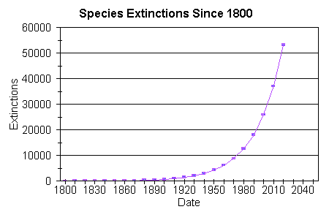
The Biodiversity Crisis
Over 20,000 known species are threatened with extinction today. Many more are unknown to science.

Slide 8
Aka “invasive species”

Slide 9
Biodiversity Review
What is it / how is it measured?
Where is the biodiversity of Earth?
Why is it valuable to ecosystems and humans?
What are the causes of biodiversity loss?

Slide 10
Ecological Succession 4.26
OBJECTIVE:
Define ecological succession, distinguish primary & secondary succession, and describe pioneer and climax species
TASK:
What happens to vacant lots or unmanaged yards in Baltimore over time?
Notes are yours today…

Slide 11
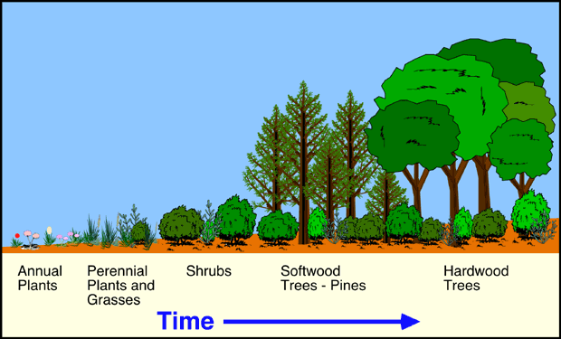
Ecological Succession
Succession is the change in the species structure of a community over time.

Slide 12
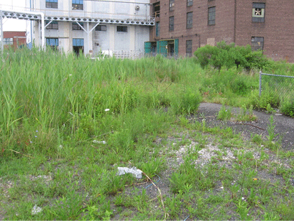
Succession in an Urban Vacant Lot

Slide 13
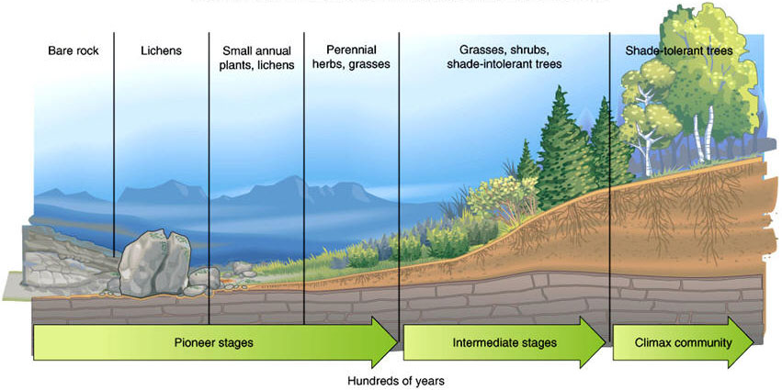
Succession Types
Primary succession refers to the first colonization of new land (e.g. from volcanoes, uplift, etc.)

Slide 14
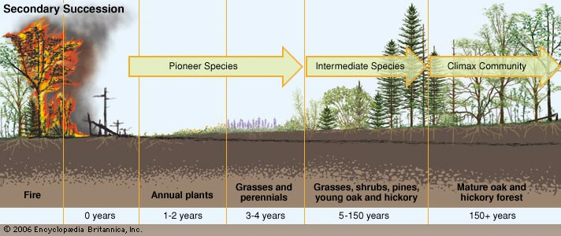
Succession Types
Secondary succession refers to the recolonization of land after a disturbance (e.g. fire, clear-cut, etc.)

Slide 15
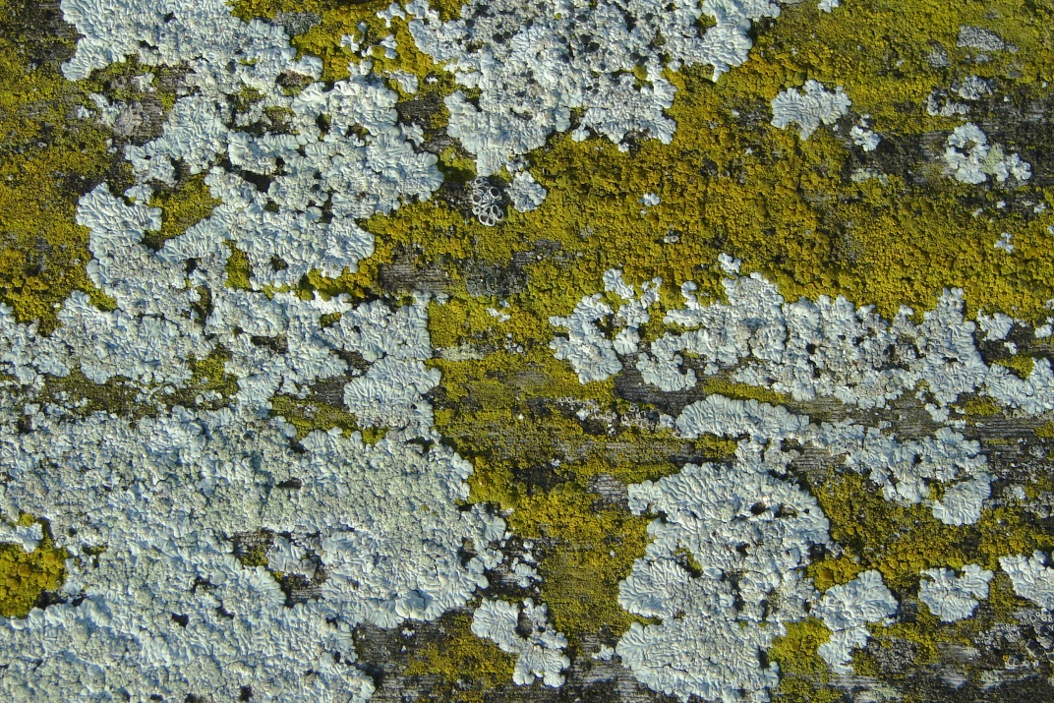
Succession Stages
Pioneer stage / pioneer organisms: The first organisms to establish populations are called pioneer organisms.
Quickly growing
Minimum requirements (e.g. lichen)
Climax community: high biodiversity, slower growing organisms (e.g. trees), more specialization in niches.

Slide 16
Succession Recap
What is it?
What types are there?
What is a pioneer organism?
What is a climax community?

