Slide 1
Do Now 4.3 (Week 31 / Q4)
OBJECTIVES:
Define habitat and niche, and provide examples of each.
Distinguish fundamental niche and realized niche
TASK:
What’s your niche? Ecological or otherwise…
Wondering about new seats? We’ll get them on the other side of spring break – and get a fresh start for the home stretch

Slide 3
Habitat: the particular place in which an organism lives.
Niche: the unique role an organism plays in its environment.

Slide 4
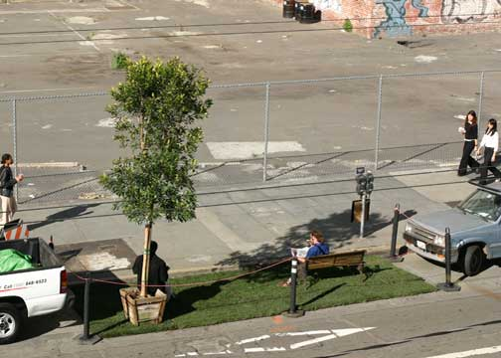
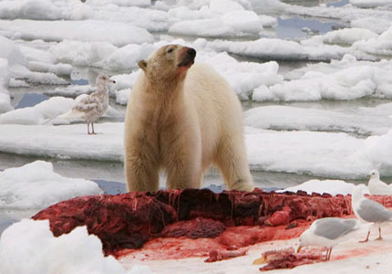
Habitat: Humans & Polar Bears
Polar bears can be found on pack ice, coastal islands, coastlines and even out in Arctic waters. They are exceptional swimmers and have been observed in the sea more than 100 miles from the nearest land or pack ice.
A majority of human beings live in urban environments
Urban Land:
3% of Earth’s land surface
3,500,000,000 people

Slide 5
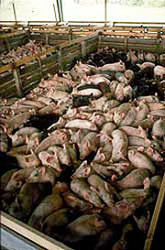
Niche: Humans & Polar Bears
Humans generally eat plants and animals grown using technology such as chemical fertilizers and irrigation.
Polar bears are strictly carnivores and feed or scavenge only meat. Their primary prey is the ringed seal though they also take bearded, harp and hooded seals and the occasional walrus youngster. They will also scavenge walrus and whale carcasses.

Slide 6
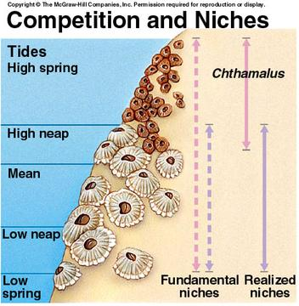
Fundamental Niche vs. Realized Niche
The fundamental niche is the potential, realized niche is actual.
Ecosystem factors (biotic or abiotic) may limit the fundamental niche to produce the actual.

Slide 7
Trophic Levels: New Word, Old News
The different areas organisms occupy in a food web are called trophic levels.
Examples
Producer
Primary Consumer
Secondary Consumer
Tertiary Consumer

Slide 8
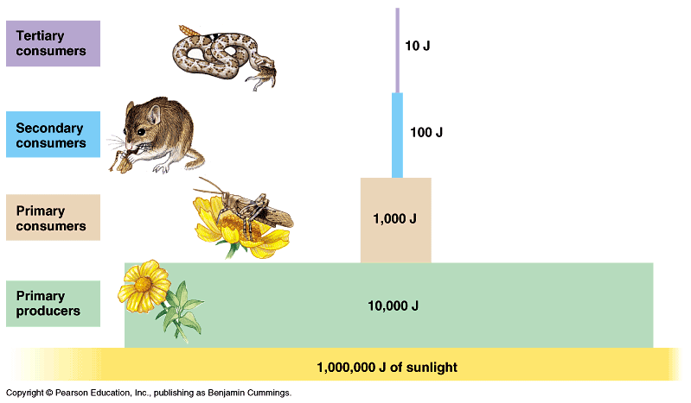
TROPHIC LEVELS / Energy Pyramid
“No transfer of energy is 100% efficient” – 2nd Law of Thermodynamics
Did you know?
It takes approximately
10. kg of hay and
grain for a cow to
produce 1 kg of beef?

Slide 9
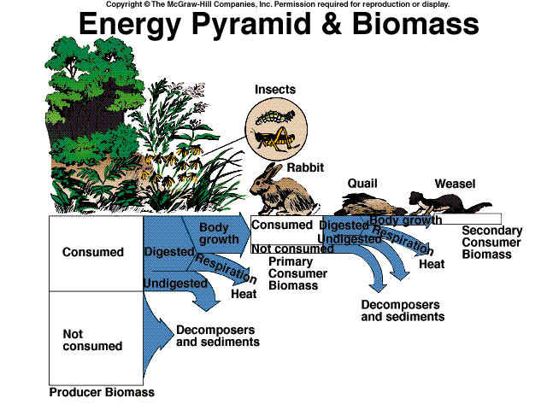

Slide 10
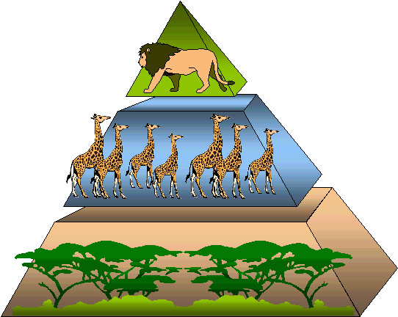
Biomass
The total mass of living organisms in an ecosystem, population, or trophic level.

Slide 11
Back to Our Ecosystem Model
Now we can complete our ecosystem modeling activity from last week!
Ecosystem Lab & Syllabus homework due Tuesday!

