Slide 1
Do Now 3/20 (Continue on week 28)
OBJECTIVES:
Define plasmid and restriction enzyme. Identify where a restriction enzyme will cut a DNA sequence.
Explain how REs and plasmids are used to make transgenic organisms.
TASK: Syllabus update: switch today & tomorrow; add restriction enzyme worksheet to tonight’s homework
OLD NEWS – do you remember:
What type of reaction builds polymers?
What does the smooth endoplasmic reticulum produce?
In which direction does the sodium/potassium pump move sodium?

Slide 2
Today’s Biotech Topic: Restriction Enzymes
WHAT THEY ARE:
Enzymes that cut DNA at specific sequences.
WHY THEY’RE USEFUL:
To insert or remove DNA sequences from a plasmid or chromosome.
WHERE THEY COME FROM:
In nature, bacteria produce restriction enzymes as a defense against viral DNA.

Slide 3
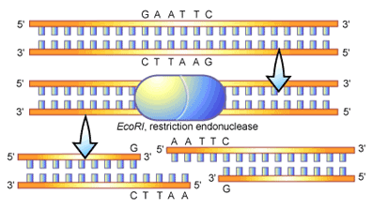
Restriction Enzymes Cut DNA at Specific Sequences.

Slide 4
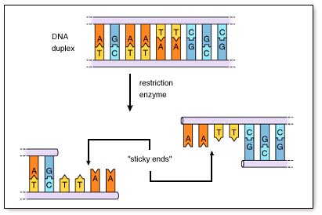
Many Restriction Fragments Have Sticky (Cohesive) Ends

Slide 5
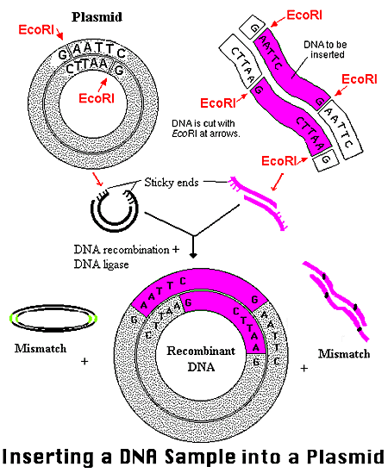
Restriction Fragments Join Together Because of Sticky Ends

Slide 6
Plasmid Cloning
Plasmid… old news (tiny bacterial chromosome with non-essential genes)
Think: Why do plasmids used for genetic engineering usually have one or more antibiotic resistance genes?
VECTOR: a genetic element (often a plasmid or bacteriophage) that is used to store or deliver cloned DNA.

Slide 7
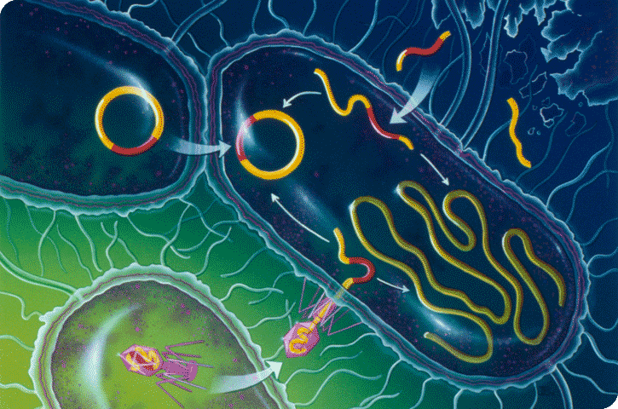
Transformation by environmental DNA
Conjugation transfers plasmid DNA
Transduction of phage DNA into chromosome or plasmid

Slide 8
Recombinant Plasmids: The most common vector for getting DNA into a Prokaryote.

Slide 9
RECAP
RESTRICTION ENZYMES:
Cut DNA at specific sites.
Many produce “sticky ends” which allows different fragments to be stuck together.
Fundamental tool used to add DNA (genes) to a target
RECOMBINANT PLASMIDS:
Common biotech tool for inserting DNA sequences into bacteria.
Often contain 3 parts
Origin of replication
Antibiotic Resistance Gene
Polylinker site to add DNA

