Slide 1
Today’s Biotech Topic: Restriction Enzymes
WHAT THEY ARE:
WHY THEY’RE USEFUL:
WHERE THEY COME FROM:

Slide 2
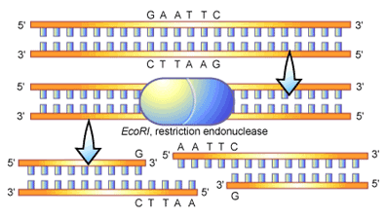
Restriction Enzymes ______________ _______________________________.

Slide 3
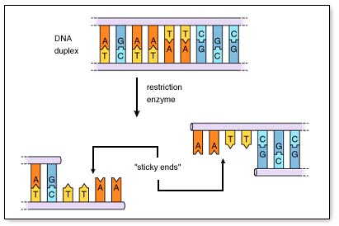
Many Restriction Fragments Have ____ ___________________________________

Slide 4
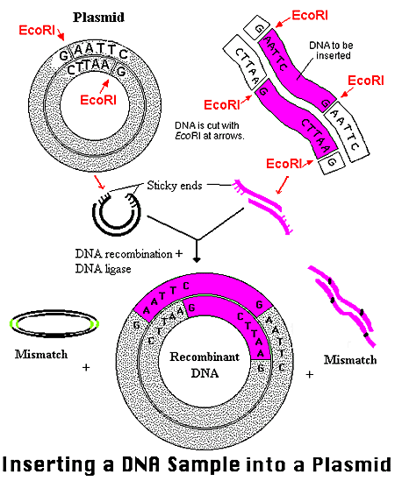
Restriction Fragments Join Together Because of ________ ________

Slide 5
Plasmid Cloning
Plasmid… (___________________________________________)
Video…
Think: Why do plasmids used for genetic engineering usually have one or more antibiotic resistance genes?
VECTOR: a genetic element (often a plasmid or bacteriophage) that is used to _____________________________________________

Slide 6
Getting DNA into Prokaryotes
Conjugation:
Transformation:
Transduction:

Slide 7
Recombinant Plasmids: The most common vector for getting DNA into a Prokaryote.

Slide 8
RECAP
RESTRICTION ENZYMES:
____________________________________________.
Many produce ___________________which allows different fragments to be stuck together.
Fundamental tool used to ________________to a target
RECOMBINANT PLASMIDS:
Common biotech tool for inserting DNA sequences into bacteria.
Often contain 3 parts
___________________________________________
___________________________________________
___________________________________________

