Slide 1
Translation: RNA→ Protein
Do Now 3.10 (week 28):
Objectives:
1. Describe the processes of post-transcriptional modification and translation.
2. Determine the sequence of amino acids in a polypeptide given a DNA sequence.
Task:
1. Pass forward week 26/27 Do Nows.
2. On the “Transcription & Translation” handout, determine the “pre-mRNA” sequence by using the sequence given.

Slide 2
Monday Cosmos Update
“I am often amazed at how much more capability and enthusiasm for science there is among elementary school youngsters than among college students.” Carl Sagan
What was happening on Cosmos:
Our address in the Cosmos
Giordano Bruno, heliocentrism, and imagination.
Cosmic Calendar & the Big Bang
Carl Sagan shout out
Random thoughts:
Voyager 1

Slide 3
Voyager I: The Human Reach to Beyond
Space probe launched in 1975.
Since it’s primary mission to investigate outer planets was completed in 1980, it has travelled on, outwards into the Universe
Currently, far beyond the Oort Cloud, it is the only human-made object in interstellar space.
Distance traveled:
1.955×10¹⁰ km (50,000 x circumference of Earth)
131 AU
18 light hours (0.002 light years)
It is still in contact with Earth, and is expected to go silent in 2025.

Slide 4
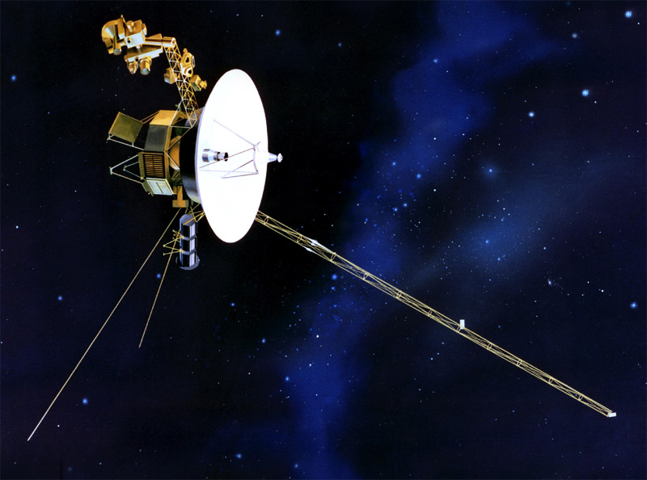
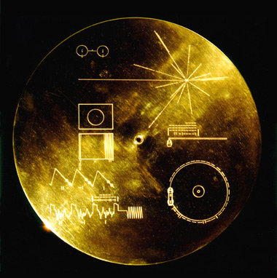
What Would You Put on A Message to Interstellar Space?
What information?
What pictures?
What sounds?
What else?

Slide 5
Old News
TRANSCRIPTION: process that makes an RNA copy of DNA.
RNA is single-stranded, and T is replaced by U (A-U; G-C)
RNA polymerase makes RNA, using bases complimentary to a DNA sequence.

Slide 6
Transcription

Slide 7
Post-Transcriptional Modification
In Eukaryotes, mRNA must be further processed before being used.
Before processing, the product of transcription is called a pre-mRNA molecule. After processing it is called a mature mRNA.
Steps in post-transcriptional modification
A methyl group is added to the 5’ end of the mRNA, called a 5’ cap.
A long series of adenine bases is added to the 3’ end. This is called a poly-A tail.
Parts of the pre-mRNA molecule called introns are removed. The remaining parts, called exons, are joined together.

Slide 8
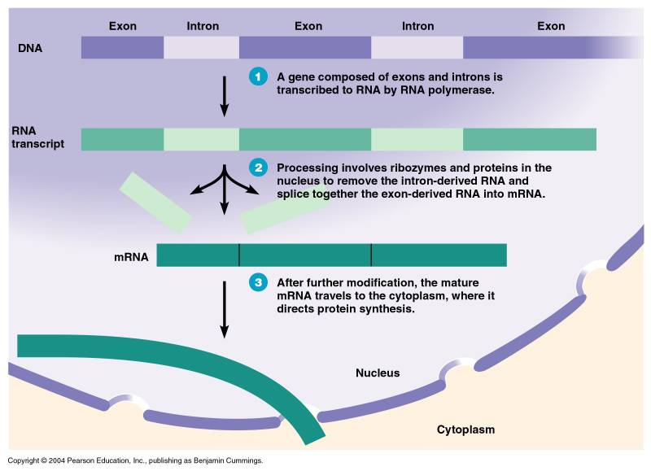
Introns & Exons

Slide 9
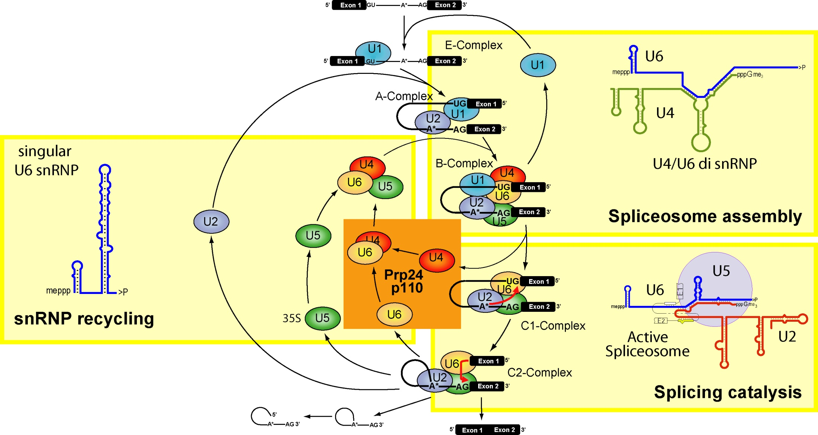
How? It’s Complicated…

Slide 10
Which is which?
Introns are “intervening sequences” which must be cut out.
Exons are “expressed sequences” which remain and are spliced together.
Remember – prokaryotes DON’T do this.

Slide 11
Translation: RNA → Protein
The mRNA copy of a gene leaves the nucleus, and heads to the ribosomes to be used.
Ribosomes build proteins by following the mRNA instructions

Slide 12
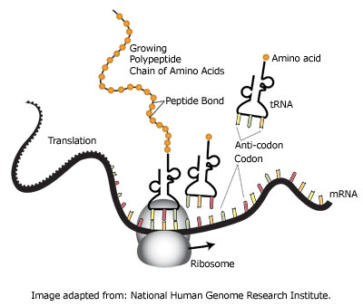
Translation

Slide 13
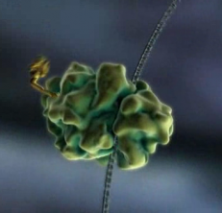
1: Ribosome attaches to mRNA
Once the mRNA message leaves the nucleus, a ribosome will attach to it.
mRNA
Ribosome

Slide 14
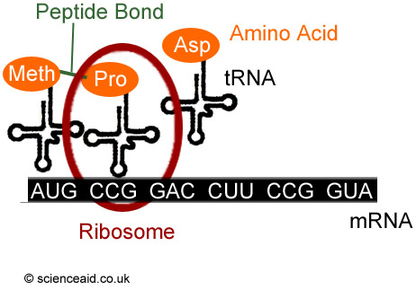
2: tRNA Brings Amino Acids to the Ribosomes

Slide 15
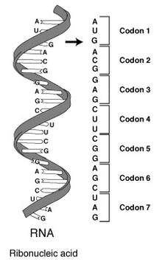
Codons
A codon is a 3-nucleotide sequence of mRNA that codes for a single amino acid.

Slide 16
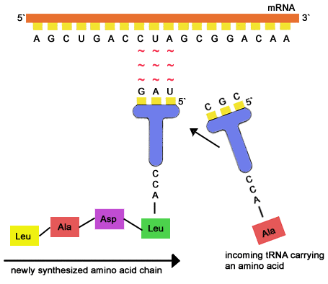
tRNA molecules have an anti-codon that is complimentary to the mRNA codon.
This is how amino acids get put together in the right order

Slide 17
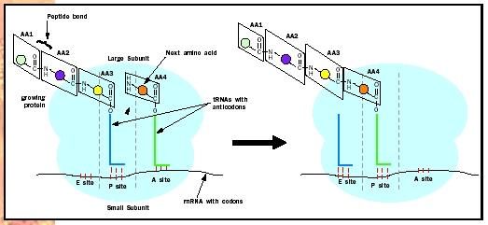
3: Amino Acids are Transferred to the Growing Polypeptide
The ribosome attaches the new A.A. to a growing polypeptide chain.

Slide 18
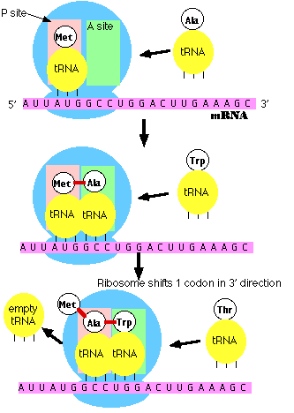
4: The ribosome moves to the next codon.

Slide 19
5. Translation stops at a stop codon
Stop codons code for a tRNA molecule that doesn’t carry any amino acids.
The new protein is released.

Slide 20
6. Protein modification
After the stop codon is reached, the ribosome lets go of the mRNA. Both will be used again.
Most proteins are modified by other enzymes before they are ready to be used by the cell.

Slide 21
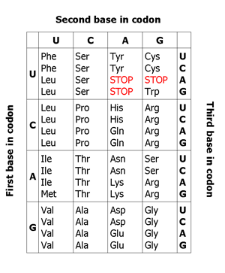
The (almost) Universal Genetic Code
With few exceptions, almost every cell uses the same genetic code.
This is one of the big pieces of evidence for a universal common ancestor to all living things.

Slide 22
Recap
Translation makes proteins, using the instructions in an mRNA molecule.
A codon is 3 nucleotides that code for a single amino acid.
Ribosomes build the proteins from amino acids carried by tRNA molecules.
tRNA molecules “decode” the message into protein form by matching their anti-codons with the mRNA codons.
The universal genetic code can be used to figure out the sequence of amino acids in a protein from an mRNA sequence.

Slide 23
How to figure out an amino acid sequence of a protein from a DNA Sequence.
STEP 1: Transcription.
If the template DNA strand (3’-5’) is given, the mRNA transcript will be complimentary to it.
If the coding strand (5’-3’) is given, the mRNA transcript will be the same (except U replaces T)
STEP 2: Post-Transcriptional modification.
Remove any indicated introns from the sequence.
STEP 3: Use the Universal genetic code to translate the mRNA into amino acids. The first codon used is the first AUG (met) from the 5’ end. Stop at the first stop codon.

