Slide 1
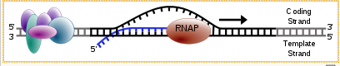
Old News
TRANSCRIPTION: process that makes an _______ ___________ of DNA.
RNA is ________________, and ___ is replaced by ___ (A-U; G-C)
RNA___________________ makes RNA, using bases complimentary to a DNA sequence.

Slide 2
Translation: RNA → Protein
The mRNA copy of a gene leaves the nucleus, and heads to the ribosomes to be used.
Ribosomes ______________________by following the ___________ instructions

Slide 3
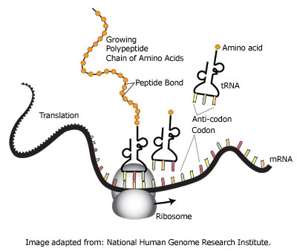
Translation

Slide 4
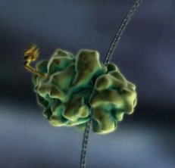
1: ____________ attaches to mRNA
Once the mRNA message leaves the nucleus, a ribosome will attach to it.
mRNA
Ribosome

Slide 5
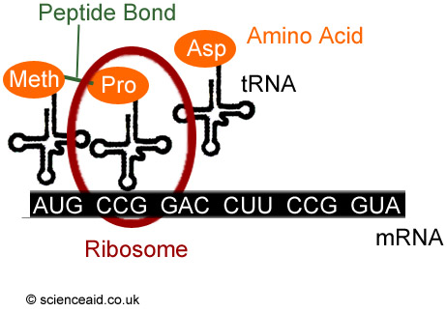
2: ___________ Brings Amino Acids to the Ribosomes

Slide 6
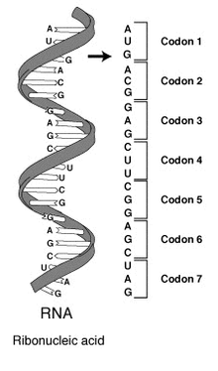
Codons
A codon is a __________________ sequence of mRNA that codes for a single __________________.

Slide 7
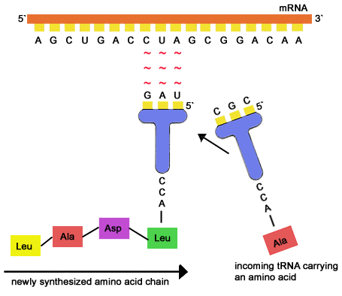
tRNA molecules have an anti-codon that is complimentary to the mRNA codon.
This is how amino acids get put together in the right order

Slide 8
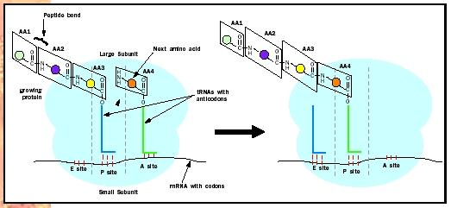
3: Amino Acids are Transferred to the Growing Polypeptide
The ribosome attaches the new A.A. to a growing _________________ chain.

Slide 9
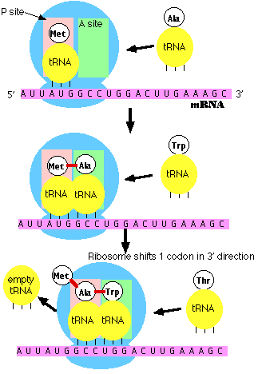
4: The ribosome moves to the next codon.
5. Translation stops at a stop codon
_____________code for a tRNA molecule that doesn’t carry any amino acids.
The new protein is released.

Slide 10
6. Protein modification
After the stop codon is reached, the ribosome lets go of the mRNA. Both will be used again.
Most proteins are modified by other enzymes before they are ready to be used by the cell.

Slide 11
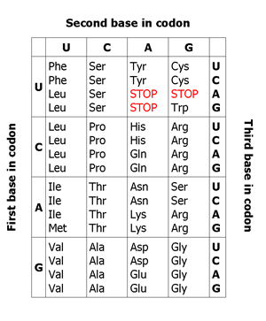
The (almost) Universal Genetic Code
With few exceptions, almost every cell uses the same genetic code.
This is one of the big pieces of evidence for a _______________________________ to all living things.

Slide 12
Recap
Translation makes ____________, using the instructions in an ___________ molecule.
A __________ is 3 nucleotides that code for a single amino acid.
_______________ build the proteins from amino acids carried by _____________ molecules.
tRNA molecules “decode” the message into protein form by matching their __________________ with the mRNA codons.
The _____________________________________ can be used to figure out the sequence of amino acids in a protein from an mRNA sequence.

