Slide 1
Do Now 1.29 FLYDAY 1
Objective: Be able to describe some basic characteristics of Drosophila, including their chromosome number and types
Task:
Take out mitosis labs for collection.
Fruit flies are 2n = 8. How many chromosomes are in fruit fly egg cells?

Slide 2
New Seats/Teams for Quarter 3
Sit with whomever you like! This will be your team for quarter 3.
Rules:
Seat you select today is permanent and NOT OPTIONAL.
Seat must be at a desk.
Desks may not be rearranged (limit of 3-4 per group)
You have precisely 3 minutes to figure this out. If you’re standing when time’s up, I choose for you.

Slide 3
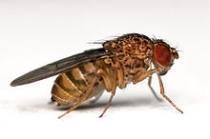
Fly Day I: Introducing Fruit Flies

Slide 4
Drosophila melanogaster: Classification
Domain: Eukaryota (eukaryotes)
Kingdom: Animalia (animals)
Phylum: Arthropoda (arthropods)
Class: Insecta (insects)
Order: Diptera (flies)
Family: Drosophilidae
Genus: Drosophila
Species: melanogaster

Slide 5
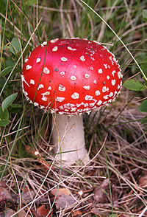
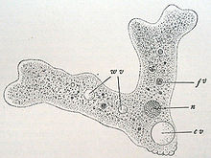
Domain Eukaryota: Cells have nuclei
Plants
Animals
Fungi
Kingdom Animalia
Protists

Slide 6
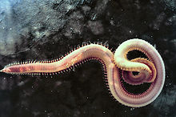
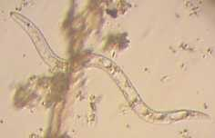
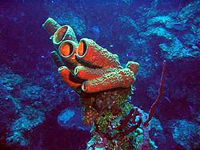
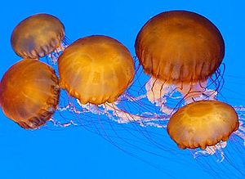
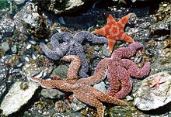
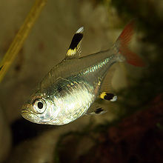
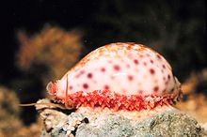
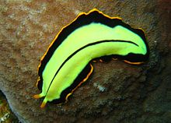
Kingdom Animalia Heterotrophic, multicellular, no cell walls
Phylum Arthropoda

Slide 7
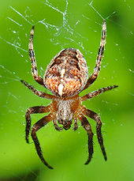
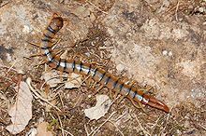
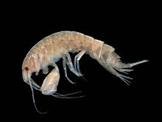
Phylum Arthropoda: exoskeletons and body segments
Class Insecta

Slide 8
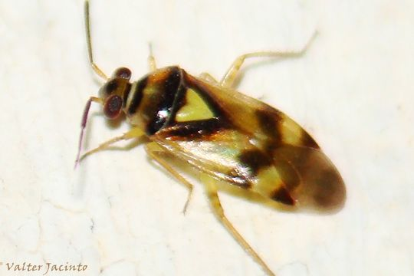
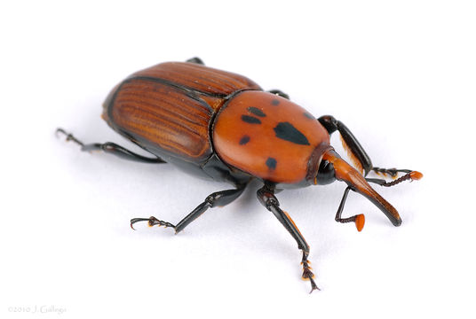
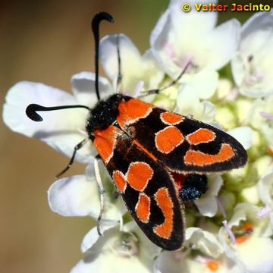
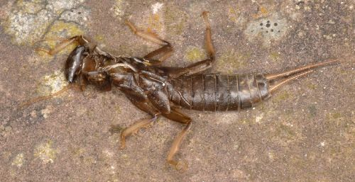
Class Insecta: 6 legs, compound eyes, 2 antenae
Order diptera

Slide 9
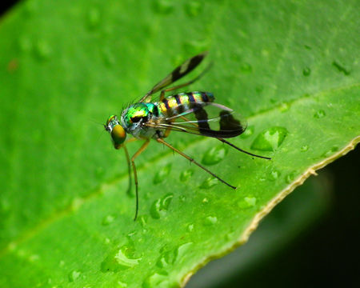
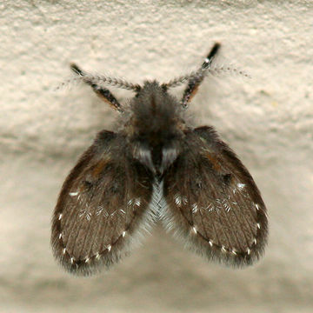
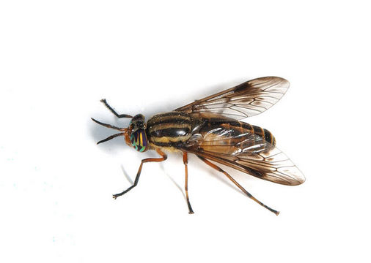
Order Diptera: “flies”
Family Drosophilidae

Slide 10
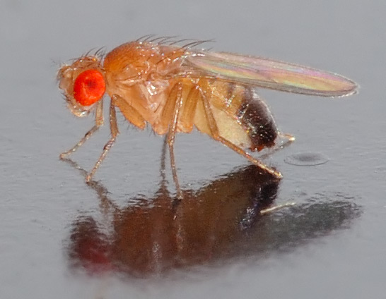
Family Drosopholidae, Genus Drosophila
Includes many species of very similar organisms, including…
Drosophila melanogaster

Slide 11
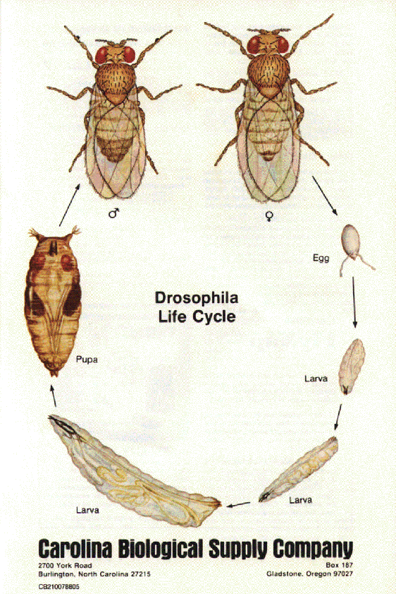
Drosophila Life Cycle
Like most insects, the fruit fly life cycle includes 4 stages:
Egg
Larva (i.e. “maggot”)
Pupa
Adult (aka imago)
The transition from a wormlike larva to an adult insect is called metamorphosis.

Slide 12
Fruit Flies in the Wild
Species of Drosophila can be found on every continent.
Most eat decaying plant matter (like banana peels)
They are primary consumers since they eat plants directly.

Slide 13
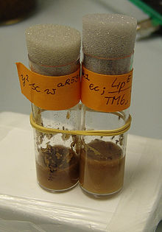
D. Melanogaster is a Model Organism
It has been studied for over a century because:
Small size
Fast life cycle (1-2 weeks per generation)
Prodigious reproducers (100 eggs per day! 2,000 offspring in a lifetime)
Easy to keep healthy cultures.
Simple nutrient requirements

Slide 14
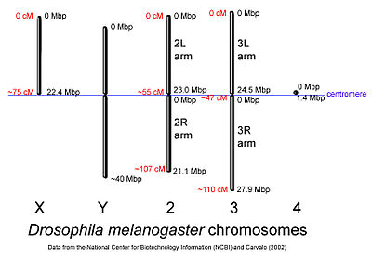
Drosophila Genetics: 2n = 8

Slide 15
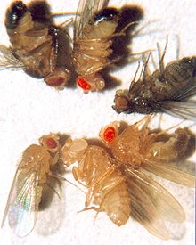
Lots of Mutants to Study
D. melanogaster types (clockwise):
brown eyes with black body,
cinnabar eyes,
sepia eyes with ebony body,
vermilion eyes,
white eyes,
wild-type eyes with yellow body

Slide 16
What Are We Going to Do With Our Flies?
We will be answering some basic questions about heredity, like:
Can we predict what characteristics the offspring of two parent flies will look like before they hatch?
How are parents and children genetically related?
Can an organism have a certain type of a gene that doesn’t affect its characteristics?
How is the inheritance of genes different for genes on autosomes and genes on sex chromosomes?

Slide 17
Some Basic Terminology
Male and Female symbols:
♂ = male ♀= female
Generation names:
P generation = parents
F1 generation = children (from Latin “filius” = son)
F2 generation = grandchildren of P from a F1 x F1 cross

Slide 18
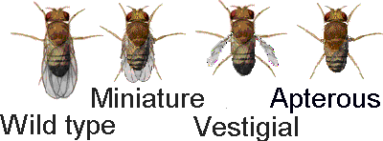
Traits We May Study
Eye color
Normal “wild type” = red eyes
Many mutants, including white eyes
Wings
Normal “wild type” = wings
Wingless (aka apterous)
Vestigial wings (small wings that can’t fly)

Slide 19
Crosses You Will Investigate
Red eye female x White eye male
What color eyes do the offspring have?
Do males and females have any differences in eye color based on sex?
Normal wings (male or female) x Apterous or vestigial wings
What kind of wings do the offspring have?
How many of the offspring will have each characteristic?
Advanced Crosses
Can we produce any double mutants that have white eyes AND mutant wings? How could we do it?

