Slide 1
Do Now 3/3: Non-Mendelian Inheritance (HW Check 9.8)
OBJECTIVES:
Describe non-mendelian inheritance, including polygenic traits, pleiotropy, and sex-influenced traits.
Explain how heritability can provide some measurement of the genetic influence on a trait.
TASK:
3. Make two short lists. In list one take a guess about what traits in humans might be “mostly genetic” and in list two, guess what might be “mostly environmental” in how those traits are determined.

Slide 2
Schedule Reminders
Today: Non-Mendelian Inheritance (P2 flywork)
Tomorrow: Quiz: dihybrd crosses, Mendel’s Laws, non-mendellian genetics (p2: FLY SEMINAR!!!)
Wednesday: Review (p4: FLY SEMINAR!!!)
Thursday: Test: Cell division and classical genetics (P4 research)
Friday: New unit: Molecular Genetics (P2 research)

Slide 3
Mendelian Inheritance = 1 gene, one trait, one dominant allele
This includes the autosomal dominance and sex-linkage types of inheritance we studied.
Non-mendelian inheritance we have studied already:
Incomplete dominance (intermediate phenotype in heterozygotes)
Codominance (both phenotypes present in heterozygotes)
Multiple alleles (more than 2 common alleles)
There are several more important examples of non-Mendelian Inheritance.

Slide 4
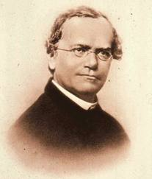
Sorry, Mendel.
Your 19th century laws have been updated and amended. Nice way to get the ball rolling, but we’ve learned a lot in the last 150 years.

Slide 5
1: Polygenic Traits
Definition: a trait which is influenced directly by two or more genes.
Examples: height, eye color, skin color, intelligence, many others.
Characteristics: more genes lead to a greater number of possible genotypes, and thus more phenotypes.

Slide 6
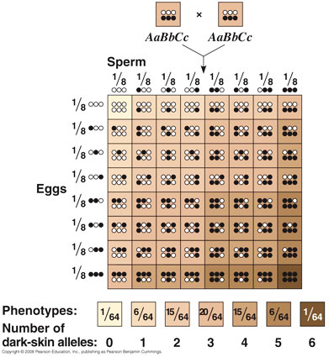
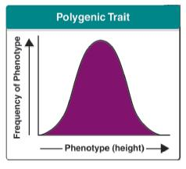
Polygenic Traits Produce A Range of Phenotypes

Slide 7
Polygenic Trait Example: HLA Complex
The HLA (human leukocyte antigen) Complex is a group of genes that produces the major histocompatibility complex (MHC) in humans.
The MHC is used by the immune system to identify self and non-self cells and particles.
A combination of a large number of genes (polygenic) and a large number of alleles for many of these genes (multiple alleles) results in an estimated 30,000,000 possible genotypes.
This huge diversity allows for human populations to rapidly adapt the immune system to quickly evolving pathogens.

Slide 8
2: Pleiotropy
Definition: A single gene influences multiple traits.
Example: sickle-cell trait (anemia, physical development, heart, lung, kidney, eye problems)
Example: albinism (hair color, eye color, vision effects)

Slide 9
3: Sex-Influenced Traits
Definition: Autosomal genes whose effect varies depending on the sex of the individual.
i.e. same genotype results in different phenotypes for males and females.
Example: facial hair genes, susceptibility to some diseases (e.g. same genotype 8x more likely to produce serious gout in males than females)
In other words, the genotype + sex → phenotype

Slide 10
Nature vs. Nurture: The Effect of the Environment
Heritability is a measurement of what fraction of PHENOTYPE variation in a population is a result of GENOTYPE variation in a population
Example: height is highly heritable: About 80-90% of the differences in human height are due to genetic differences in the population.
Example: Intelligence is moderately heritable: genetics and the environment split this variability about 50/50.

Slide 11
Measuring Heritability
A trait with a heritability of 1 is 100% heritable; a trait with a heritability of 0 is completely determined by factors other than parentage.
Heritability is difficult to measure (twins come in handy), and can even change over time as a population evolves.
High heritability does not necessarily mean a big genetic influence, but traits with a large genetic component will always have high heritability.

Slide 12
Recap of Non-Mendelian Inheritance
Old News: Incomplete dominance, codominance, multiple alleles
Polygenic traits: multiple genes
Pleiotropy: one gene, multiple traits
Sex-influenced traits: same genotype produces different phenotypes depending on sex.
Heritability: Estimates the genetic contribution to phenotype variance

Slide 13
Controversy Anyone? How heritable are psychological traits?
Homosexuality (female) twin study (Bailey et al., JAMA, 1993):
Homosexual females w/ identical twins: 48% of twin sisters homosexual.
Homosexual females w/ biological sisters: 14-16% of sisters homosexual.
Homosexual females w/ adopted sisters: 6% of sisters homosexual
Background rate (various sources): 2-10%

Slide 14
Schizophrenia
Large study (>2 million data points) by Lichtenstein et al. in Lancet:
First-degree relatives (parent, sibling, offspring) at significantly increased risk of developing schizophrenia or bipolar disorder as compared to half-siblings or genetically unrelated individuals.
Comorbidity with bipolar disorder suggests a genetic influence of over 60%

Slide 15
Other Genetically-Influenced Psychological traits
Aggression (males): 28-47% heritable
Alcoholism (varies by symptom) 3-53% heritable
ADHD: 76% heritable (note: about as highly heritable as height!)
“Big Five” Personality traits: 41-63% genetic influence (Includes: Neuroticism, Extraversion, Openness, Agreeableness, and Conscientiousness)

Slide 16
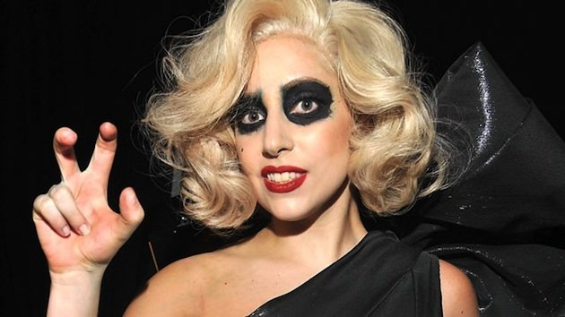
… Lady Gaga on Heritability…
“Don't be a drag, just be a queen Whether you're broke or evergreen You're black, white, beige, chola descent You're Lebanese, you're orient Whether life's disabilities Left you outcast, bullied, or teased Rejoice and love yourself today 'cause baby you were born this way“

