Slide 1
Do Now 2.3
Objectives:
Define genetics, trait, phenotype, gene, allele, pure-breeding, self-fertilization, cross-fertilization, dominant, recessive, P, F1, and F2 generations.
Identify & describe the importance of Gregor Mendel’s experiments on pea plants
Task:
1. 4-minute quick study for quiz!

Slide 2
Genetics
Genetics is the field of biology that studies how characteristics are passed from one generation of organisms to the next
What molecule transmits that information from one generation to the next? ______________

Slide 3
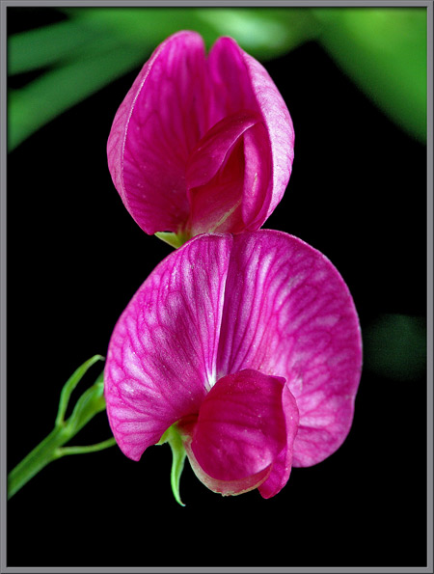
Mendel’s Experiments
Mendel noticed that pea plants have a number of different traits, or characteristics such as flower color.
Some pea plants have purple flowers, and others have white.

Slide 4
Trait vs. Phenotype
A trait is a characteristic. For example, flower color.
A phenotype is the value an organism has for a trait, for example purple flowers.
Trait | Phenotypes
Flower color | Purple, white
Seed color | Yellow, green

Slide 5
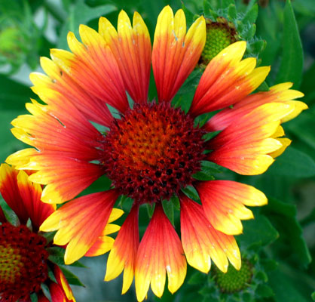
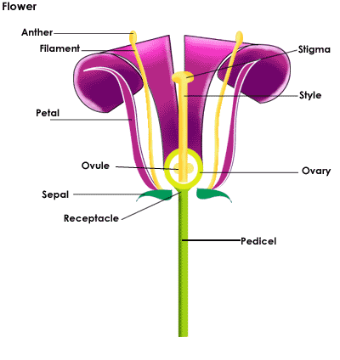
Angiosperms
Pea plants are a type of angiosperm
Angiosperms are flowering plants.
Angiosperms reproduce sexually, but most of them can self-fertilize
Seeds are the result of fertilization in plants.

Slide 6
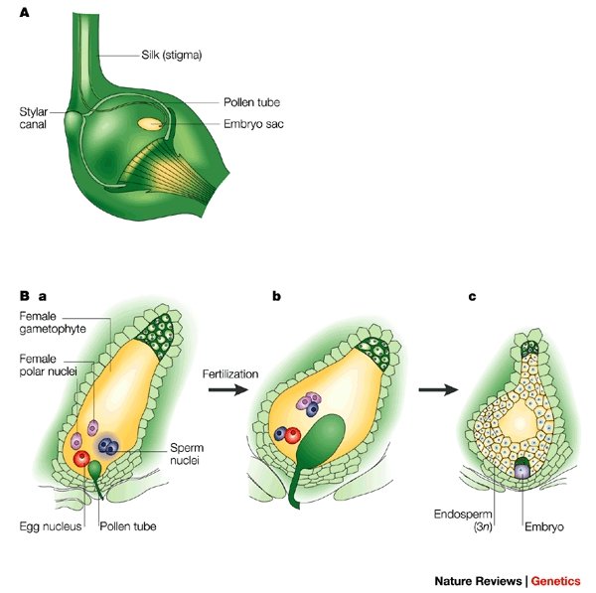
Angiosperm “Double Fertilization”

Slide 7
Back to Mendel
First, Mendel developed pure-breeding strains of pea plants.
A pure breeding strain of plant is one which always produces offspring with the same phenotypes
He then cross-fertilized two pure plants to observe the results.
In a genetic experiment, the parents are called the P generation.

Slide 8
Make A Prediction
If the two pea plants shown were crossed (mated), what % of the offspring do you predict will be purple? Why?

Slide 9
Anyone Predict 100% PURPLE???
The first plant was PURE BREEDING for purple flowers – meaning when it was SELF-FERTILIZED all of the offspring had purple flowers.
The second plant was pure breeding for white flowers.
Which flower color would you describe as DOMINANT in pea plants? ________________

Slide 10
Dominant vs. Recessive Phenotypes
A dominant factor (“gene” or “allele”) is one that masks or hides the presence of a recessive one.
The F₁ generation is the first generation of offspring in a genetic cross

Slide 11
A Discussion About Candy:
What’s Your Favorite?

Slide 12
There are many varieties…
…But…
They are all Candy

Slide 13
The connection
Gene
A segment of DNA that influences a particular trait (like the category: Candy)
ex – The Hair Color Gene produces Hair Color
Allele
A certain variety of a gene that influences a trait. (like a variety of candy: Snickers)
ex – Alleles for Hair Color = Brown, Blonde, Red…

Slide 14
Recessive Factors Skip Generations
When Mendel bred the F₁ generation (either self or cross), he made an amazing observation!
About 25% of the plants in the F₂ generation were white-flowered!

Slide 15
Recap
Greggor Mendel is important because:
A trait is different from a phenotype – explain.
What is a dominant genetic factor? What is a recessive one?
What types of characteristics can skip generations?

