Slide 1
Genetics
Genetics is the field of biology that studies how _______________________________________________________________________________________________________________
What molecule transmits that information from one generation to the next? ______________

Slide 2
Mendel’s Experiments
Mendel noticed that pea plants have a number of different traits, or _________, such as ________________.
Some pea plants have purple flowers, and others have white.

Slide 3
Trait vs. Phenotype
A trait is a characteristic. For example, flower color.
A phenotype is the ________________________, for example _________________________.
Trait | Phenotypes
Flower color | Purple, white
Seed color | Yellow, green

Slide 4
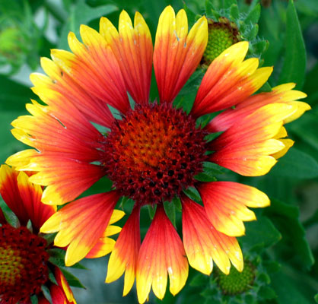
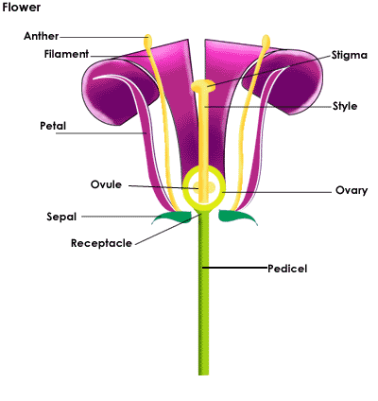
Angiosperms
Pea plants are a type of ______________.
Angiosperms are _____________ plants.
Angiosperms reproduce ___________, but most of them can self-fertilize
Seeds are the result of ____________ in plants.

Slide 5
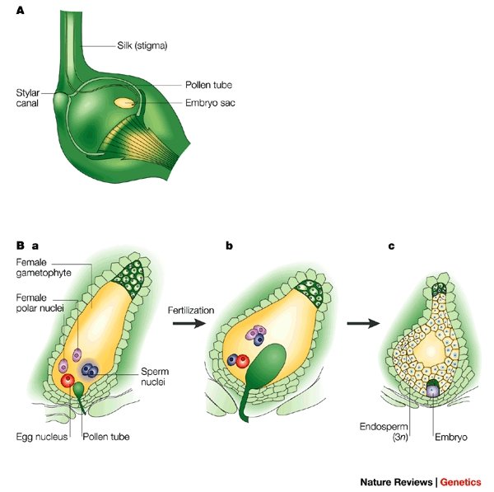
Angiosperm “Double Fertilization”

Slide 6
Back to Mendel
First, Mendel developed pure-breeding strains of pea plants.
A pure breeding strain of plant is one which always produces offspring with the _____________________________________
He then cross-fertilized two pure plants to observe the results.
In a genetic experiment, the ___________ are called the P generation.

Slide 7
Make A Prediction
If the two pea plants shown were crossed (mated), what % of the offspring do you predict will be purple? Why?

Slide 8
Anyone Predict ______________?
The first plant was PURE BREEDING for purple flowers – meaning when it was SELF-FERTILIZED all of the offspring had purple flowers.
The second plant was pure breeding for white flowers.
Which flower color would you describe as DOMINANT in pea plants? ________________

Slide 9
Dominant vs. Recessive Phenotypes
A dominant factor (“gene”) is one that __________________________________________________________________________________________
The F₁ generation is the ___________________________in a genetic cross

Slide 10
The connection
Gene
A segment of DNA that influences a particular ___________ (like the category: Candy)
ex – The Hair Color Gene produces Hair Color
Allele
A ____________________________________that influences a trait (like a variety of candy: Snickers)
ex – Alleles for Hair Color = Brown, Blonde, Red…

Slide 11
Recessive Factors Skip Generations
When Mendel bred the F₁ generation (either self or cross), he made an amazing observation!
About____of the plants in the F₂ generation were ____________!

Slide 12
Recap
Greggor Mendel is important because:
A trait is different from a phenotype – explain.
What is a dominant genetic factor? What is a recessive one?
What types of characteristics can skip generations?

