Slide 1
Do Now 1.31
Objectives:
1. Classify cells by the stage of mitosis they are in by observing their nuclei.
Determine which stage of mitosis (I, P, M, A, or T) cells spend the most time in by analyzing data
Task:
After reading the directions, write a hypothesis and prediction on the lab handout.
NOTE: Do not begin writing the introduction until you complete the hypothesis & prediction. You can finish the introduction later, if necessary.

Slide 2
Hypothesis & Prediction
Hypothesis: Cells spend the most time in ??? phase, because in ??? phase they ???
Prediction: If cells spend the most time in ??? phase, then we will observe ?????????

Slide 3
Refresh Your Knowledge
Interphase: time between divisions
Chromosomes NOT visible
Nucleolus may be visible in nucleus as a dark spot
Prophase: Chromosomes becoming visible
Metaphase: Chromosomes line up at center
Anaphase: Chromosomes split apart
Telophase: 2 new nuclei begin to form

Slide 4
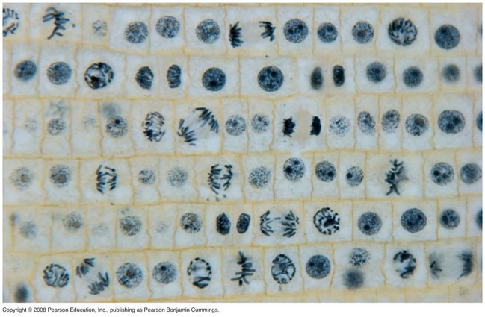
2
3
4
5
6
7
8
9
1
10
16
18
19
17
20
11
12
14
13
15
24
27
28
29
31
21
22
23
25
26
30
41
33
34
37
38
39
40
42
32
35
36
45
46
48
49
43
44
47
T
50
A
I
P
M
On a numbered list (1-50), record I,P,M,A, or T for each cell in the picture above according to which stage of mitosis it is in.

Slide 5
Next Steps
Get a total # and % for each stage.
Bar Graph (categories; remember P.A.S.T.A)
Conclusion (4 things to do)
DUE TOMORROW!

