Slide 1
The Electron Transport Chain & Chemiosmosis
Do Now 12/12
OBJECTIVE:
Describe the location, function, and process of the electron transport chain.
Define chemiosmosis and describe the structure and function of ATP synthase.
TASK:
Remember: respiration quiz Wednesday!
Some prokaryotes, including the green sulfur bacteria at the bottom of our slime tank, run the krebs cycle IN REVERSE! What does that process do?

Slide 2
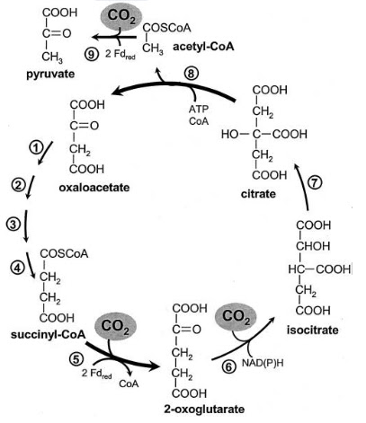
Reductive Krebs Cycle
It builds carbohydrates by reducing CO₂!
Total detail – if this confuses you, fuggetabowdit: only a few wacky prokaryotes do it.
Odd fact: this reverse version probably evolved before the oxidative one!

Slide 3
Aerobic Respiration
Glycolysis: C₆H₁₂O₆ → 2C₃H₄O₃ + 2 ATP + 2 NADH
Krebs (w/PDC): 2C₃H₄O₃ → 6CO₂ + 2 ATP + 8 NADH + 2 FADH₂.
Electron Transport chain: electrons from NADH and FADH₂ are used to create a H⁺ gradient across the inner membrane of the mitochondria
Chemiosmosis: The flow of hydrogen across the inner membrane of the mitochondria powers the ATP synthase enzyme, which produces 32 additional ATP molecules from ADP + P_{i}.

Slide 4
Aerobic Overview
2 steps so far:
  Glycolysis splits sugar into 2 pyruvates
    Makes a little ATP (2) and NADH (2)
  Krebs cycle (w/PDC) oxidizes Pyruvate compound to 3 CO₂
    Makes a little ATP (2) and LOTS of reduced coenzymes (6NADH & 2 FADH₂ per glucose)
2 steps to go
  Electron Transport Chain creates H+ gradient in mitochondria
  Chemiosmosis produces ATP using the energy of the gradient.

Slide 5
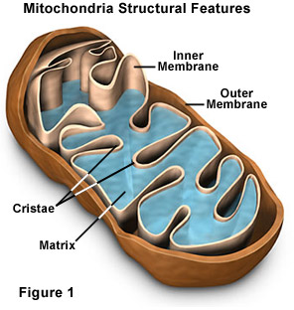
In The Mitochondria
The intermembrane space is where H⁺ ions are pumped by the ETC.
The matrix (where the Citric Acid Cycle occurs) has a lower H⁺ concentration

Slide 6
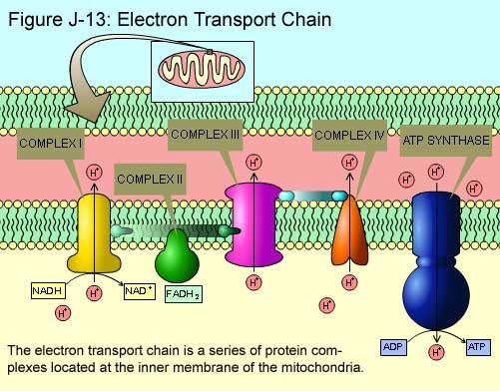

Slide 7
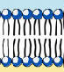
The Electron Transport Chain Makes a Hydrogen Gradient
H⁺
H⁺
H⁺
H⁺
e-
H⁺
MATRIX
H⁺
INTERMEMBRANE
SPACE
H⁺
H⁺
H⁺
H⁺
Electrical energy allows ACTIVE transport from low concentration to hi.
H⁺
H⁺

Slide 8
ETC
Play Clip

Slide 9
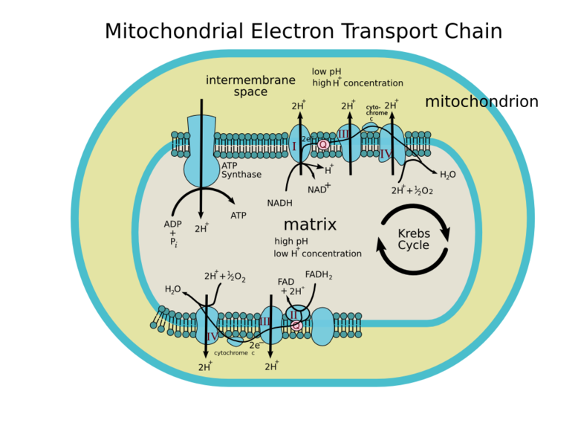

Slide 10
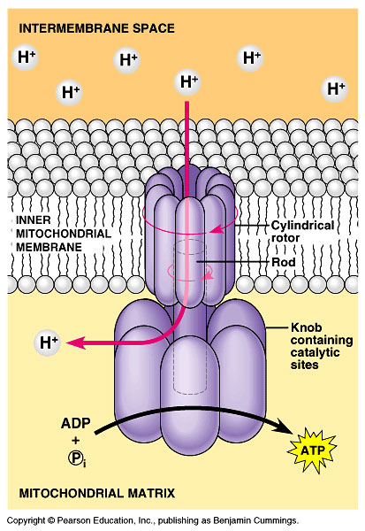
CHEMIOSMOSIS: Converting a H+ gradient into ATP energy
Things Fall Down Stairs.
Atoms Diffuse From High Concentration to Low.
This molecular machine converts the released energy into ATP.

Slide 11
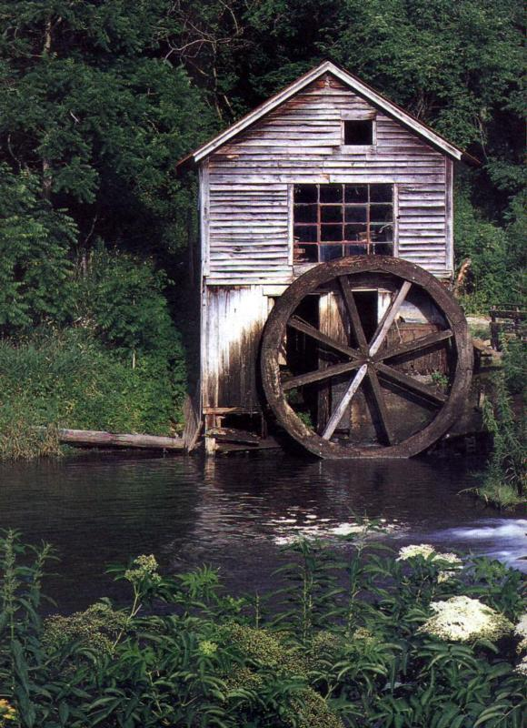
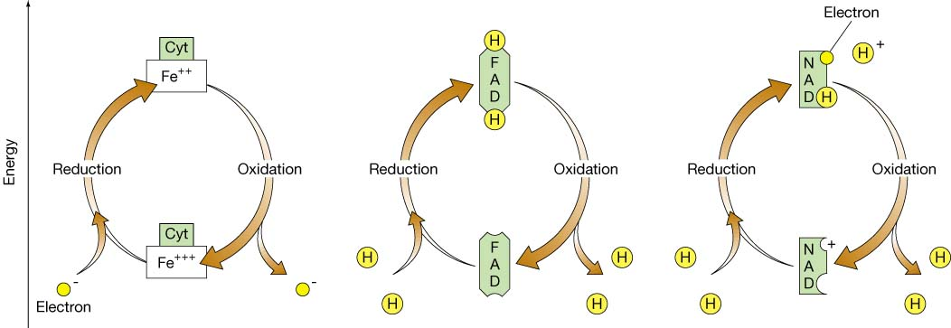
Electrons or water, the idea is the same

Slide 12
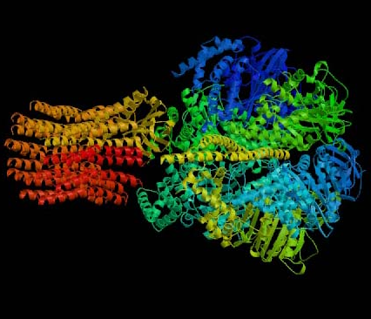
The Best Protein Animation Ever
ATP synthase clip

Slide 13
Recap: ETC
The electrons ripped from food molecules (like glucose) are carried to the electron transport chain by NADH and FADH₂.
The ETC is a series of proteins embedded in the mitochondrial inner membrane.
The flow of electrons through the ETC powers the pumping of H+ ions from the mitochondrial matrix into the intermembrane space. At the end of the ETC, the electrons are transferred to oxygen, forming water (with H⁺).

Slide 14
Recap: Chemiosmosis & ATP Synthase
The flow of protons (H⁺) down their concentration gradient through the enzyme ATP synthase (aka chemiosmosis) powers the synthesis of ATP from ADP + P_{i} (located in the matrix).
The ETC + chemiosmosis produces 32 ATP from the energy that was in NADH and FADH₂.

Slide 15
The Overall Aerobic Respiration Equation
C₆H₁₂O₆ + 6O₂ → 6CO₂ + 6H₂O
The process also produces 36 ATP from 36 ADP and 36 P_{i}.

