Slide 1
Do Now 12/17
OBJECTIVES:
Describe the net equation for glycolysis.
Describe the process of glycolysis in terms of the investment phase and payoff phase.
Identify what organisms conduct glycolysis and where in cells.
TASK:
What is the first step in anaerobic respiration? In aerobic?
Have you eaten any carbohydrates today? If so, what?

Slide 2
Glycolysis Summary: Glucose → 2 Pyruvate + 2 ATP
Glycolysis is the first step in both aerobic and anaerobic respiration.
Here is the complete chemical reaction:
C₆H₁₂O₆ + 2ATP + 2ADP + 2P_{i} + 2NAD⁺
→
2C₃H₄O₃ + 4ATP + 2NADH + 2H⁺

Slide 3
Glycolysis is Common to Almost All Life
Human and banana DNA sequences are about 50% identical… why? How?
Many of the functions of a cell are the same, regardless of cell type. For example:
Copying DNA
Building proteins
Getting energy from glucose
Evolution can only select from what is available, and once a mechanism for doing these very important processes developed, it “sticks.”

Slide 4
Glycolysis Was an Early Metabolic Process
Glycolysis certainly evolved in prokaryotes before oxygenation of the atmosphere
Probably one of the very first complex biochemical pathways (>3.5 BYA)
Evidence?
Almost universal.
No requirement for O₂: it is an anaerobic process, even when used by aerobic organisms.
Must predate photosynthesis: it’s only useful to make glucose if you can get the energy back out!

Slide 5
Glycolysis Occurs in Two Phases
The first portion of glycolysis is called the investment phase because the cell must use 2 ATP molecules to begin the process.
The second part is called the payoff phase, because 4 ATPs are produced, (along with other useful products like NADH)

Slide 6
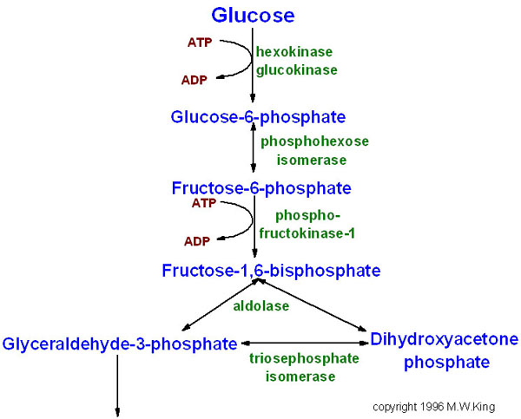
Investment Phase Detail
C
C
C
C
C
C
C
C
C
C
C
C
P
C
C
C
C
C
C
P
P
C
C
C
C
C
C
P
P
C
C
C
“G3P”
C
C
C
P

Slide 7
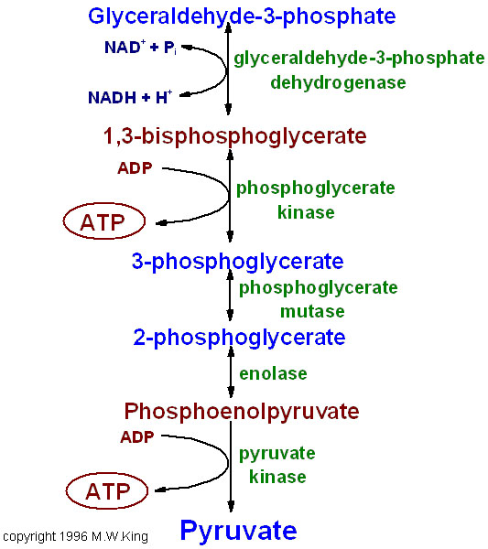
Payoff Phase Detail
Note: This P is NOT from ATP, but rather the cytosol
P
C
C
C
P
C
C
C
P
SUBSTRATE LEVEL
PHOSPHORYLATION:
Phosphate is transferred from a substrate to ADP to make ATP
C
C
C
P
P
C
C
C
C
C
C

Slide 8
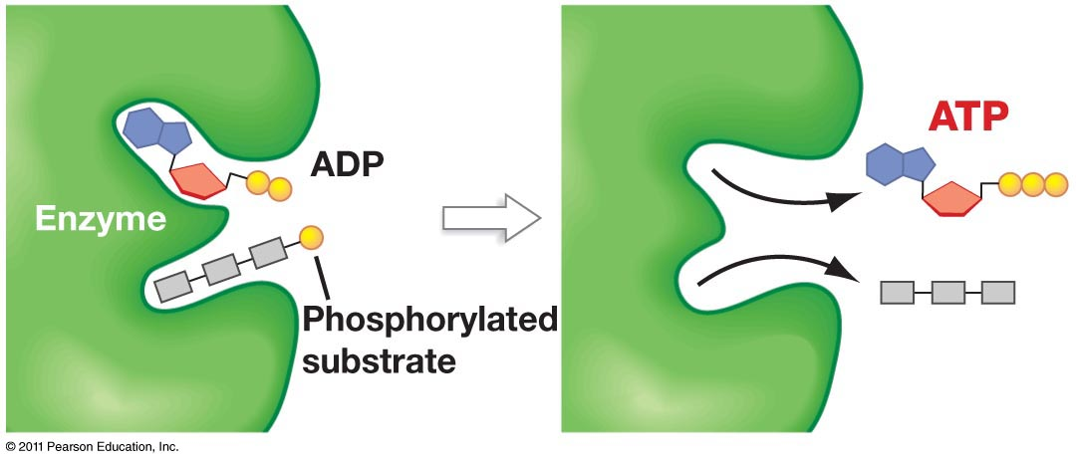
Glycolysis Produces ATP by Substrate-Level Phosphorylation

Slide 9
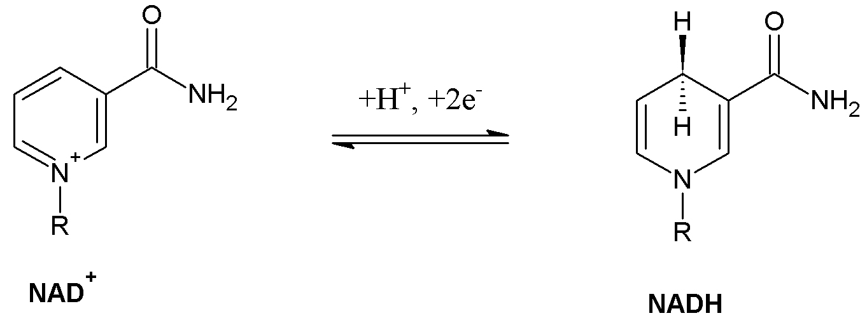
What is this NAD+ / NADH Stuff?
NAD+ and NADH are two versions of the same coenzyme. (Nicotinamide adenine dinucleotide)
It is an electron (energy) carrying molecule.
What to know?
NADH is the reduced, energy-rich version
NAD+ is the oxidized, low-energy version

Slide 10
Recap: Glycolysis
Glycolysis produces 2 net ATPs per glucose (4 gross)
No oxygen required
Glucose is split into two molecules of pyruvate (2 x 3 carbons)
ATP is produced by substrate-level phosphorylation.

Slide 11
Cell Respiration: What Happens After Glycolysis? What is the Fate of Pyruvate?
Anaerobic Respiration:
Glycolysis is the only ATP-producing step of anaerobic cell respiration.
During fermentation (the next step), NAD+ is regenerated to allow glycolysis to continue
Many different types of fermentation process pyruvate into different products (e.g. ethanol, lactate, etc.)
Aerobic Respiration:
The pyruvate is further processed by the Citric Acid Cycle and electron transport chain, producing lots more ATP and oxidizing carbon completely to CO₂.

