Slide 1
Do Now 12/2
OBJECTIVES:
Quiz
Define colonial organism.
Examine evidence and reasoning about the organization of multicellular life and how it evolved on Earth.
TASK:
1. Super-quick study for short (10 SRQ) quiz: cytoskeleton, movement, stem cells (~3 minutes)

Slide 2
Hierarchical Organization of Biology, in 9 Levels
All Life: Molecules→cells (& viruses?)→
Multicellular Life: tissues→organs→organ systems→organisms→
Living Communities: populations→ecosystems→biosphere

Slide 3
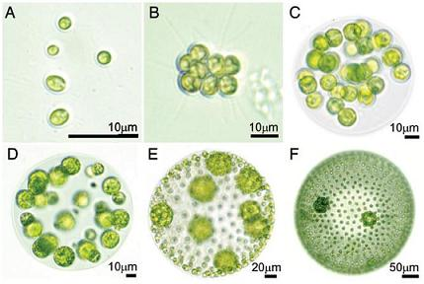
So How’d It (We) Get Here? A Model
Colonial Organism:
clonal colonies composed of many physically connected, interdependent individuals
Each mature Volvox colony is composed of up to thousands of cells from two differentiated cell types: numerous flagellate somatic cells and a smaller number of germ (reproductive) cells.

Slide 4
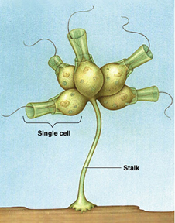
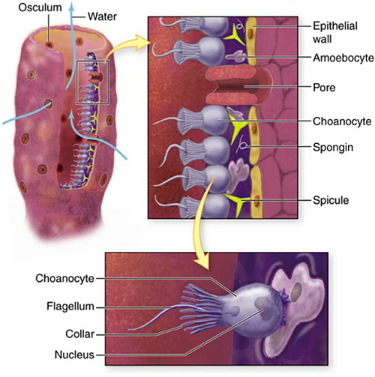
Drill Deeper: The Choanoflagellate Hypothesis

Slide 5
To the interwebs… https://www.youtube.com/watch?v=1v6cgSkiHik
Nicole King (UC Berkeley, HHMI) 1: The origin of animal multicellularity

