Slide 1
Do Now 12/8: Mitochondrial Eve
OBJECTIVES:
Analyze text and video resources to determine the special characteristics and evolutionary implications of mt DNA.
TASK:
1. If we assume a generation time of ~20 years, how many generations separate a modern human from:
A. Homo erectus, 1,900,000 years ago (YA)
The most distant Homo sapien, 160,000 YA
Pan troglodytes, 6.3 x 10⁶ YA
Musa acuminata, 1.4 x 10⁹ YA

Slide 2
Read, Annotate: Mitochondrial Eve
? = huh?
Unknown term, idea, or a specific question you have (write in margin)
! = Important!
Big ideas, or crucial details you want to remember or reference easily.
♥ = Like
Things that are interesting or clever
* = Other / Note
Your own miscellaneous thoughts, ideas, or connections to text

Slide 3
Defining the Problem
What two points of view are in conflict in the text?
How can the claims be evaluated scientifically?

Slide 4
Question: How Did Homo sapiens Colonize Earth?
“Mulitregional continuity model” asserts H. erectus migrated out of Africa more distantly in history (0.6 – 2 MYA) and gradually evolved into H. sapiens. (Paleoanthropologists)
“Out of Africa model” asserts it was Homo sapiens that migrated out of Africa more recently (~0.1 to 0.16 MYA) and displaced existing H. erectus and H. neanderthalis populations. (Molecular geneticists)

Slide 5
Premise #1
Mitochondrial DNA is inherited exclusively from the egg cell during sexual reproduction.

Slide 6
Premise #2
Mitochondrial DNA can be used to trace matrilinear (mother → offspring) inheritance.

Slide 7
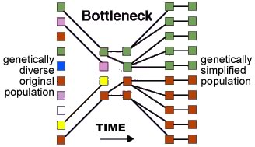
Population Bottleneck? Perhaps…

Slide 8
Logical Consequence
At some point in time, a female must have existed with the mitochondria that were the ancestors to all mitochondria currently found in humans

Slide 9
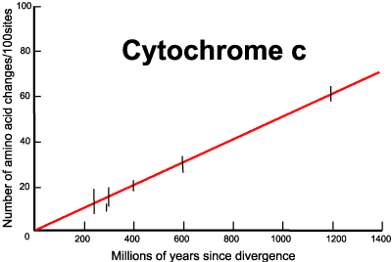
Premise #3: molecular clocks
Over long periods of time, DNA mutates (changes) at a constant rate.
By combining genetic data and the fossil record, a mutation rate can be established.

Slide 10
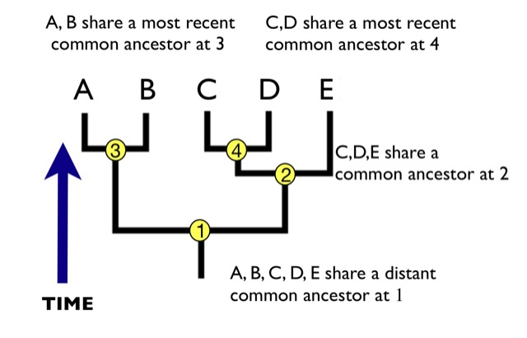
Logical Consequence
Molecular clocks can be used to determine the amount of time that has passed since two organisms had their MOST RECENT COMMON ANCESTOR (MRCA)

Slide 11
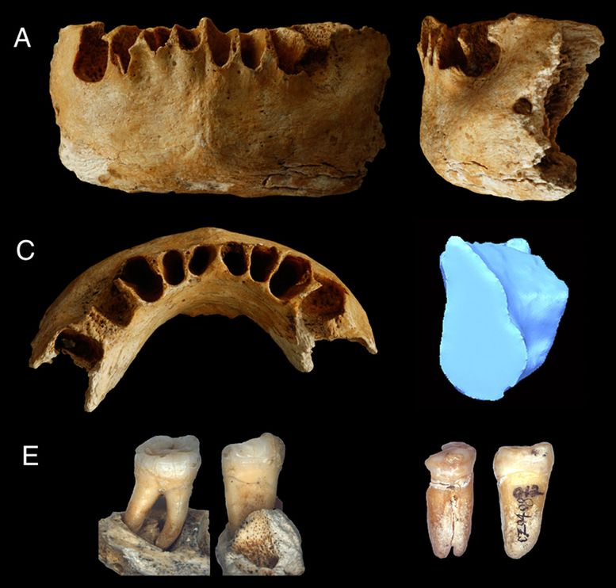
Multiregional Continuity Model Fossil Evidence: China, 2007
Oldest H. sapiens fossil found outside of Africa is ~100,000 years old.
Not definitively H. sapien
What does this mean to the “Out of Africa” model?

Slide 12
What Evidence Can Settle the Issue?
What evidence exists for and against each model?
What additional evidence, if available, could settle the issue?
How could that evidence be found?

Slide 13
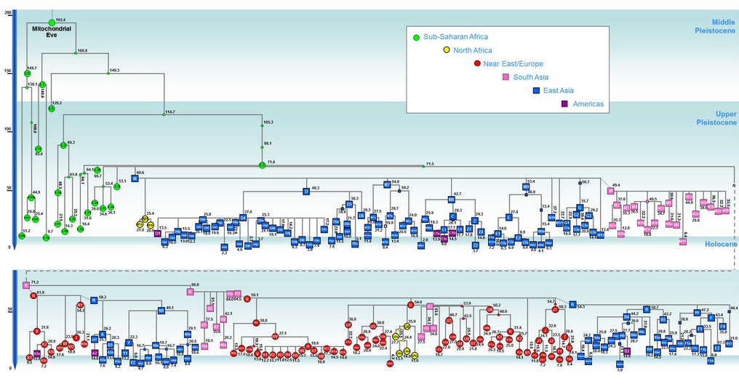
The Family Tree of All Humanity, by MtDNA

Slide 14
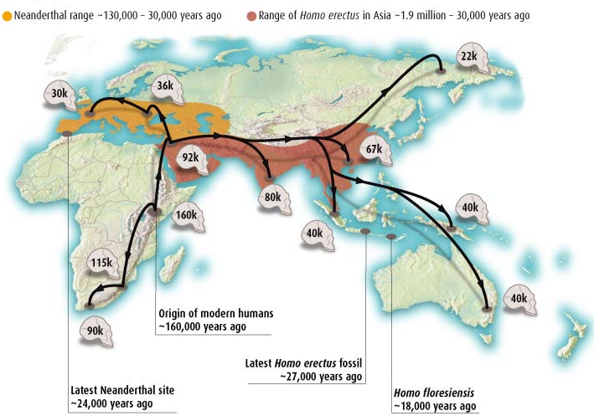
So What’s The “Answer?”
100k

Slide 15
Can We Reach Consensus?
What does this debate among different groups of scientists tell us about the science process?
What range of possible dates could both sides of the argument agree on for the appearance of Homo sapiens outside of Africa?
Can the two sides agree if H. sapiens evolved from Eurasian H. erectus or if they killed them off?

