Slide 1
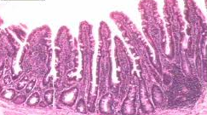
The Digestive System
Do Now: What is this a picture of? List your top 3 guesses.

Slide 2
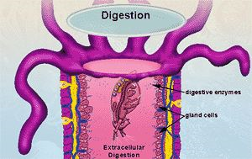
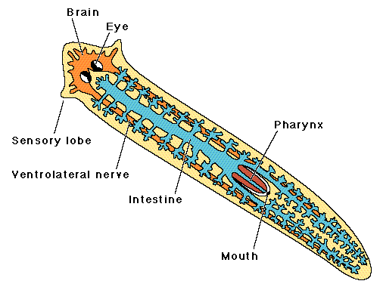
Digestion in Simple Animals
In cnidarians and planarians, digestion is extracellular, and nutrients are absorbed directly by cells. Only a single opening takes in food; there is no anus.

Slide 3
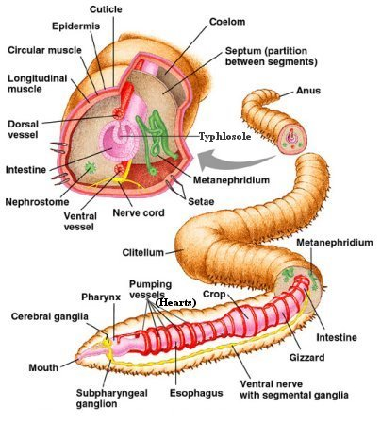
Digestion in Annelids
Mouth → Pharynx →Esophagus → crop → gizzard → intestine → anus
Crop stores food for digestion later
Gizzard grinds food, often with rocks

Slide 4
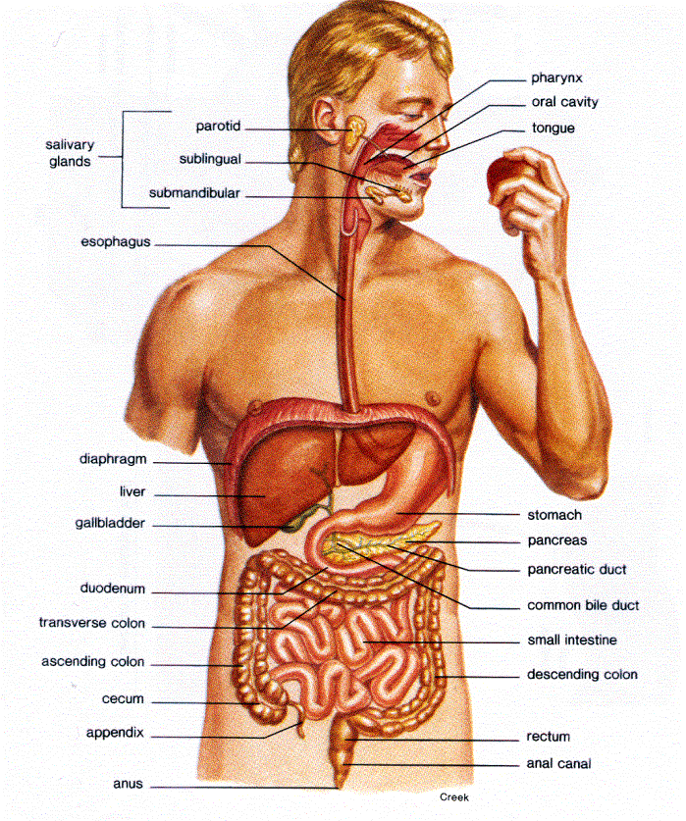
Human Digestive System
The system contains two parts:
The alimentary canal is the tube through which food travels, beginning with the mouth and ending with the anus.
The system also includes glands which produce enzymes and other substances that aid digestion.

Slide 5
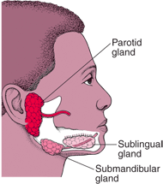
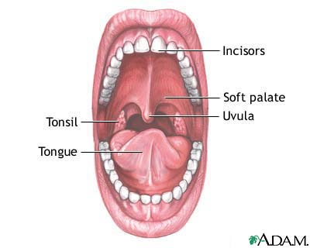
Mouth
The mouth is the site of mechanical digestion, which is the physical break down of food.
The tongue houses the sense of taste, which helps determine if food is edible.
The 6 salivary glands produce saliva, a solution that is mostly water but includes mucus and salivary amylase.
The water and mucus dissolve and lubricate food.
Salivary amylase is an enzyme that breaks down the polysaccharide starch into the disaccharide maltose. This is the first step of chemical digestion, the chemical breakdown of food.
A mouthful of food is called a bolus after being chewed.
Swallowing moves the bolus from the mouth, through the pharynx (throat) to the esophagus.

Slide 6
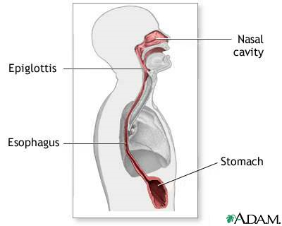
Esophagus
esophagus: tube that carries food from mouth to stomach.
At the top of the throat is the epiglottis, a flap that closes the trachea (windpipe) during swallowing.
Peristalsis is a wave of muscular contractions that push a bolus to the stomach.
The cardiac sphincter is a valve (normally closed but open during peristalsis) that prevents stomach contents from entering the esophagus.

Slide 7
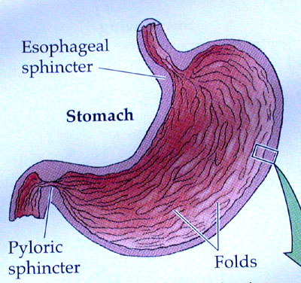
Stomach
Muscular walls contract to churn and mix food, continuing mechanical digestion.
Walls secrete hydrochloric acid, producing a pH < 2. This is a defense mechanism that kills microorganisms.
Pepsin is the main enzyme of the stomach. It breaks down long polypeptides into smaller pieces. It is secreted as pepsinogen, a denatured form of the protein that becomes active only at low pH.
Stomach walls are protected by a thick layer of mucus. If worn away, ulcers can develop.
The pyloric sphincter controls the exit of chyme (partially digested food) from the stomach

Slide 8
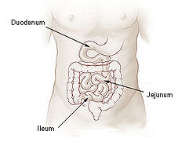
Small Intestine
The small intestine has 3 parts:
Duodenum
Jejunum
Illeum
The duodenum is where most chemical digestion takes place.
The jejunum and illeum are where amino acids, sugars and other substances are absorbed into the bloodstream

Slide 9
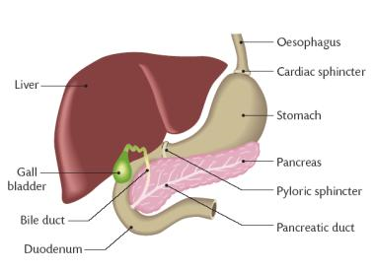
Duodenum and Associated Glands
The liver produces bile, which is stored in the gallbladder.
Bile emulsifies fats in chyme into tiny droplets, increasing surface area.
The pancreas produces a base to neutralize stomach acid. It also produces MANY digestive enzymes

Slide 10
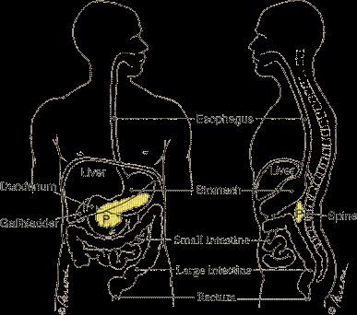
Some Pancreatic Digestive Enzymes
Enzyme | Function
Lipase | Digests fats into glycerol and fatty acids
Trypsin and Chymotrypsin | Digests polypeptides further.
Pancreatic Amylase | Digests polysaccharides to disaccharides
Pancreatic enzymes are produced in inactive forms – so the pancreas doesn’t digest itself!

Slide 11
Enzymes Produced by the Walls of the Small Intestine Complete Digestion
Enzyme | Function
Maltase, Lactase, and Sucrase | Break down disaccharides into monosaccharaides
Aminopeptidases | Complete polypeptide digestion by cleaving individual amino acids
Digestion is complete after the duodenum!

Slide 12
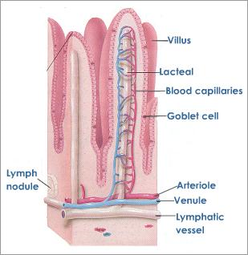
Absorption of Nutrients in the Small Intestine
The jejunum and illeum are responsible for absorbing the amino acids, monosaccharides and lipids produced by digestion.
They contain many millions of villi, small finger-like projections that increase the effective surface area for absorption.
Nutrient-rich blood then travels to the liver for processing and filtering.

Slide 13
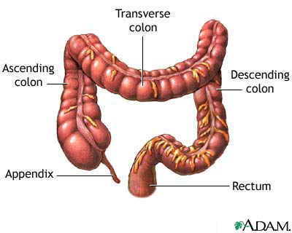
The Large Intestine (Colon)
Undigested food that is not absorbed in the small intestine is waste.
The large intestine has several functions:
Water reclamation
Symbiotic E. coli inhabit it and produce Vitamin K, which is absorbed in the large intestine
The end of the large intestine is the rectum, which stores feces before elimination through the anus.

Slide 14
Minerals: Inorganic Substances the Body Needs
Important minerals | Function / location
iron | Required for hemoglobin
iodine | Required for thyroid hormone
calcium | Bones and other
Sodium, chlorine, potassium | Many body fluids
phosphorus | Nucleic acids, body fluids
Vitamins & minerals are also absorbed by the digestive system

Slide 15
Vitamins: Complex Organic Molecules the Body Needs
Vitamin | Function / Location | Solubility
Vitamin A | Required for retinal, for vision | Fat-soluble
Vitamin B complexes | Required for cellular respiration and DNA replication | Water-soluble
Vitamin C | Required for collagen production (connective tissue); supports immune function | Water-soluble
Vitamin D | Required for calcium absorption, supports bone growth | Fat-soluble
Vitamin E | Maintains healthy red blood cells, supports liver and kidney function | Fat-soluble
Vitamin K | Required for blood clotting | Fat-soluble

