Slide 1
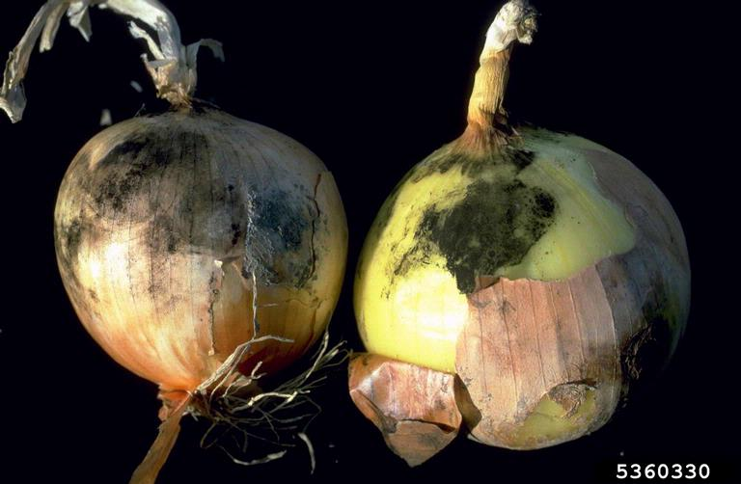
Do Now 10.27
OBJECTIVE:
Design a controlled experiment that will provide data to support or refute the hypothesis that enzymes have an optimal pH or temperature.
TASK:
What does the word optimal mean?
Enzymes which break down pectin are produced in nature by Aspergillus niger, the common black mold. This species exists in temperate environments. What temperature do you hypothesize might be optimal for enzyme activity? (Hint: Human body temperature 37ºC, average temperature on Earth 15ºC, freezing point of water 0ºC)
Aspergillus niger growing on onions

Slide 2
Design an Experiment
Your goal: design a controlled experiment to produce data that can be used to determine if the enzyme pectinase has an optimal temperature or pH.
Material constraints: You will be limited to just two filtration apparatuses.
Tasks to accomplish (all of Part 2):
Materials (select)
Plan: Briefly describe your plan in general.
Circle which condition you will test: High pH, Low pH, High Temperature, Low Temperature
What will be in each sample of applesauce you test?
Experimental Variables
Procedure changes
Data: What data will you need to collect? Construct a data table
Hypothesis: Describe what effect you think the change in conditions will have on how well the enzyme works
Prediction: Create a prediction that will test your hypothesis:

