Slide 1
Do Now 10/8
OBJECTIVE:
1. Identify, name, describe, and construct models of the hydroxyl, carboxyl, carbonyl, and amine functional groups.
TASK:
1. HW check 3.1
2. Which of the following is an alkane (single bonds only)? Which is an alkene (double bond)? An alkyne (triple bond)?
C₂H₆
C₂H₄
C₂H₂

Slide 2
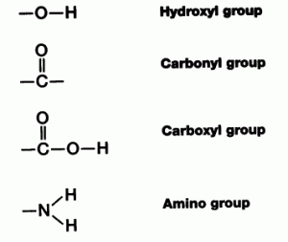
Putting the “Fun” in “Functional Group”
The four functional groups you shall memorize:
Alcohols
Aldehydes and Ketones
Carboxylic Acids
Amines

Slide 3
Classes of Carbon Compounds
Class | Functional Group | Naming convention | Example compound | Example Formula
Alkanes | n/a (all single bonds) | “-ane” | propane | CH₃CH₂CH₃
Alkenes | C=C | “-ene” | propene | CH₂CH₂CH₃
Alkynes | C-C triple bond | “-yne” | propyne | CHCCH₃
Alcohols | hydroxyl | “-ol” | methanol | CH₃OH
Aldehydes & Ketones | carbonyl | “-one” or “aldehyde” | formaldehyde | HCOH
Carboxylic Acids | carboxyl | “acid” | Formic acid | HCOOH
Amines | amine | “-amine” | Methylamine | CH₃NH₂

Slide 4
What to do
Construct models of the compounds listed using the provided molymod models.
Circle the indicated functional groups on the chemical structures.
Classify each compound into one of the categories listed in step 2 on handout.

Slide 5
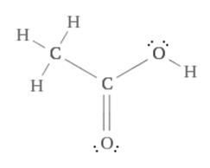
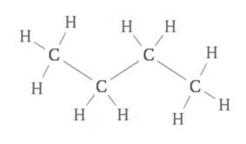
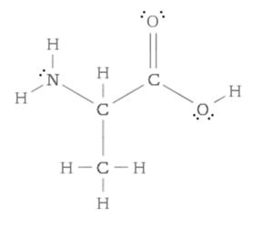
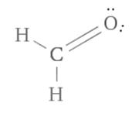
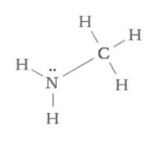
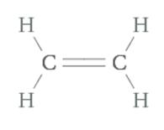
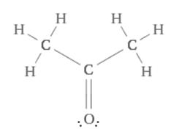
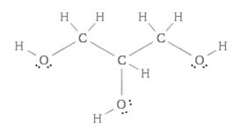
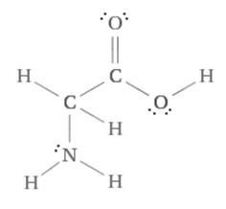
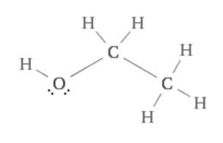
To build
Acetic Acid
Butane
Alanine
Formaldehyde
Ethene
Methylamine
Acetone
Glycerol
Glycine
Ethanol

