Slide 1
Water & pH
Do Now: 10.5
OBJECTIVES:
Define pH and the pH scale.
Describe the properties of acids and bases.
Solve pH concentration problems.
TASK: 1. List the 4 special properties of water we saw recently.
2. Make a prediction: place the following in order from the MOST acidic to the LEAST acidic:
Water, Soda, Coffee, Soapy water

Slide 2
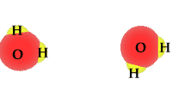
Dissociation of Water – What pH is All About

Slide 3
Arrhenius Acids & Bases
Acid: A substance which produces H⁺ when dissolved in water.
Base: A substance which produces –OH when dissolved in water.

Slide 4
pH measures H+
ACIDS | BASES
Low pH | High pH
Lots of H⁺ / H₃O⁺ | Little H⁺ / H₃O⁺
Little ⁻OH | Lots of ⁻OH
Taste sour (e.g. lemon juice, vinegar) | Feel soapy (e.g. bleach)

Slide 5
Quick Math Refresher What is a logarithim? Log 10 = ? What is an exponential equation?

Slide 6
pH of Solutions
What was the average pH of each of the liquids?
What are we measuring?

Slide 7
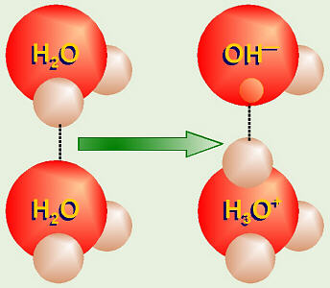
A Word About Hydrogen Ions and Hydronium
H+ is a proton.
In solution, H+ is always stuck to a water molecule (which part?)
Therefore, the following terms are all refer to what there is more of in an acid :
protons
H+
Hydronium

Slide 8
Hydroxide and hydronium
Hydronium = H₃O+. Higher concentration → more acidic solution → lower pH
Hydroxide = -OH. Higher concentration → more basic solution → higher pH

Slide 9
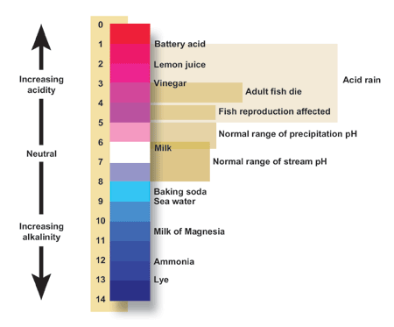
The pH Scale and Some Examples

Slide 10
The pH scale is logarithmic
pH = -log [H+]
[H+] = concentration of H+ in mol / L
Examples:
Neutral water: [H+] = 10⁻⁷ mol/L
-log 10⁻⁷ = 7
Vinegar: [H+] = 10⁻³ mol/L
-log 10⁻³ = 3
Notice: Even though there is10,000 times as much [H+] in the vinegar the pH is different by 4.
A change of 1 unit on the pH scale indicates a 10x change in ion concentration!

Slide 11
K_{w}: The Ionization Constant of water
It’s a constant… it doesn’t change, no matter what the pH is.
K_{w} = [H+][⁻OH] = 10⁻¹⁴
In other words, as [H+] goes up, [-OH] goes down.
This is an example of an inversely proportional relationship.

Slide 12
Example Problems
Type 1: What is the concentration of H+ in one sample compared to another.
A sample of water is pH 7. A sample of HCl has a pH of 1. How many times as much H+ ions are in the HCl?
7-1 = 6. Therefore, there is 10⁶ times as much H+ in the acid.
Type 2: What is the concentration of H+ or –OH, if the other is known, using K_{w}.
A sample has a –OH concentration of 10⁻⁸. What is the pH of the sample?
Since K_{w} = 10⁻¹⁴ = [H+][10⁻⁸]
[H+] = 10⁻⁶
pH = -log [10⁻⁶] = 6

Slide 13
Do Now 10/2: pH Lab
OBJECTIVES: 1. Determine the effect of biological material on pH regulation by collecting and analyzing experimental data.
TASK: 1. HW for checking.
2. For each of the examples below, indicate which of the two solutions is the MOST acidic:
pH 3 pH 8
pH 5 pH 6
[H+] = 10⁻⁴ mol/L [H+] = 10⁻⁵ mol/L

Slide 14
Today’s Lab
Question: What is the effect of (recently) living matter on pH change?
Plan: We will add small amounts of acid to a sample of liver homogenate (think liver shake) and compare the pH changes to a control group.

Slide 15
Hypothesis / Prediction
Liver will (increase/decrease/have no effect on) the amount of pH change when acid is added to a sample.
If liver (affects pH change the way we hypothesize), then the pH of the liver will change (more/less/the same as) than the pH of the water

Slide 16
Homework
On syllabus

