Slide 1
Electronic Configuration & Atomic Bonding 9/28
Do Now:
OBJECTIVES:
Identify and describe ionic, covalent, and polar covalent bonds; Define chemical reaction
2. Illustrate the Lewis dot structures of ionic and covalent compounds
TASK:
1. Take out HW (2.17) for checking
2. Determine the number of protons, neutrons, and electrons in:
H⁺
¹⁴C (14 = mass number)
Cl⁻

Slide 2
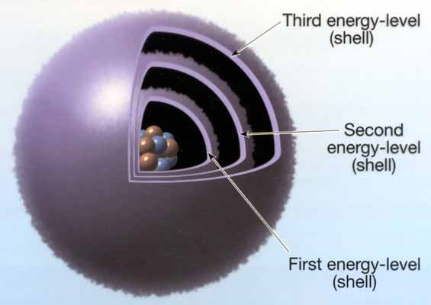
Electrons are seemingly everywhere at once!
We cannot pinpoint electrons to one given spot at one given moment – they move too fast
They are PROBABLY found in various energy levels around the outside of the nucleus:

Slide 3
What’s more likely? Things go from high energy to low!
Water flowing down a cliff to make a waterfall… or water flowing up?
Falling down a flight of stairs or falling up?
Dropping an egg and making a mess or dropping a broken egg and getting one that’s back together?

Slide 4
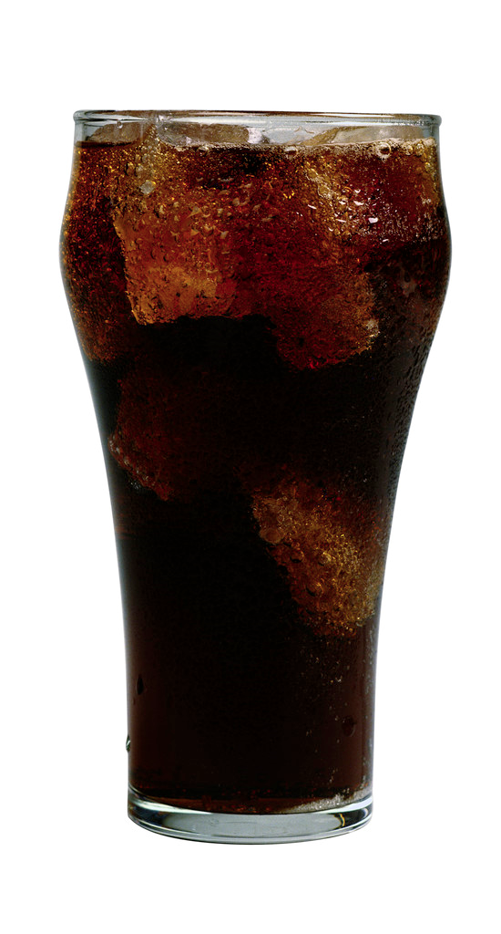
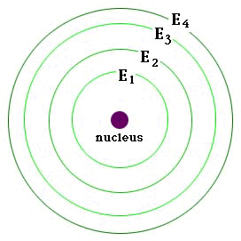
It’s all about Potential Energy
Electrons fill the lowest energy orbitals just like this soda fills the lowest energy part of the glass first.
Arrows indicate increasing potential energy

Slide 5
Energy Levels and Orbitals
Each energy level of an electron cloud contains one or more orbitals
An orbital is the volume of space where a particular electron is most likely to be found.
Each orbital can hold two electrons

Slide 6
How many electrons are in each level?
The first energy level has one orbital. Thus, it can hold up to 2 electrons.
The second and third energy levels have 4 orbitals each, and can thus hold up to 8 electrons.
For the first three energy levels, each level is completely filled before the next begins to be filled.

Slide 7
The bottom line
Energy Level | Max # Electrons
1 | 2
2 | 8
3 | 8

Slide 8
Valence Electrons
Valence electrons are the electrons in the highest energy level of the electron cloud that contains any electrons.
Valence electrons are important because they are the electrons that can form bonds with other atoms.
How many valence electrons does oxygen have? (atomic # = 8)

Slide 9
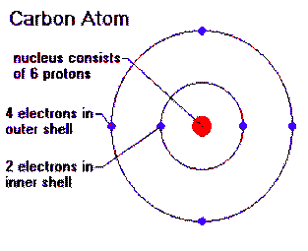
Consider Carbon

Slide 10
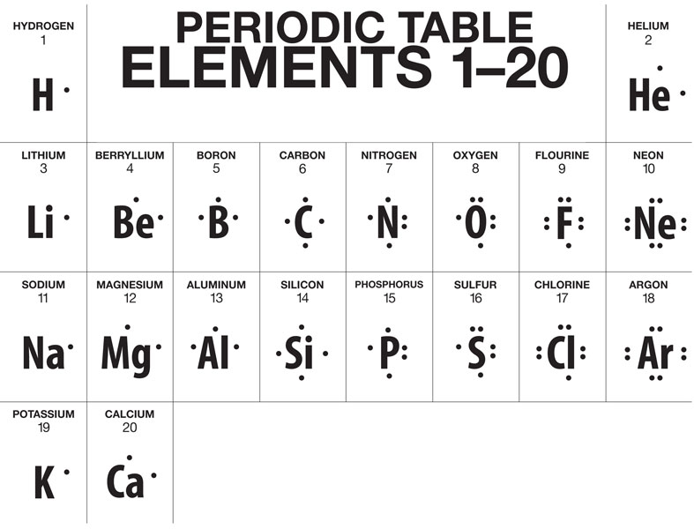
Lewis Dot Diagrams
A Lewis Dot diagram uses dots to represent valence electrons of an atom or molecule.
Only place two dots on one side of the symbol if the other 3 sides already have one.
Examples:

Slide 11
Valance WS
Complete (from yesterday)

Slide 12
Atomic Bonds [aka chemical bonds] and Chemical Reactions
What is a bond?
So what is an atomic bond?
An attractive force between 2 atoms.
A chemical reaction occurs when atoms change how they are bonded.
C₁₂H₂₂O₁₁(s) + 12O₂(g) → 12CO₂(g) + 11H₂O(l)

Slide 13
Please Copy the following chart into your notes:
Type of bond | What electrons do | Example molecule

Slide 14
What causes atomic bonds?
When atoms change how they are bonded to one another, that is called a chemical reaction.
Example: CH₄ + 2O₂ → CO₂ + 2H₂O
Why do chemical reactions happen?

Slide 15
But Why? ELECTRONS DETERMINE HOW ATOMS BOND
Atoms that have a full outer energy level are very stable. This is the driving force of bonding reactions.
Atoms bond together in a way that fills their outermost electron energy level.
This is the lowest energy configuration possible.

Slide 16
What types of bonds atoms form
Almost always lose electrons
Polar (greedy for electrons)
Don’t bond
-
+
Metals (electrons “float” around nuclei)
Mostly non-polar
Almost always gain electrons

Slide 17
Do Now 9/24
OBJECTIVE
1. (#2 from yesterday)Identify and describe ionic, covalent, and polar covalent bonds.
TASK
HW listed for last night due tomorrow. Ignore HW for tonight for now (will be due Monday)`
Syllabus upcoming (sorry)
An element has the electronic configuration 2-8-5
If it is a neutral atom, what element is it?
If it has a +1 charge, what element is it?
If it has a -1 charge, what element is it?

Slide 18
Ionic Bonds
An atom loses 1 or more valence electrons, giving it a positive charge.
Another atom gains the electron(s) and becomes negatively charged
+ & - ions attract.
-
+
e-
e-
Cl
Na
e-
e-
e-
e-
e-
e-

Slide 19
Covalent bonds
2 atoms share a pair of valence electrons
H
H
e-
e-

Slide 20
It’s all about Energy
2-8-1
Not
Stable
Ne
Ne
Ne
2-7 Not
Stable
2-8 VERY
Stable

Slide 21
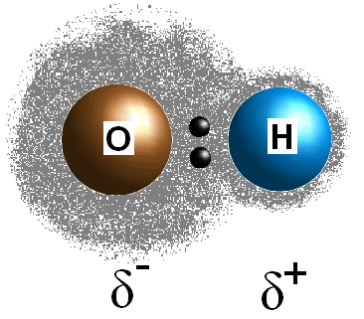
TWIST: Polar Covalent Bonds
In a polar covalent bond, a pair of electrons is shared between two atoms… unevenly
One part of the molecule now has a small – charge, and the other has a small + charge
Polar covalent
Electron Sharing
100%
Non-polar covalent
100%
Ionic

Slide 22
What Now?
Remaining class time:
Video
atomic structure, electronic structure, and valence WSs
Modeling types of atomic bonds
4 molecules: NaCl, H₂O, MgF₂, NH₃
Determine if the bonds will be ionic or covalent
If ionic, transfer the electron (pushpin) COMPLETELY
If covalent, place electrons on the line, shared by both bonding atoms.

