Slide 1
What’s more likely? Things go from ____________________________!
Water flowing down a cliff to make a waterfall… or water flowing up?
Falling down a flight of stairs or falling up?
Dropping an egg and making a mess or dropping a broken egg and getting one that’s back together?

Slide 2
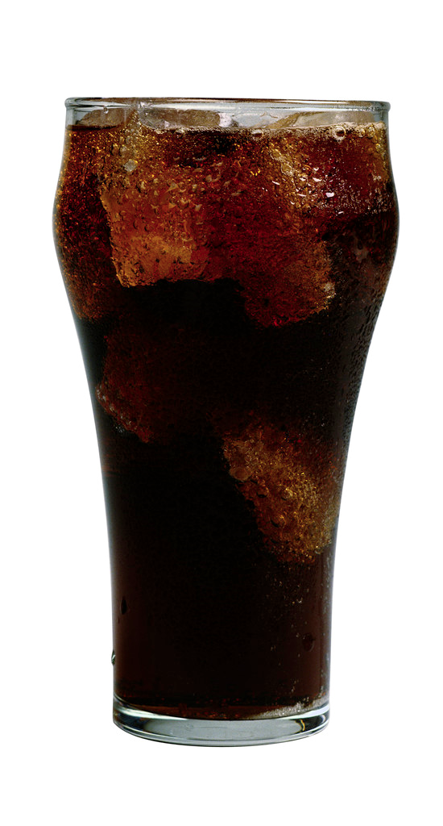
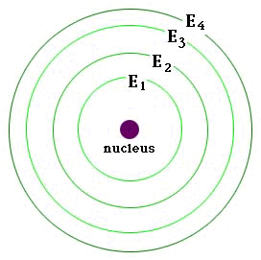
It’s all about Potential ________
Atoms bond to get a lower energy configuration.
Arrows indicate increasing potential energy

Slide 3
The bottom line
Energy Level | Max # Electrons
1
2
3

Slide 4
Valence Electrons
Valence electrons are the electrons in the ___________________________of the electron cloud that contains any electrons.
Valence electrons are important because they are the electrons that can ______________with other atoms.
How many valence electrons does oxygen have? (atomic # = 8)

Slide 5
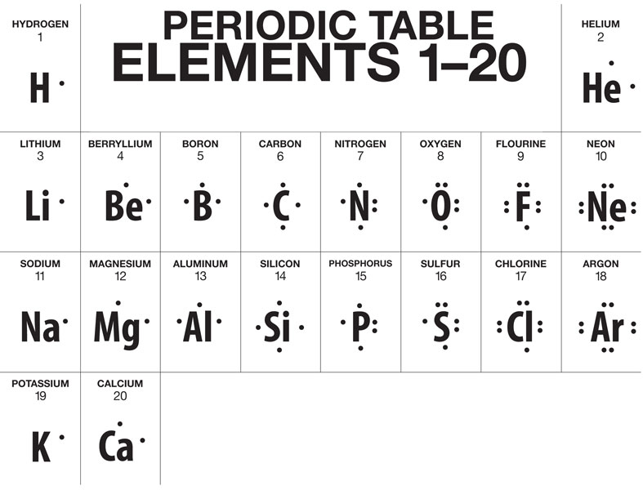
Lewis Dot Diagrams
A Lewis Dot diagram uses dots to represent valence electrons of an atom or molecule.
Only place two dots on one side of the symbol if the other 3 sides already have one.
Examples:

Slide 6
Atomic Bonds [aka chemical bonds] and Chemical Reactions
What is a bond?
So what is an atomic bond?
_________________________________.
A chemical reaction occurs when atoms __________________________________

Slide 7
Type of bond | What happens | Example molecule

Slide 8
But Why? ELECTRONS DETERMINE HOW ATOMS BOND
Atoms that have a full outer energy level are very ______________. This is the driving force of bonding reactions.
Atoms bond together in a way that _________ _____________________________________
This is the lowest energy configuration possible.

Slide 9
What types of bonds atoms form
Almost always lose electrons
Polar (greedy for electrons)
Don’t bond
-
+
Metals (electrons “float” around nuclei)
Mostly non-polar
Almost always gain electrons

Slide 10
Ionic Bonds
An atom loses 1 or more _____________, giving it a positive charge.
Another atom gains the electron(s) and becomes _________________ charged
+ & - ions attract.
-
+
e-
e-
Cl
Na
e-
e-
e-
e-
e-
e-

Slide 11
Covalent bonds
2 atoms __________________________ of valence electrons
H
H
e-
e-

Slide 12
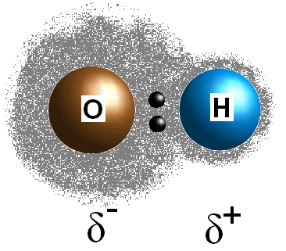
TWIST: Polar Covalent Bonds
In a polar covalent bond, a ________________ is shared between two atoms… ____________.
One part of the molecule now has a small – charge, and the other has a small + charge
Polar covalent
Electron Sharing
100%
Non-polar covalent
100%
Ionic

