Slide 1
Do Now 9.26 (Week 5)
OBJECTIVES:
1. Describe the number of particles in an atom and their arrangement.
2. Define: atomic number, atomic mass, AMU, isotope, ion, energy level.
TASKS:
1: Pass forward week 4 do nows.
2: Classify the following as elements, compounds, atoms, or molecules:
a. A gold (Au) nugget
b. The smallest piece of water (H₂O) possible.
c. A glass window (SiO₂)
d. The smallest piece of sodium (Na) possible
3. Sketch a helium atom: 2 protons, 1 neutron, 2 electrons

Slide 2
Recap of Last Time
Definitions: atom, molecule, element, compound.
Atomic structure: protons (+) and neutrons in nucleus (nucleus has ~99.9% of mass), and a cloud of electrons (-) around it (electron cloud is ~99.99% of volume)

Slide 3
Atomic Mass & Atomic Number
If one atomic mass unit (amu) is relatively the same size as a proton or neutron,
And an atom has a mass of 10 amu,
How many electrons does it have?
Trick Question!
Electrons have almost no (0.001 amu) mass! Maybe Boron?

Slide 4
Atomic Mass & Atomic Number
Mass Number – The number of neutrons and protons in an atomic nucleus
Atomic Number – The number of protons in an atomic nucleus

Slide 5
Practice
Atomic Mass | Atomic Number | Number of Neutrons
10 | 5
 | 10 | 10
27 | 14
35 | 16
5
20
13
19

Slide 6
What about the number of electrons?
Since electrons are involved in bonding – they often leave, are added, or are stolen from atoms.
We GENERALLY assume that the number of electrons is the same as the number of protons

Slide 7
Charges?
Ions – Atoms with charges (either + or -)
What’s the charge of an atom with…
1 electron, 1 proton?
5 electrons, 5 protons?
1 electron, 2 protons?
2 electrons, 1 proton?

Slide 8
Isotope
Any atom that behaves the same chemically, but contains an abnormal number of neutrons
Examples:
Carbon (mass 14)
Oxygen (mass 18)
Phosphorous (mass 32)

Slide 9
Review
The number of protons in an atom’s nucleus is ALWAYS equal to it’s atomic number. If the number of protons changes (i.e. radioactive decay), then the atom becomes a new element.
Although atoms can gain or lose electrons through chemical bonding, in an electrically neutral atom, the number of electrons is equal to the number of protons.
Neutrons are a little trickier… atomic mass – atomic number = # neutrons.

Slide 10
CLASSWORK
Atomic Structure WS.

Slide 11
Electronic Configuration
OBJECTIVES: 3. Determine the number of valence electrons of an atom 4. Describe how electrons are arranged in energy levels for the first 18 elements
We will now consider how electrons are arranged in space around the nucleus of an atom.

Slide 12
Wait…Electron Cloud?

Slide 13
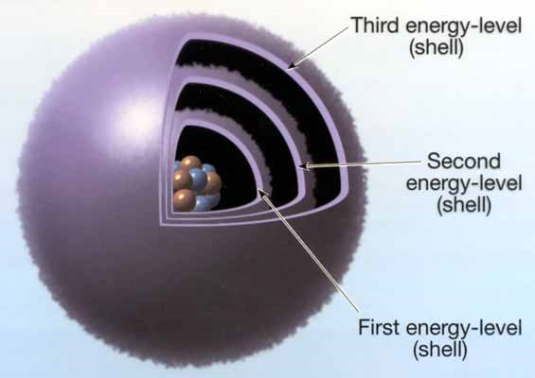
Electrons are seemingly everywhere at once!
We cannot pinpoint electrons to one given spot at one given moment – they move too fast
They are PROBABLY found in various energy levels around the outside of the nucleus:

Slide 14
What’s more likely? Things go from high energy to low!
Water flowing down a cliff to make a waterfall… or water flowing up?
Falling down a flight of stairs or falling up?
Dropping an egg and making a mess or dropping a broken egg and getting one that’s back together?

Slide 15
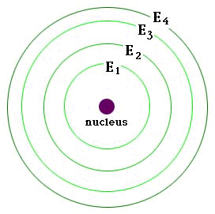
It’s all about Potential Energy
Electrons fill the lowest energy orbitals just like this soda fills the lowest energy part of the glass first.
Arrows indicate increasing potential energy

Slide 16
Energy Levels and Orbitals
Each energy level of an electron cloud contains one or more orbitals
An orbital is the volume of space where a particular electron is most likely to be found.
Each orbital can hold two electrons

Slide 17
How many electrons are in each level?
The first energy level has one orbital. Thus, it can hold up to 2 electrons.
The second and third energy levels have 4 orbitals each, and can thus hold up to 8 electrons.
For the first three energy levels, each level is completely filled before the next begins to be filled.

Slide 18
Valence Electrons
Valence electrons are the electrons in the highest energy level of the electron cloud that contains any electrons.
Valence electrons are important because they are the electrons that can form bonds with other atoms.
How many valence electrons does oxygen have? (atomic # = 8)

Slide 19
The bottom line
Energy Level | Max # Electrons
1 | 2
2 | 8
3 | 8

Slide 20
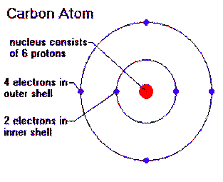
Consider Carbon

