Slide 1
9.9: Termites Introduction
Do Now:
OBJECTIVES:
Describe the classification and basic biology of termites.
TASK:
1. Prepare for quiz:
Metric Prefixes & Conversions
Measurement & SI
Experimental Design

Slide 2
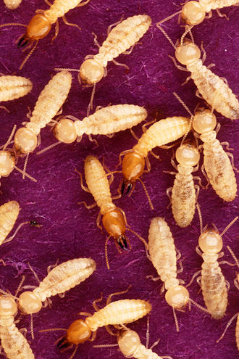
Termite Background
Termites
Species Reticulitermes flavipes is the common termite of Eastern N America
Live in large colonies of about 20,000 to several million insects)
Eat dead plant material, incl. wood.
Important recyclers in forest ecosystems

Slide 3
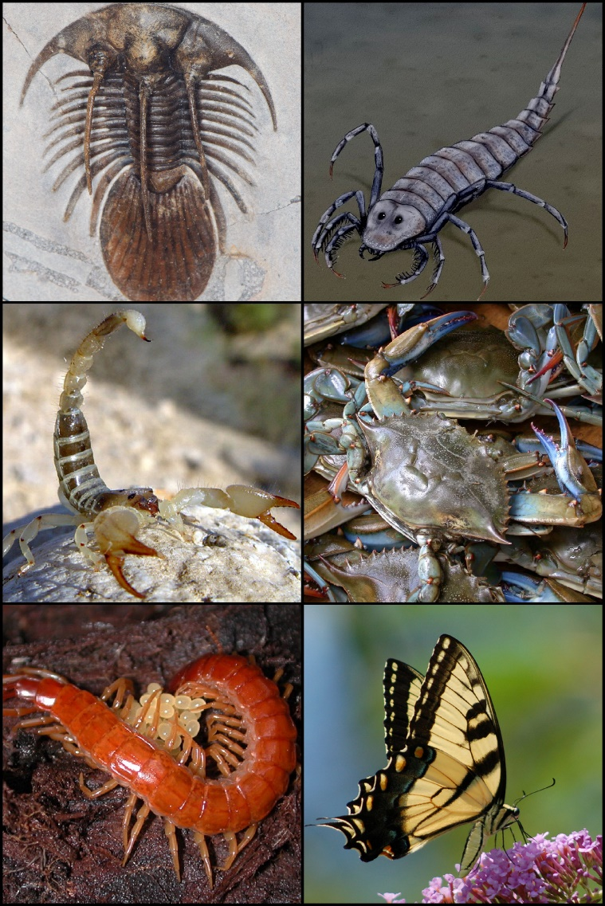
Termites Phylum: Arthropoda Class: Insecta
Phylum Arthropoda
Arthropods: animals with exoskeletons and segmented bodies.
Insects are the most successful class of animal on Earth by diversity and by biomass.
Class Insecta

Slide 4
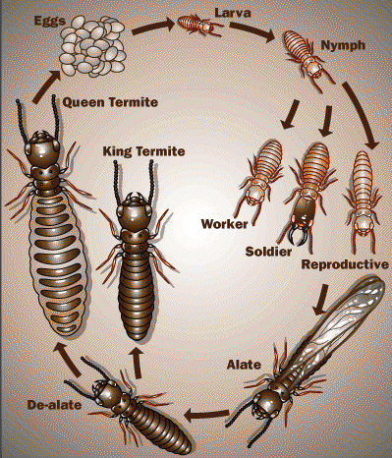
Termite Castes and Life Cycle
Caste system social order:
Workers
Soldiers
Reproductives
All termites in a colony are offspring of the single queen.
To begin a new colony, reproductives “swarm” to a new location.

Slide 5
Termite Reproduction
The King and Queen reproductives begin a new colony after a swarm.
The queen can live up to 50 years, and mates for life with a king. (kings don’t live as long, and are replaced)
Development from egg→adult is controlled by pheremones (chemical signals).
For example, the queen produces a pheremone that prevents new queens from developing. When she dies, that pheremone is no longer present, and new young queens develop.
Queens can lay up to 1,000 eggs a day!

Slide 6
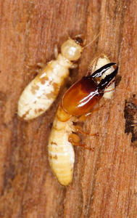
Workers and Soldiers
Workers and soldiers are sterile
Workers:
Smallest, and most common
Many jobs, including
Foraging for food / feeding other castes
Building & maintaining nest
Caring for brood
Soldiers:
Powerful jaws on large heads. Far fewer than workers
Colony defense

Slide 7
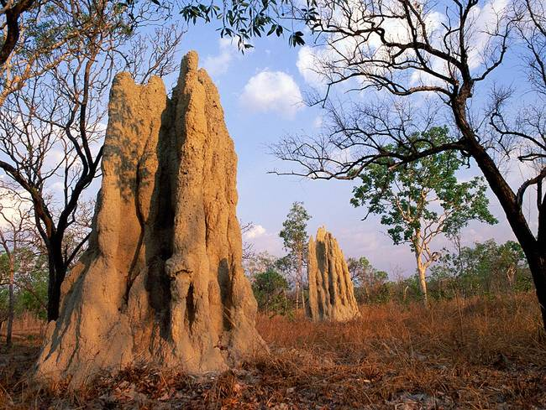
We will watch a short video about South African mound-forming termites.
Although a very different species from the one you will work with, the castes remain the same, and social behavior is evident.

Slide 8
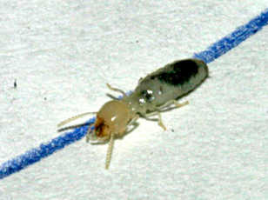
Termites Follow Some Ink
You’ve got to see it to believe it…

Slide 9
Play with Some Termites
BE GENTLE! Termites are fragile… always use a paint brush to move them.
Attempt to complete procedure day 1, including:
General observations
Labeled sketch
Observation with CONTROL PEN line
Questions

