Slide 1
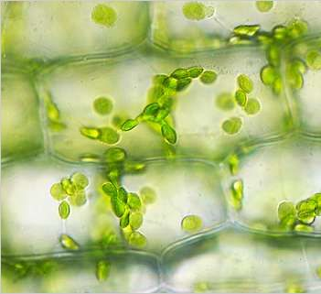
Microscope Lab
DO NOW 9/19
OBJECTIVES:
Identify key parts of a microscope, describe their functions, and use them competently.
Define FOV size, and determine its values for our microscopes.
Observe and analyze cells from the four kingdoms of domain Eukaryota.
TASK:
If the diameter of the circle shown is 0.5 mm, about how long are the sides of the rectangular cells?
ALSO: pass up Bias WS if you haven’t already turned it in.

Slide 2
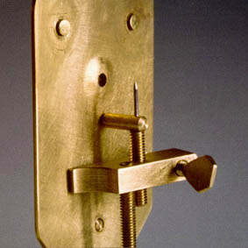
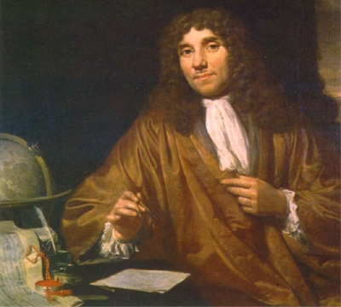
Microscopes!
The first microscopes were developed in the 17th century.
Antonie Van Leeuwenhoek was the first human to see unicellular organisms, in 1674

Slide 3
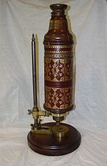
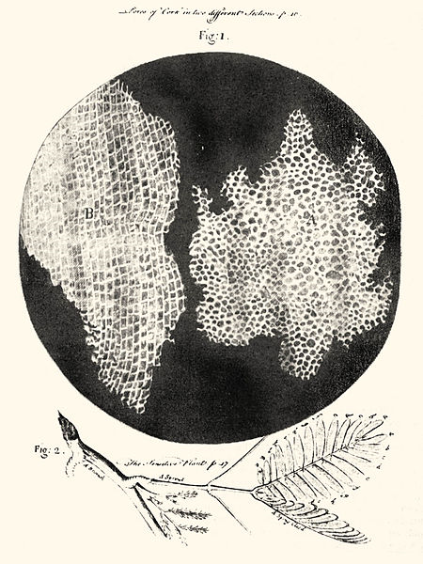
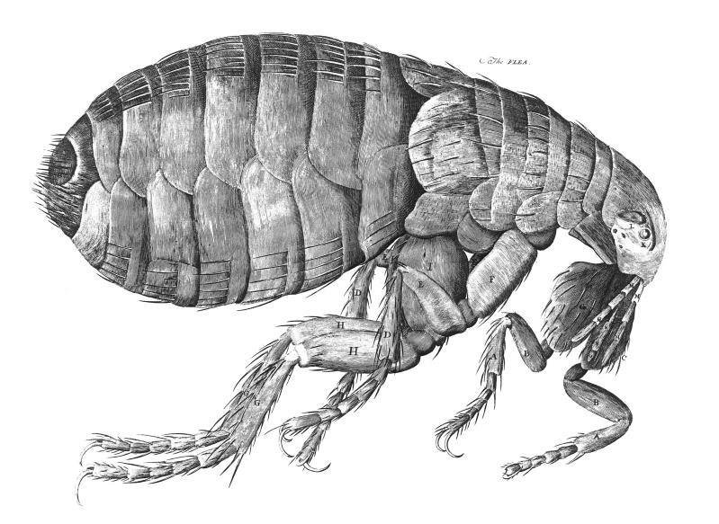
Robert Hooke coined the term “cell”
1665, Hooke publishes Micrographia, a book of his sketches taken with the microscope shown at right

Slide 4
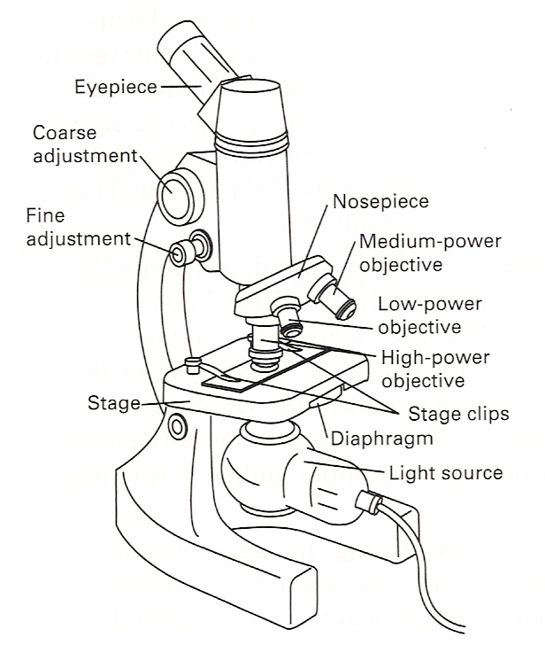
The Compound Light Microscope
The compound light microscope uses two convex glass lenses to magnify a specimen.
Advantage: can visualize living cells.
Disadvantage: not as powerful as some other technology

Slide 5
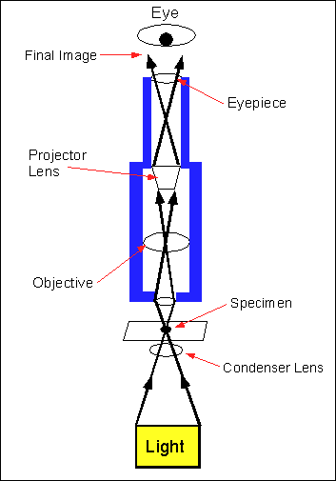
Magnification
To find the total magnification of a microscope, multiply the magnification of the ocular lens (eyepiece) by the magnification of the objective lens.
Resolution matters! (Low res = blurry)

Slide 6
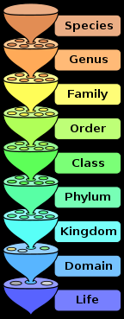
The Lab: Exploring Domain Eukaryota
All life is divided into 3 domains.
You, as well as all multicellular organisms (and some unicellular ones) are part of domain Eukaryota.
You are a eukaryote, made of eukaryotic cells.
We will observe specimens from the four kingdoms of domain Eukaryota.

Slide 7
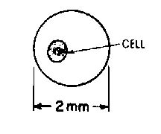
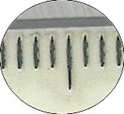
Field of view (fov) size
Measure on low power only!
Calculate low, medium and high power values using equations given.
Use FOV to estimate cell sizes

Slide 8
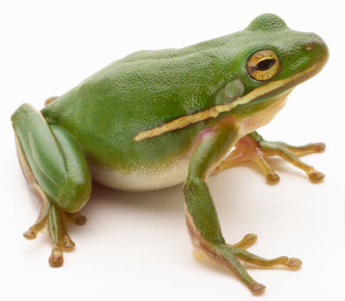
Kingdom Animalia: Frog Skin (& others)

Slide 9
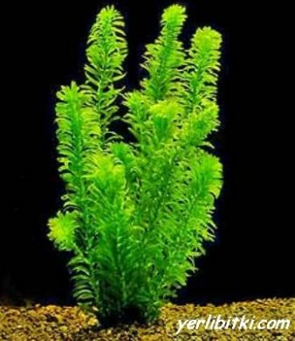
Kingdom Plantae: Elodea sp. And others

Slide 10
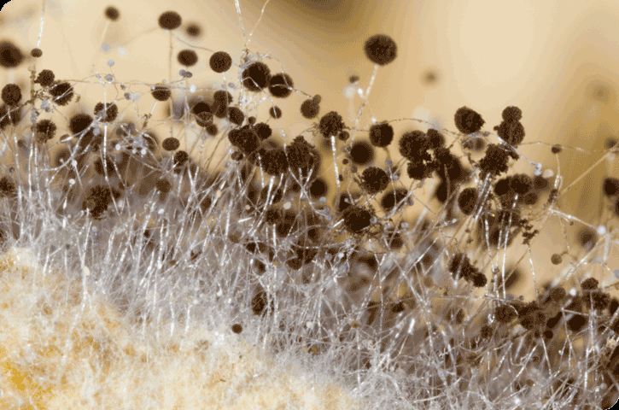
Kingdom Fungi: Rhizopus nigricans and others

Slide 11
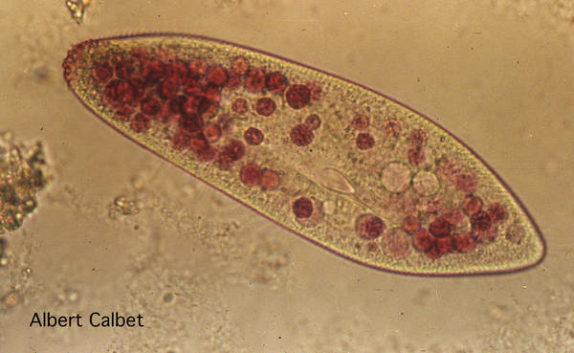
Kingdom* Protista: wet mount from fish tank.

