Slide 1
Do Now 9.15
Objectives (please copy):
Define instinctual behavior and learned behavior, and distinguish 3 types of each.
Define circadian rhythm.
Define, identify, and explain bias in science.
Task:
1. When I was attacked by a swarm of wasps last year, what type of behavior were the wasps exhibiting? What kind of behavior was my swatting, yelling, and running?

Slide 2
Animal Behavior
Instinctual Behavior
automatic processes triggered by specific stimuli. Present at birth
Simple reflexes: Are not processed by brain, but spinal cord.
Fixed action pattern: like reflexes but behavior is more complex. (e.g. egg rolling, avian mating dances, brood parasitism exploit)
Imprinting: fast, irreversible learning (e.g. filial imprinting, sexual imprinting)

Slide 3
Animal Behavior
Learned Behavior
Not present at birth.
Habituation: repeated stimuli become ignored.
Classical Conditioning: Pavlov’s dog (association of stimuli)
Operant conditioning: trial and error learning based on positive or negative outcomes.
Circadian Rhythms
Internal “clock” that can regulate behavior, i.e. activity cycle.

Slide 4
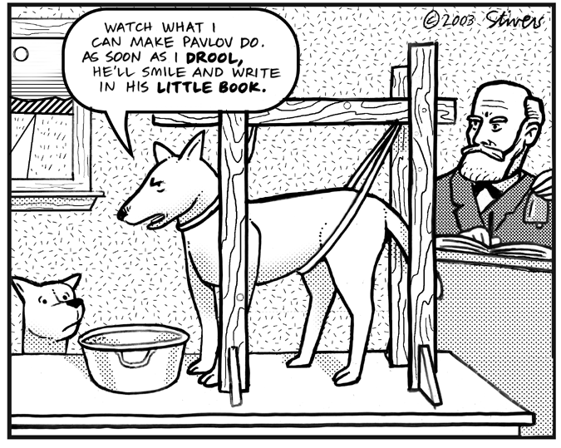
Who conditioned who? ☺

Slide 5
What about the Termites?
What type of behavior is the trail-following behavior we studied in Reticulitermes flavipes?
Simple reflex
Fixed-action pattern
Imprinting
Habituation
conditioning

