Slide 1
Characteristics of life & Cornell Notes
DO NOW 9.10 :
OBJECTIVES:
  Use the Cornell notes method of note taking to summarize texts.
  Identify and describe the characteristics common to all living systems by using a mnemonic device (OGR₃E₂).
TASK:
1. Pass forward characteristics lab
2. Convert using conversion factors:
2.5 cm to m
48 µm to m
** 1.4 km to mm

Slide 2
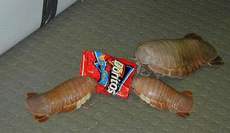
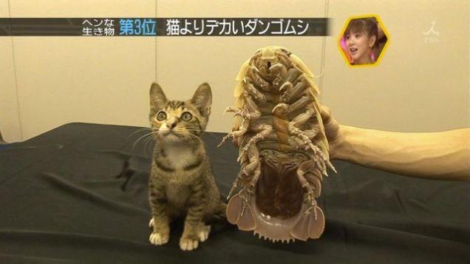
Random Organism of the Day: Giant Isopod
Giant version of the common pill-bug…

Slide 3
Surprise!
Or not such a surprise… it’s a quiz on metric prefixes.
5 minutes.

Slide 4
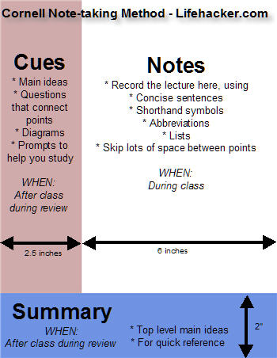
Cornell Notes
Title
This is a recommended format for notes you take in class and while reading.
Notice that only the “notes” section should be completed during lecture or reading.

Slide 5
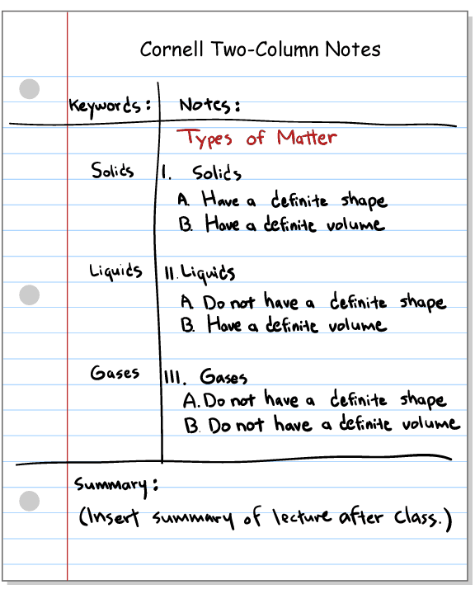
Example
Notice how easy it is to find a few KEY terms.
Try to limit what goes in the left column.

Slide 6
7 Characteristics of Life
I will distribute textbooks.
  Write name & HR on bottom of page 115
  Complete a book receipt
  I will sign the book and collect a receipt.
Read selected portion Campbell Text (section 1.5 on p. 8 about the characteristics of life)
As you read, complete a set of Cornell Notes
  Stop after completing the “notes” section

Slide 7
Key Ideas & Summary: OGR₃E₂
Complete the remaining two Cornell notes sections (Key Ideas& Summary) for the characteristics of life.
Characteristics of Life:
  Organization
  Growth & development
  R₃eproduction, Response, Regulation
  E₂nergy use, Evolution

Slide 8
Homework
Complete a set of Cornell notes for the animal behavior spark notes. Due tomorrow.

