Slide 1
SI 9.1
OBJECTIVES: 1.Define & distinguish quantitative and qualitative observations.
Identify 2 advantages of SI over imperial (US) measurements.
Define and distinguish base units and derived units.
Identify the values of the following metric prefixes: micro, (µ); milli, (m); centi (c); deci, (d); Kilo (k); Mega (M); Giga (G)
TASK: Copy & Complete the table below
Quantity | US Standard Units | SI Units
length
 | Pounds
Volume

Slide 2
Recap of Yesterday (Collect HW)
Simpson’s Science

Slide 3
Qualitative vs. Quantitative Observations
Qualitative observations describe the apparent qualities of something. SUBJECTIVE!!!
Green, fast, heavy, etc.
Quantitative observations measure the quantity of some characteristic. OBJECTIVE!!!
32.5 g , 88 m/s, 300 nm

Slide 4
SI: Système International d’Unités
International System of Units
Universal system of units and measures used by scientists and engineers everywhere.
Official measurement system of the world: 99% of the countries of Earth (193/196)
All conversions are base 10.
How big is a foot anyway?
Why is an exact, precise system of measurement so important?

Slide 5
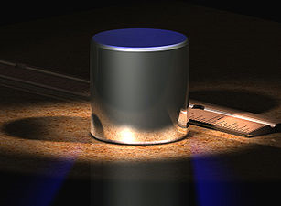
SI Base Units
Length: the meter is defined as the distance travelled by light in vacuum in 1⁄299,792,458 of a second
Mass (NOT weight*): defined by an actual platinum / iridium object. It is the only SI base unit not defined by a fundamental natural constant.

Slide 6
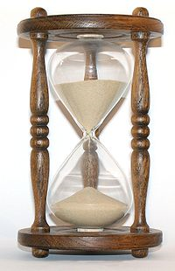
Time (s)
One of the 7 fundamental physical quantities that all units are based on.
Length, time, mass, electric current, temperature (K), amount of substance (mol), and luminous intensity
What is time???

Slide 7
Derived units
There are innumerable combinations of base units (those 7 fundamental quantities) that measure quantities.
Example: density = mass/volume kg/L
Example: Force
Unit: Newton (N)
Derivation: 1 kg*m/s²

Slide 8
WRAP
Qualitative vs. Quantitative observations
SI – what is it?
Fundamental quantities (base units)
Length, mass, time, etc.
Derived units
Density, etc.

Slide 9
Part II: Metric prefixes
Please copy and complete the following table:
Prefix | Factor of 10 | standard | written
Micro, µ | 10⁻⁶ | .000,001 | Millionth
Milli, m | 10⁻³ |  | Thousandth
 | 10⁻² | .01 | Hundreth
deci, d |  | .1 | Tenth
Kilo, k | 10³ |  | Thousand
Mega, M |  | 1,000,000 | Million
 | 10⁹ | 1,000,000,000 | Billion

Slide 10
Working with Prefixes
Prefix | Factor of 10 | standard | written
micro, (µ) | 10⁻⁶ | .000,001 | Millionth
milli, (m) | 10⁻³ | .001 | Thousandth
centi (c) | 10⁻² | .01 | Hundredth
deci, (d) | 10⁻¹ | .1 | Tenth
Kilo (k) | 10³ | 1,000 | Thousand
Mega (M) | 10⁶ | 1,000,000 | Million
Giga (G) | 10⁹ | 1,000,000,000 | Billion
How to read this chart:
EXAMPLE: 1 milligram (mg) = 10⁻³ g = .001 g = 1 thousandth of a gram

Slide 11
SI & Measurement II 9/4
OBJECTIVES:
1. Manipulate and convert metric units using factors of 10 and scientific notation.
2. Define and distinguish accuracy and precision.
3. Define parallax and describe how it affects measurement.
TASKS:
Complete scientific notation practice on notes from yesterday if you have not done so.
Note: I will collect week 1 Do Nows Tuesday.

Slide 12
Quick Review: Scientific Notation:
Used to represent very large and very small numbers.
Includes two parts – a number between 1 and 10 and the appropriate factor of 10.
Examples:
1,653,000 = 1.653 x 10⁶
0.000,343 = 3.43 x 10⁻⁴

Slide 13
Multiplying and Dividing in Scientific Notation
To multiply or divide numbers written in scientific notation,
Multiply or divide the value, then
Multiply or divide the exponent
REMEMBER: when multiplying exponents, add; when dividing, subtract.
Ex: (4 x 10⁶)(2 x 10²) = 8 x 10⁸
Ex: (6 x 10⁴) / (3 x 10⁶) = 2 x 10⁻²

Slide 14
Converting Units
To convert from one unit to another, use a conversion factor.
A conversion factor is a fraction whose value is one.
To make the right conversion factor, put the unit you are converting FROM in the denominator and the unit you are converting TO in the numerator.
Multiply. Note that units can cancel like variables.
Ex: Convert 2 feet to inches
2 feet (12 inches) = 24 inches
(1 foot)
X

Slide 15
Converting SI Units
This works the same way.
Ex: Convert 15 seconds to milliseconds
15 s 1 ms = 15,000 ms
10⁻³ s
Note: Dividing by a negative exponent is the same as multiplying by the positive one
X

Slide 16
Do Now 9.4
OBJECTIVES:
Complete objectives 2-4 from yesterday
Task:
Convert using conversion factors:
2.5 cm to m
35 µm to m
** 1.4 km to mm

Slide 17
Measurement
Scientific measurement is designed so that all observers will achieve the same result. (i.e. it is objective)
It is based on two concepts:
Accuracy: the “correctness” of a measurement.
Precision: the degree of detail of a measurement.

Slide 18
Accuracy = Correctness
Assume that the rectangle shown has a true length of 11.256 cm
The following are all accurate measurements:
11 cm
11.3 cm
11.26 cm
11.256 cm
An accurate measurement is one where every number place has the correct value.

Slide 19
Precision = Detail
Assume that the rectangle shown has a true length of 11.256 cm
The following are all accurate measurements, but some are more precise than others
11 cm
11.3 cm
11.26 cm
11.256 cm
Precision is a relative term. The more decimal places measured, the more precise the measurement is.

Slide 20
Uncertainty
Uncertainty is an important part of science. It too, can be measured.
For example: An index card is 12.7 cm wide.
ANY length between 12.65 cm and 12.74 cm would be accurately measured as 12.7 cm, if the precision of the measurement is 0.1 cm.

Slide 21
What it all means.
From my old house, my ride to Poly was 3 miles long.
Although I am unsure of the EXACT distance, I am 100% certain that the true value is between 2.5 mi and 3.4 mi.
Therefore, to the greatest possible precision available to me, it is a 3 mile ride.

Slide 22
3 mi ≠ 3.0 mi
When dealing with measurements (not pure numbers), the number of decimal places represented matters.
A measurement of 3 mi means 2.5 < X <3.4
A measurement of 3.0 mi means 2.95 < X < 3.04
Which is more precise?

Slide 23
Accuracy & Precision
The actual length of an object is 8.4592 cm
Different instruments are used to measure the length, and the following results are obtained:
8 cm
8.4 cm
8.6 cm
8.40 cm
8.46 cm
9.021 cm
Which measurements are accurate? Which accurate measurement is accurate AND most precise?

Slide 24
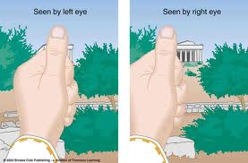
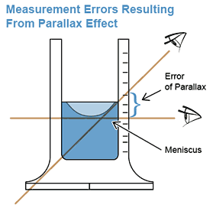
Parallax
Parallax is the apparent difference in measurements taken by observation at different locations.
To avoid parallax in common laboratory measurements, make sure the object being measured is being looked at from a perpendicular angle.

Slide 25
So… how do we measure?
First, measure accurately
Always begin at zero! (balances, rulers, etc.)
Be careful and use good technique (read the meniscus, look straight on, etc.)
Repeat and average if necessary!
Second, use the correct precision.
Record a measurement to the most precise decimal place you are 100% certain is accurate.
Use the smallest place marked on the measuring tool you use.

Slide 26
What we’re not doing: math with measurements (significant digits)
There are rules for adding, subtracting, multiplying, and dividing measurements that take precision into account.
The idea is: you cannot increase the precision of a measurement by doing math.
You will do this in chemistry next year ☺
3 m x 4 m = 10 m²
3.0 m x 4.0 m = 12 m²
3.00 m x 4.00 m = 12.0 m²

Slide 27
Wrap
Accuracy is a description of how correct a measurement is.
Precision is the degree of detail of a measurement
Memorize and be able to use the seven metric prefixes on this powerpoint

Slide 28
Observation and Measurement
2 Parts
Observations (qualitative vs. quantitative)
Measurement

