Slide 1
Skeletal & Muscular systems
Notes are Yours Today:
Jot down this list of important terms, and make sure they make it into your notes during the lesson:
Tendon Ligament Osteon Bone Marrow Skeletal Muscle Smooth Muscle Cardiac Muscle Myofibril Sarcomere Actin / Myosin

Slide 2
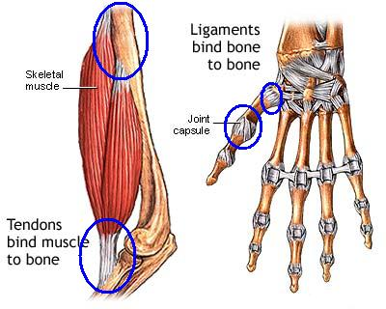
Skeletal & Muscular System

Slide 3
Connective Tissues of the Skeletal System
Bones
Rigid matrix of calcium and phosphate with cells embedded.
Provide support and structure and allow locomotion
Homeostasis of calcium levels
Marrow inside contains blood stem cells
Cartilage
Flexible, cushions joints.
Sharks and rays (cartilagenous fish) have cartilage skeletons

Slide 4
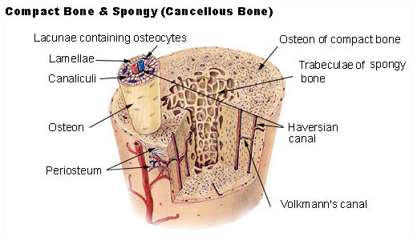
Osteon: Tissue Units of Hard Bone

Slide 5
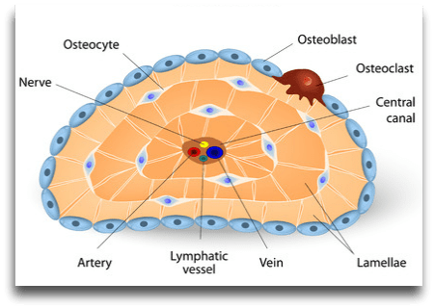
Cells of the Osteon

Slide 6
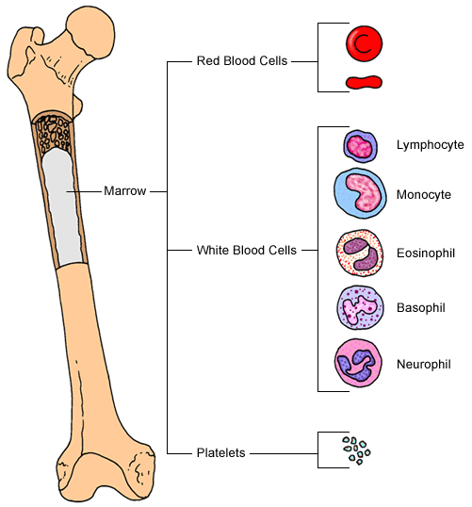
Bone Marrow: Where blood cells of all types come from

Slide 7
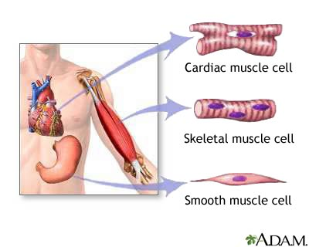
Three Types of Muscle Tissue
Skeletal muscle (aka “striated”): voluntary. Attaches to bone
Smooth muscle: involuntary (i.e. peristalsis)
Cardiac muscle: heart.

Slide 8
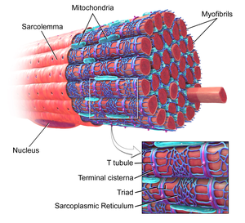
From Muscle Cell to Muscle
This whole structure is a muscle cell, or “myofibril”
Myofibrils are polynucleated

Slide 9
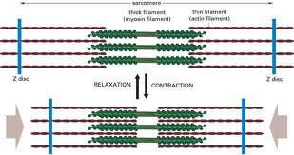
Muscle Contraction
Ca++ ions produced by motor neuron cause myosin filament to pull on actin filaments, drawing them inward.
Extensor v. flexor

