Slide 1
Do Now 12/23
OBJECTIVES:
Describe the structures & functions of the respiratory system in vertebrates and other animals.
TASK:
The respiratory system is sometimes also considered to be a part of the excretory system. Why?
How is the respiratory system connected to the functioning of other systems?

Slide 2
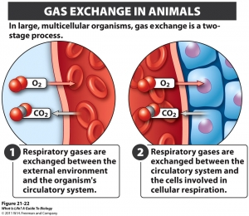
Respiratory Systems: O₂ in, CO₂ out
Acquisition of O₂ and elimination of CO₂ is called gas exchange, and it is the primary function of the respiratory system.

Slide 3
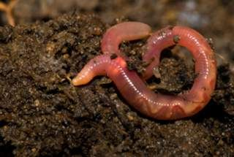
Simple Animals Use Diffusion
Cnidarians and planarians have no real respiratory system.
Annelids also use diffusion for gas exchange, which is why their skin must remain wet.

Slide 4
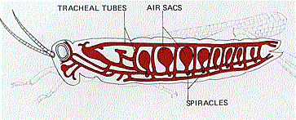
Arthropods Use Tracheae
Gas exchange is passive in arthropods
air is not actively drawn into tracheae.
This is a limiting factor to their size.
Openings to environment are called spiracles.

Slide 5
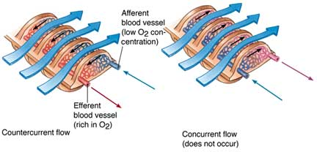
Vertebrate Systems Maximize Surface Area
Fish use gills.
Countercurrent exchange: fresh water pulled over deoxygenated blood (against current of water.)

Slide 6
Lungs: Inside-out gills
Terrestrial vertebrates have internal lungs to respire.
Must be internal to prevent dessication
Birds have an extremely efficient open-ended system of parabronchi

Slide 7
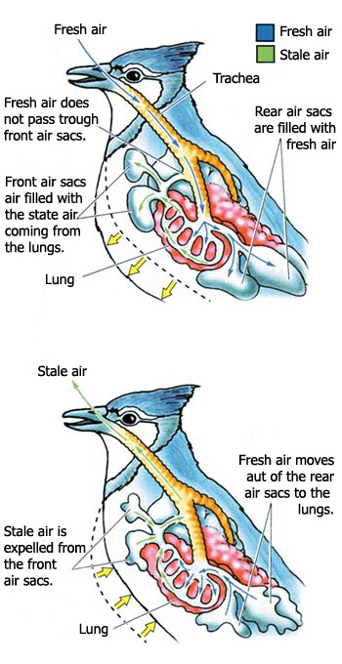
Bird Lungs: The best in the business!
Birds use a system of small tubes (parabronchi) and air sacs so that lungs are covered in fresh, oxygen-rich air, EVEN WHILE EXHALING!!!
Got to respire fast if you want to fly!

Slide 8
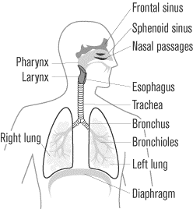
Mammals and other higher vertebrates
Nose/mouth → pharynx → larynx (vocal cords) → trachea →
LUNGS: bronchi → bronchioles → alveoli
Most epithelial (surface) cells that line the system produce mucus to trap dust, bacteria, viruses, etc, and cilliated cells to expel them from the system.

Slide 9
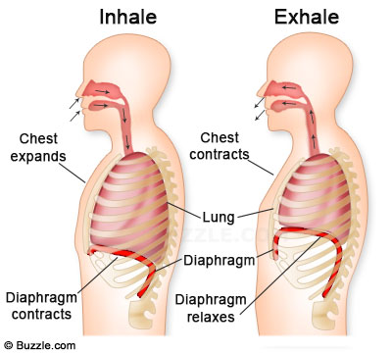
The Diaphragm is the Muscle of Respiration
Breathing is based on air pressure: any puncture to a lung can cause it to collapse.

Slide 10
Blood pH Regulation
Since CO₂ forms carbonic acid, excess CO₂ in the blood lowers blood pH
By adjusting the breathing rate, more or less CO₂ can be expelled over time.
When you feel out of breath, it’s not a lack of oxygen your hypothalamus is responding to, but rather too much CO₂!

