Slide 1
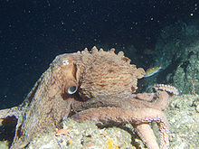
Excretory System 12/10
Do Now:
OBJECTIVES:
Describe the structures and function of the excretory system
Define nephron, and describe how the parts of a nephron work together to filter waste from the blood stream.
TASK: 1. Pass forward week 14 Do Nows
Consider the graph below, of survivorship curves. Which type represents the human strategy for reproduction? Which represents an octopus? Octopi can lay up to 200,000 eggs at a time.

Slide 2
About that Respiration Lab
Graph(s)
Conclusion, in 4 parts:
Claim (your conclusion)
Evidence (data that supports your claim)
Reasoning (how evidence cited supports claim)
Rebuttal (limitations of experiment, possible future investigations, and/or implications of findings)
A healthy paragraph should suffice.
Complete tonight (won’t check other notes – promise)

Slide 3
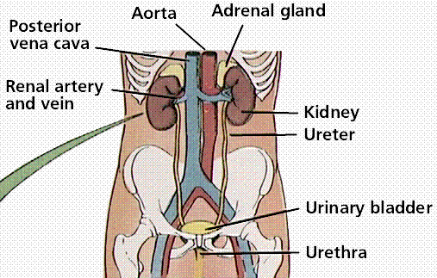
Excretory System Structures & Functions
Major Organs:
Kidneys, each of which contains many nephrons.
Urinary tract, including bladder, urethra, etc.
Major Function:
Collection and removal of nitrogen waste (produced by the metabolism of proteins and nucleic acids) from the bloodstream and the body.

Slide 4
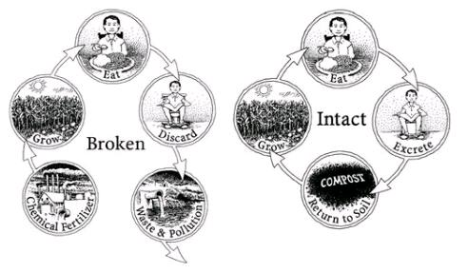
Nitrogen Cycle or Nitrogen Path?
Nitrogen is an important fertilizer for plant growth… which we flush away.

Slide 5
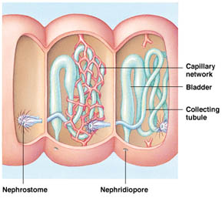
Excretion in Simpler Animals
Cnidarians: diffusion of wastes out of cells.
Annelids: Nephridia in each segment filter blood in capillaries and excrete it through pores in the skin.

Slide 6
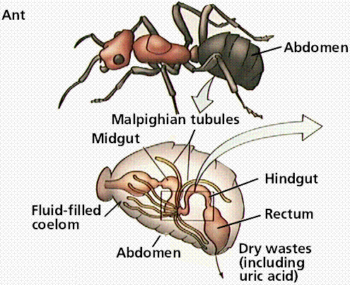
Excretion in Arthropods
Arthropods have a unique system.
Malpighian tubules collect N waste from the open circulatory system.
The waste is then added to the digestive tract, where water is reabsorbed.

Slide 7
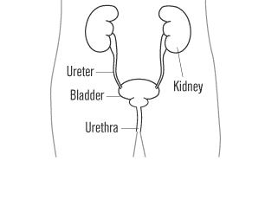
Excretion in Vertebrates Uses Kidneys
Vertebrates use kidneys to filter N waste from the bloodstream. It is eliminated in urine.
Collected waste path:
kidney→ ureter → urinary bladder → urethra.

Slide 8
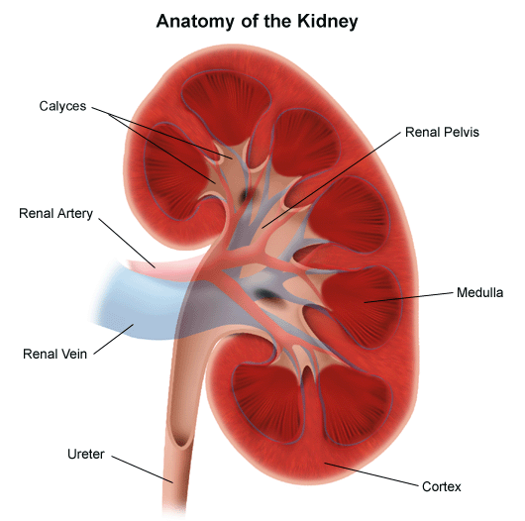
Kidney Structure
Blood enters through renal artery / exits via renal vein.
Each of the two kidneys contains about 1,000,000 blood-filtering structures called nephrons.

Slide 9
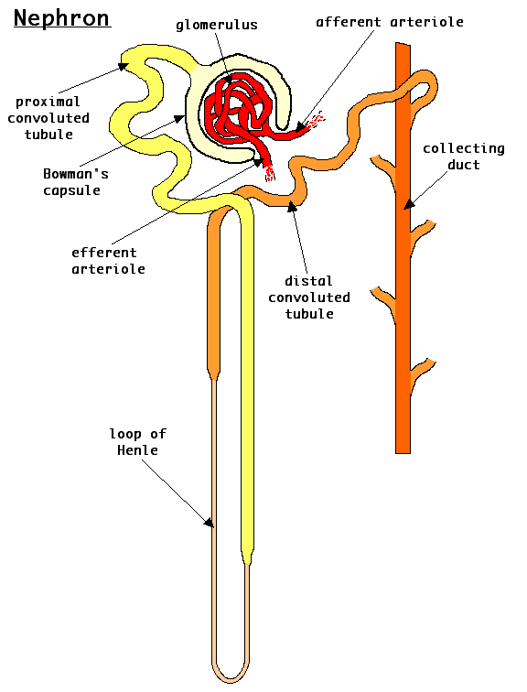
Nephron Structure
The nephron is the basic unit that filters nitrogen wastes from the blood and recaptures water and nutrients.
Nephrons span the cortex and medula of the kidney.

Slide 10
How Nephrons Filter Blood
High pressure blood in the glomerulus is filtered.
Blood plasma is collected in Bowman’s capsule, and is now called filtrate.
Blood cells are returned to bloodstream.

Slide 11
The Filtrate Contains Valuable Substances that Must be Reabsorbed.
The filtrate collected from blood contains nitrogen waste (urea) that needs to be separated from useful filtrate components including:
Water
Salts
Glucose
Amino acids
The proximal convoluted tubule reabsorbs a high percentage of these. After the proximal tubule, filtrate is called urine.

Slide 12
The Loop Of Henle Reabsorbs More Water and Salt
Descending LOH is permeable to H2O, but not salt. A high concentration of salt in the medula of the kidney draws water from the urine via osmosis.
Ascending LOH is permeable to salt, not H2O. Here, the salt diffuses out into the medula, maintaining the high concentration there.
By the time urine exits the LOH, well over 90% of water and salts have been reclaimed
Salt diffuses out
Salt in medula draws out water (osmosis)

Slide 13
Distal Convoluted Tubule: Reclaims More Salt and Water; Adds More Waste
Functions like PCT: salt pumped out of tube (active transport), and water follows out due to osmosis.
Additional function of the DCT: other waste substances (H+, K+, etc.) pumped into DCT from blood to be removed with urine.

Slide 14
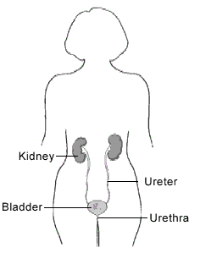
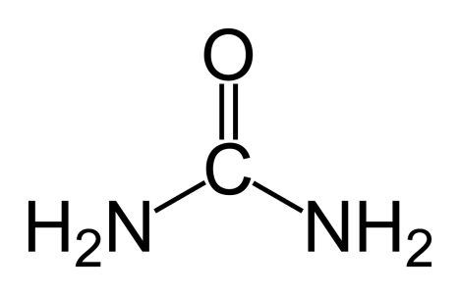
The Urinary Tract: Storing and Eliminating Nitrogenous Waste
After the collecting ducts, the urinary tract simply stores and removes urine.
Urea is the chemical form N takes when excreted.

Slide 15
ADH: How Kidneys Regulate Water Balance in the Collecting Ducts
The collecting ducts transport urine through the medula to the ureter. Since, the medula has a very high salt concentration more water can be reabsorbed.
The amount of additional water reabsorbed at this stage is regulated by a hormone called ADH, which is produced by the pituitary gland near the brain.
ADH makes the walls of the collecting ducts more permeable to water, allowing more water to be reabsorbed by the kidney.
LOW ADH = less water reabsorbed
HIGH ADH = more water reabsorbed (ADH produced in dehydrated state)

Slide 16
Kidneys Regulate Blood Pressure
The kidneys are associated with the endocrine system in several ways in addition to ADH:
Aldosterone, produced by the adrenal gland, increases sodium and water reabsorption in the distal tube.
Kidneys control blood volume and blood pressure in several ways:
Reabsorption rate of water
Production of renin, a hormone that induces aldosterone AND angiotensin II (an enzyme) production, which constricts blood vessels, increasing blood pressure.
The adrenal glands, which produce the hormone adrenalin, are located atop the kidneys.

Slide 17
Recap
The kidneys contain millions of nephrons, the structures that filter nitrogen waste from the blood.
In the first step, blood under high pressure is filtered to separate the plasma (filtrate) from blood cells. This occurs in the glomerulus and Bowman’s capsule.
The PCT, LOH, and DCT reabsorb important materials like water, salt, and glucose. The system is over 97% efficient in total.
ADH and aldosterone are hormones that affect kidney function.

