Slide 1
The Circulatory System
Do Now
OBJECTIVES:
Describe the structures and functions of the circulatory system
Trace the path of blood through the systemic circuit (body), heart, and pulmonary circuit (lungs).
TASK:
What organs and tissues make up the circulatory system? List all you can think of.
What are the functions of the circulatory system?

Slide 2
Circulatory System Basics
Major Structures:
Heart: pumps blood
Blood: Body fluid that carries blood cells and other materials through the body.
Vascular Tissue: The “tubes” that carry blood around the body, including arteries, veins, and capillaries.

Slide 3
Circulatory System Basics
Major Functions:
Gas Exchange: the blood and blood cells carry O₂ to body cells and CO₂ waste to the lungs.
Nutrition: the blood plasma provides required food (glucose) and other materials (vitamins, minerals, water, etc.) to body cells from the digestive system. It also removes wastes from tissues.
Hormone communication: The bloodstream carries hormones released by glands of the endocrine system throughout the body.
Homeostasis: blood carries heat from the warmer core of the body to the cooler extremities (arms, legs). It is also pH buffered (7.4)

Slide 4
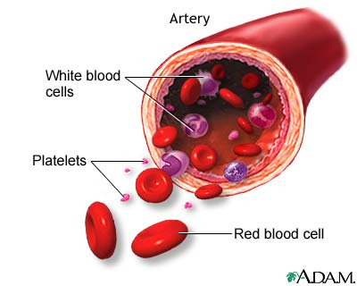
Blood Components
Blood Plasma: The solution blood cells are carried by. It contains sugars, electrolytes (K+, Na+, Ca++, etc.), phosphate buffers, and other metabolic products (like N wastes)
Red blood cells: (aka RBC or hematocytes) enucleated cells that contain hemoglobin, the protein that carries oxygen and CO₂.
White Blood Cells: (aka leukocytes) immune system cells for fighting disease.
Platelets: Tiny cells that clot blood to seal breaks in the vascular tissue.

Slide 5
Vascular Tissues
Types of circulatory vascular tissues:
Arteries: carry blood away from the heart.
Arteries are under pressure and have a pulse.
Generally (except for pulmonary artery) carry oxygenated blood, which is bright red.
Small arteries called arterioles.
Veins: carry blood towards the heart
Low pressure. One way valves keep blood moving back towards the heart.
Generally (except for pulmonary vein) carry deoxygenated blood.
Small veins called venules.
Capillaries: tiny blood vessels between arteries and veins.
gas exchange occurs between the blood and body cells.
The alveoli of the lungs are covered in capillaries, where gas exchange occurs with the environment.

Slide 6
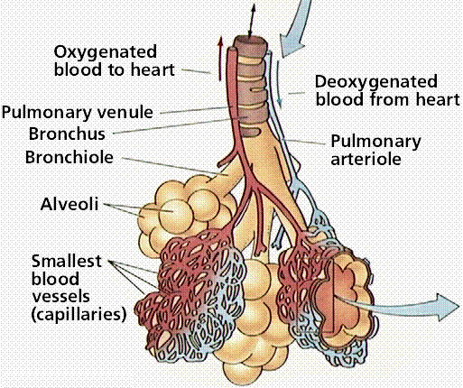
Capillaries
Capillaries are the site of gas exchange in body tissues and in the lungs.

Slide 7
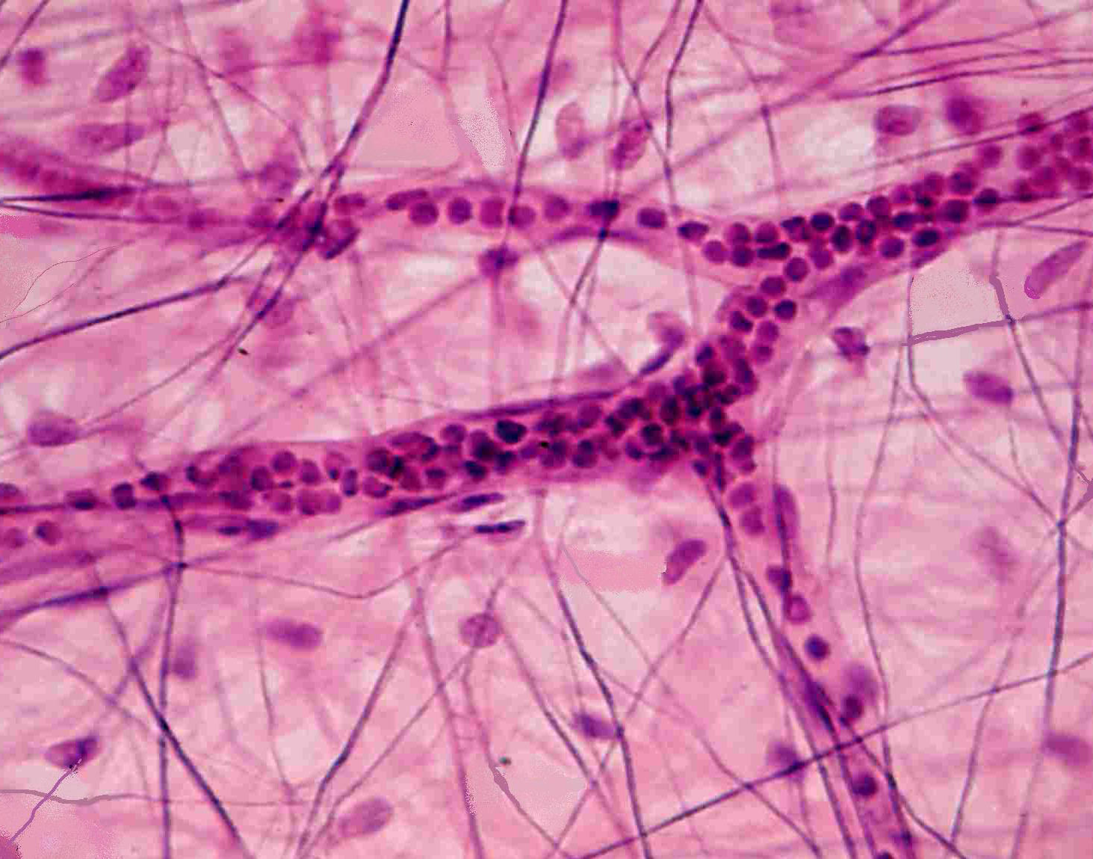

Slide 8
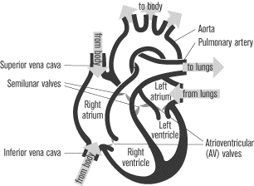
The Heart: A 4-Chambered Muscular Pump
Heart Parts
2 Atria receive blood
2 ventricles pump blood out
(anatomical) Right side from body to lungs
Left side from lungs to body
Semilunar valves prevent backflow of blood.

Slide 9
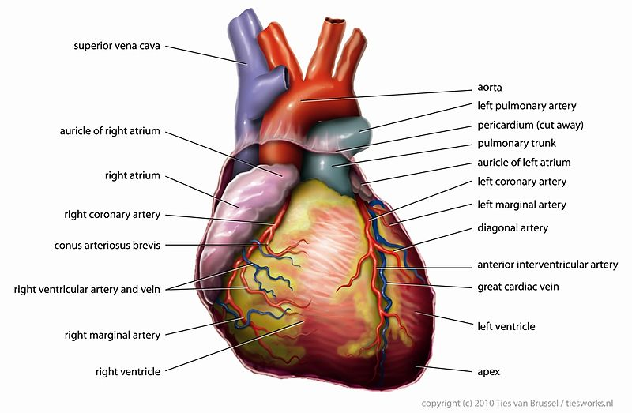
The Coronary Arteries Supply Blood to the Heart Muscle

Slide 10
Blood Flow Through The Heart in 6 Easy Steps: “Rarv-Lalv”
Blood enters R atrium from body through the vena cavas.
Blood pumped from R atrium to R ventricle
Blood pumped from R ventricle to lungs, through pulmonary arteries.
Blood from lungs enters L atrium, through pulmonary veins.
Blood pumped from L atrium to L ventricle.
Blood pumped from L ventricle to body through aorta.
6
1
6
3
4
4
1
2
5

Slide 11
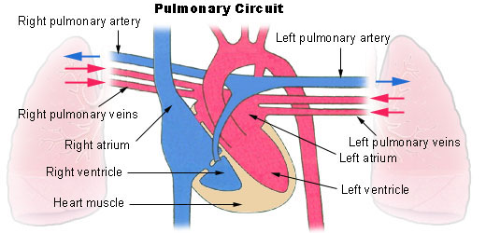

Slide 12
Recap of Main Ideas
The circulatory system pumps blood throughout the body, allowing for the transport of materials including oxygen, nutrients, wastes, and hormones to all cells.
The system is made of 3 major components:
Fluid blood
Vascular “tubes”
The heart pump

