Slide 1
Do Now 11.8: Atomic Structure
OBJECTIVES:
1. Describe the number of protons & electrons in an atom
2. Determine the number of valence electrons of the first 18 elements
TASKS:
1: Classify the following as elements, compounds, atoms, or molecules:
a. A gold (Au) nugget
b. The smallest piece of water (H₂O) possible.
c. A glass window (SiO₂)
d. The smallest piece of sodium (Na) possible
Sketch a helium atom: 2 protons, 1 neutron, 2 electrons
Notes are yours to take today – break out a fresh sheet of paper!

Slide 2
Recap of Last Time
Definitions: atom, molecule, element, compound.
Atomic structure: protons (+) and neutrons in nucleus (nucleus has ~99.9% of mass and a cloud of electrons (-) around it (electron cloud is ~99.99% of volume

Slide 3
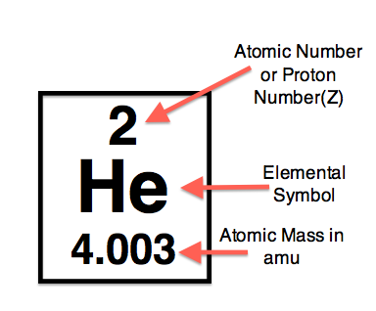
Atomic Number
Atomic Number – The number of protons in an atomic nucleus

Slide 4
What about the number of electrons?
Since electrons are involved in bonding they often leave, are added, or are stolen from atoms.
The number of protons and electrons are equal in a neutral atom

Slide 5
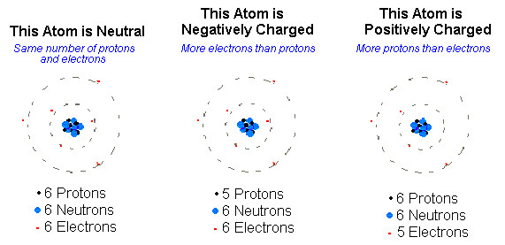
Ions are Atoms with Electrical Charges
Compared to their neutral state,
NEGATIVE IONS HAVE more ELECTRONS
POSITIVE IONS HAVE fewer ELECTRONS

Slide 6
Review
The number of protons in an atom’s nucleus is ALWAYS equal to it’s atomic number If the number of protons changes (i.e. radioactive decay), then the atom becomes a new element.
Although atoms can gain or lose electrons through chemical bonding, in an electrically neutral atom, the number of electrons is equal to the number of protons.

Slide 7
Electrons in the Electron Cloud?

Slide 8
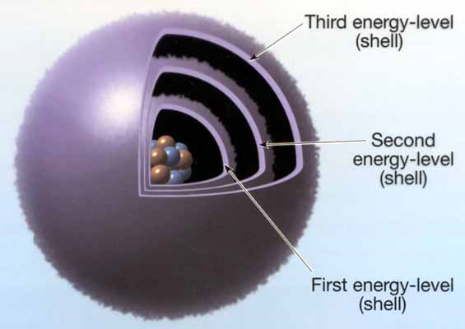
Electrons are seemingly everywhere at once!
We cannot pinpoint electrons to one given spot at one given moment – they move too fast (sort of)
They can be thought of as existing in various energy levels (or shells) around the outside of the nucleus:

Slide 9
What’s more likely? Things go from high energy to low!
Water flowing down a cliff to make a waterfall… or water flowing up?
Falling down a flight of stairs or falling up?
Dropping an egg and making a mess or dropping a broken egg and getting one that’s back together?

Slide 10
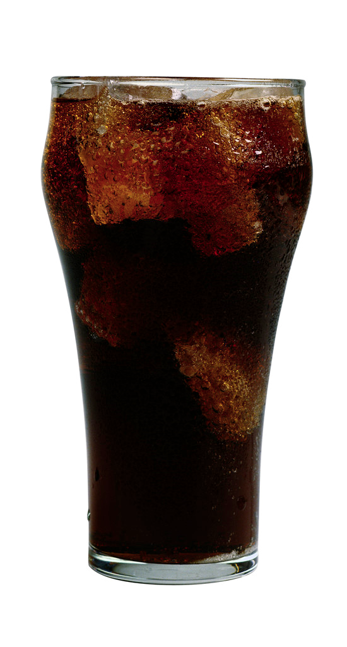
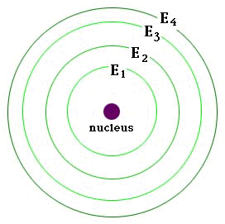
It’s all about Potential Energy
Electrons fill the lowest energy orbitals just like this soda fills the lowest energy part of the glass first.
Arrows indicate increasing potential energy

Slide 11
The bottom line… for now
Energy Level | Max # Electrons
1 | 2
2 | 8
3 | 8*

Slide 12
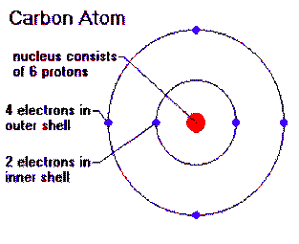
Consider Carbon

Slide 13
Valence Electrons
Valence electrons are the electrons in the highest energy level of the electron cloud that contains any electrons.
Valence electrons are important because they are the electrons that can form bonds with with other atoms.
How many valence electrons does oxygen have? (atomic # = 8)

