Slide 1
Implications for STEM Curriculum, Instruction, and Assessment
In this presentation:
What NGSS is and where it came from
3D structure and organization
Alphabet Soup: DCIs, SEPs, CCCs, PEs, and elements
Nicholas Tomasino

Slide 2
What NGSS is:
“The Next Generation Science Standards (NGSS) are K–12 science content standards. Standards set the expectations for what students should know and be able to do.” (NextGenScience.org)
Where NGSS Came From:
Project 2061 is a long-term initiative of the American Association for the Advancement of Science (AAAS) to help all Americans become literate in science, mathematics, and technology. To achieve that goal, Project 2061 conducts research and develops tools and services that educators, researchers, and policymakers can use to make critical and lasting improvements in the nation’s education system.

Slide 3
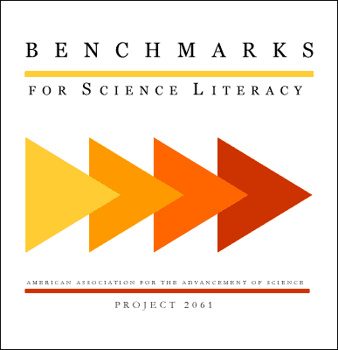
AAAS: to "advance science, engineering, and innovation throughout the world for the benefit of all people.

Slide 4
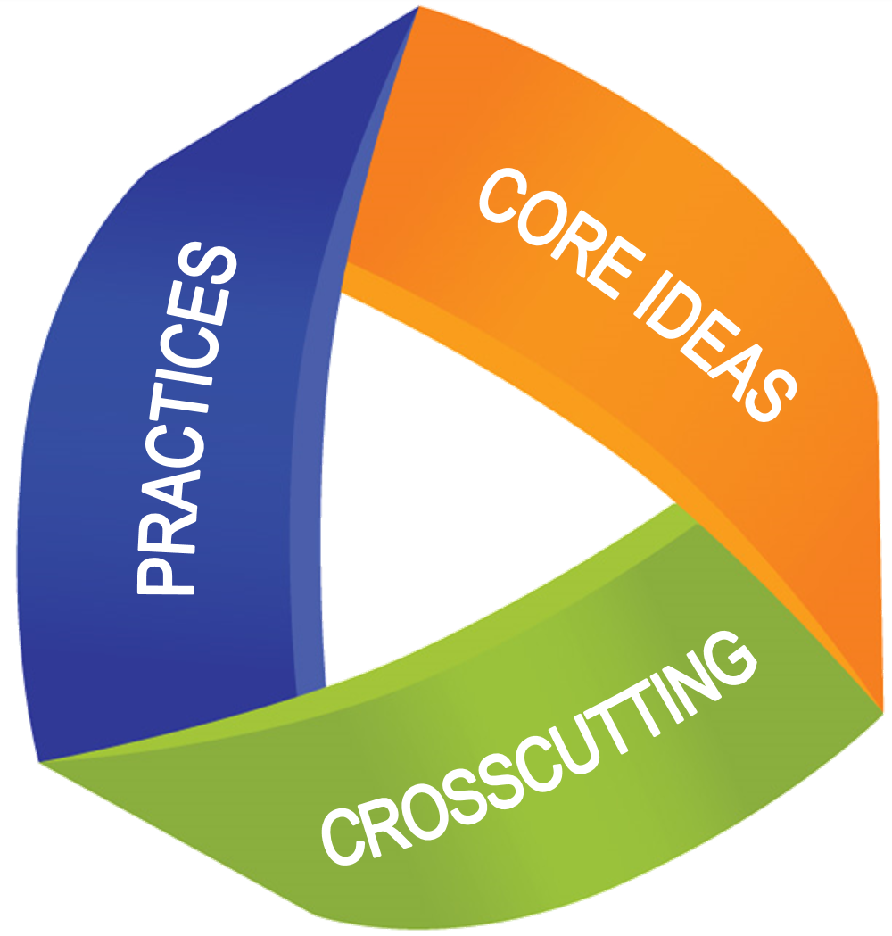
3-Dimensional Architecture
DCI:
Disciplinary Core Ideas
“What students know”
SEP:
Science & Engineering Practices
“What students do”
CCC:
Crosscutting Concepts
“How students think”

Slide 5
Each SEP, DCI, and CCC is described by grade-band specific elements
Example Middle School SEP elements for Practice 5: Using Mathematical & Computational Thinking
SEP5.MS1: Use digital tools (e.g., computers) to analyze very large data sets for patterns and trends.
SEP5.MS2: Use mathematical representations to describe and/or support scientific conclusions and design solutions.
SEP5.MS3: Create algorithms (a series of ordered steps) to solve a problem.
SEP5.MS4: Apply mathematical concepts and/or processes (e.g., ratio, rate, percent, basic operations, simple algebra) to scientific and engineering questions and problems.
SEP5.MS5: Use digital tools and/or mathematical concepts and arguments to test and compare proposed solutions to an engineering design problem.

Slide 6
Crosscutting Concepts & Science and Engineering Practices Relevance to MS Mathematics Instruction
Refer to handout…
Let’s talk about / brainstorm examples:
Tables and Graphs
Rates of Change
Probability
Proportion, Ratio, and Scale
Algebraic expressions
Relationships among variables (i.e. functions)
Large datasets of linear and non-linear data (incl. computer analysis)
Statistics (incl. mean, median, mode, and variability)

Slide 7
Get a Little Deeper… What Content is Associated with Mathematics in NGSS PEs?
A close inspection of mathematics-related SEPs and CCCs can be used to identify the particular PEs they are a part of.
MS-PS3-1: Construct and interpret graphical displays of data to describe the relationships of kinetic energy to the mass of an object and to the speed of an object. [Clarification Statement: Emphasis is on descriptive relationships between kinetic energy and mass separately from kinetic energy and speed. Examples could include riding a bicycle at different speeds, rolling different sizes of rocks downhill, and getting hit by a wiffle ball versus a tennis ball.]
MS-PS4-1: Use mathematical representations to describe a simple model for waves that includes how the amplitude of a wave is related to the energy in a wave. [Clarification Statement: Emphasis is on describing waves with both qualitative and quantitative thinking.] [Assessment Boundary: Assessment does not include electromagnetic waves and is limited to standard repeating waves.]
MS-LS4-6: Use mathematical representations to support explanations of how natural selection may lead to increases and decreasesof specific traits in populations over time. [Clarification Statement: Emphasis is on using mathematical models, probability statements, and proportional reasoning to support explanations of trends in changes to populations over time.] [Assessment Boundary: Assessment does not include Hardy Weinberg calculations.]

Slide 8
In Conclusion…
Mathematical thinking, modeling, and analysis is a crucial component of the science process.
How can we as educators support student’s ability to generalize skills and knowledge across science and mathematics?
Don’t forget: Newton invented calculus to provide an explanation for a natural phenomenon!

