Slide 1
Play on this Site before we begin: https://musiclab.chromeexperiments.com/Spectrogram/
Link in chat…

Slide 2
Waves
What’s up with dominoes?
What is traveling from one place to another when a set of dominoes fall?
What does each domino do? How does one domino change from before the crash to after?

Slide 3
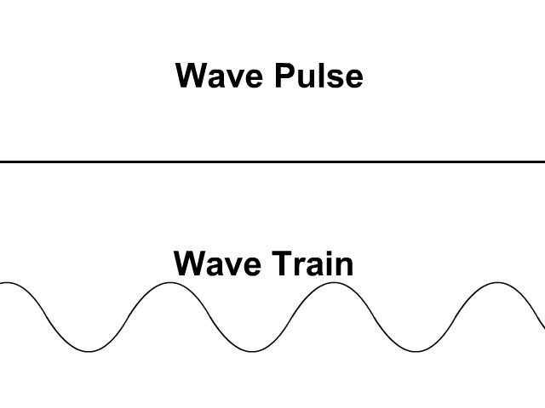
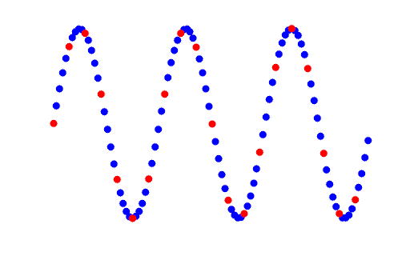
Wave Pulses Vs. Periodic Waves
The “domino effect” is an example of a wave pulse: A single burst of energy that moves through a system.
When the kinetic energy reaches a domino, it falls. When a domino strikes the next domino, the gravitational potential energy of the domino being struck becomes kinetic energy, then passed to the next domino… and so on…
A series of repeated waves is called a periodic wave. They are caused by an oscillation (oscillation = vibration)
Oscillation

Slide 4
Medium: The stuff waves Travel Through
Sound waves move through air (and other things!). The air is the medium.
The medium doesn’t produce any energy, it just transmits it across space.

Slide 5
Transverse WaveS: Water
Oscillation
Wave Propagation
In transverse waves the oscillation and wave it produces are perpendicular.
Water waves are transverse.

Slide 6
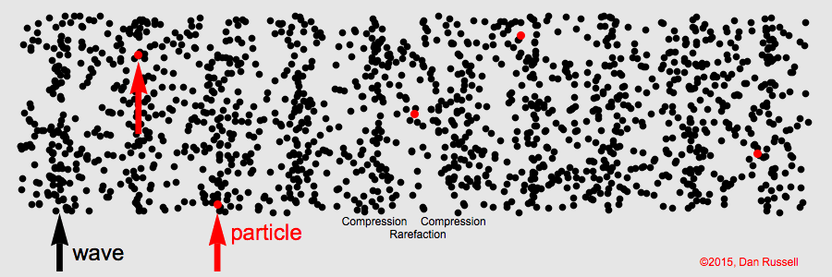
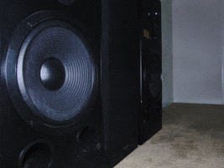
Longitudinal Waves: SOUND
Oscillation
Wave Propagation
In longitudinal waves the oscillation and wave it produces are parallel.
Sound (i.e. air pressure) waves are longitudinal.

Slide 7
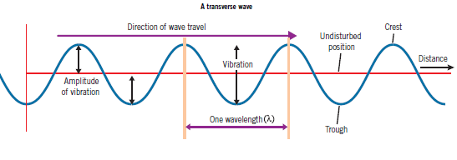
Describing Waves
WAVELENGTH (λ): distance from crest to crest (etc.)
AMPLITUDE: height of wave
FREQUENCY: number of wave cycles in one second (Hz)

Slide 8
Cool Things Waves Do
But first:
A wave moves _____________ through a ____________.
The size of one wave (“crest to crest”) called the wave’s _____________________, represented by the Greek letter ____
A subwoofer is a speaker designed to produce low-pitch sounds (all about that bass). Typically, they produce sounds with frequencies between 20 and 100 Hz. If you are standing in front of a subwoofer playing a 50 Hz sound, how many waves hit you every minute?
ENERGY
MEDIUM
WAVELENGTH
λ
“Lambda”
1 Hz = 1 cycle / second
50 cycles / second x 60 seconds / minute = 300 waves / minute

Slide 9
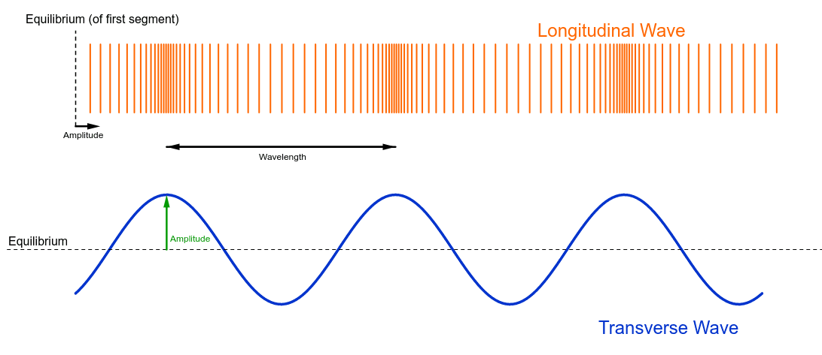
Types of Physical Waves
Sound = Longitudinal (parallel to oscillation)
Water Waves = Transverse (perpendicular to oscillation

Slide 10
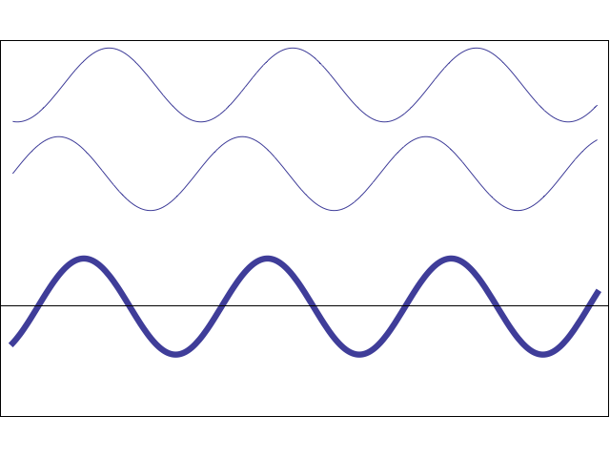
When Waves Meet: Interference Waves Just Add Up
Prof. Dave…

Slide 11
When Waves Hit Stuff

