Slide 1
Potential & Kinetic Energy Applications
Conservation of Mechanical Energy:
M.E. (Mechanical Energy) = K.E. (Kinetic Energy) + P.E. (Potential Energy)
Gravitational Potential Energy:
PE = mgh
where m = mass (kg),
g (acceleration due to Earth’s gravity) = 10 m/s²,
h = height
Kinetic Energy:
KE = ½ mv²
where m = mass (kg),
v = velocity (m/s)
Break out a sheet of paper and pencil, and try these:
Type I: Single Formula
A 20 kg object is held 10 m above the ground. How much gravitational potential energy does it have?
A 1 kg brick is thrown with a velocity of 10 m/s. How much kinetic energy does it have?
The acceleration due to gravity on the moon is only 1/6 as large as it is on Earth. What is the potential energy of a 10 kg object held 10 m above the surface of the moon?
Type II: Energy Transformation
A 2 kg rock falls off of a cliff that is 100 m tall. How fast is it moving just before it crashes into the ground?
Really, this only works if you do them ☺

Slide 2
PE = mgh KE = ½ mv²
A 20 kg object is held 10 m above the ground. How much gravitational potential energy does it have?
A 1 kg brick is thrown with a velocity of 10 m/s. How much kinetic energy does it have?
The acceleration due to gravity on the moon is only 1/6 as large as it is on Earth. What is the potential energy of a 10 kg object held 10 m above the surface of the moon?
A 2 kg rock falls off of a cliff that is 100 m tall. How fast is it moving just before it crashes into the ground?
PROBLEM SOLVING STEPS
List knowns and unknowns
Select formula
Plug-in
Solve
Check

Slide 3
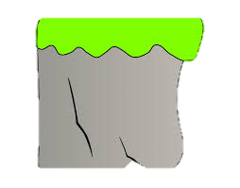
Reference Point
1 kg
A
Potential Energy is relative to a reference point.
The “zero point” is usually set to the surface of the Earth, but it doesn’t have to be.
The “true” reference point for GPE of Earth is the planet’s core.
What is the potential energy of point A?
It can only be calculated relative to a different position (B or C, for example)
1 kg
B
30 m
20 m
1 kg
C

Slide 4
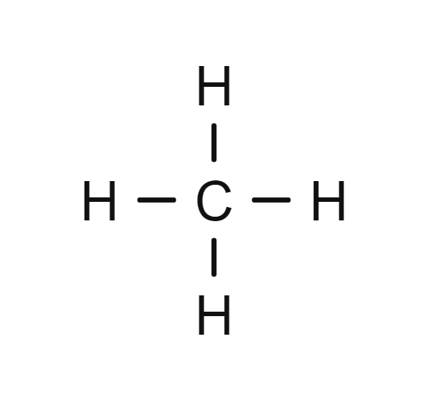
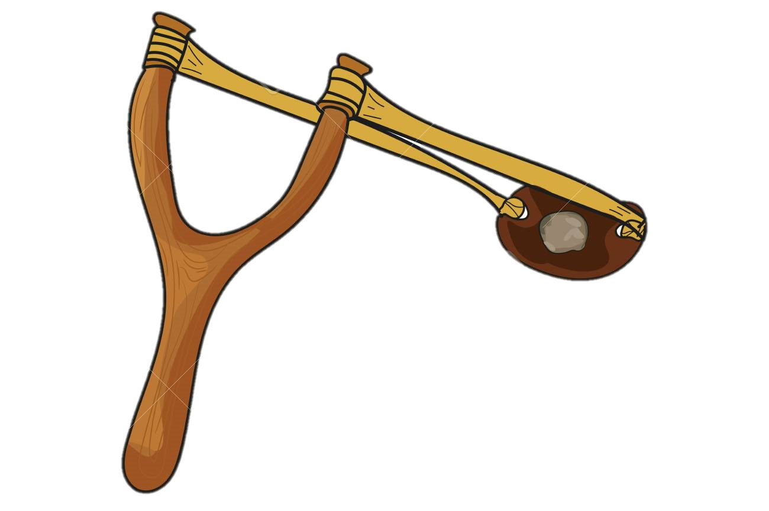
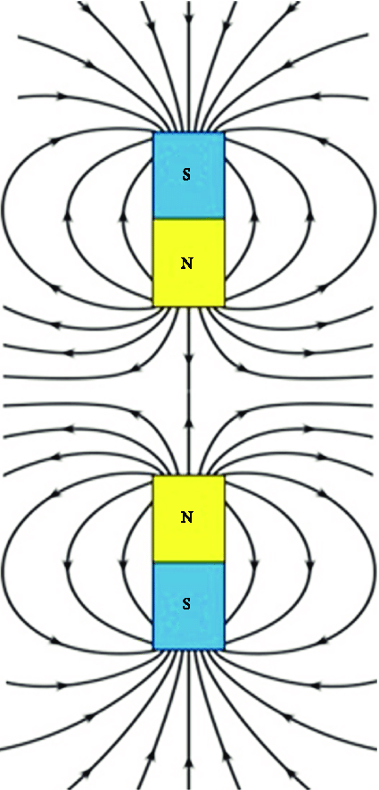
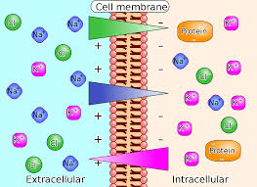
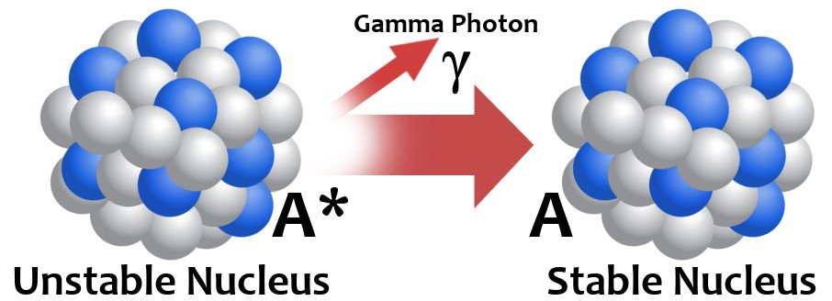
Many Other Types of Potential Energy
Elastic
Chemical Bonds
Electrochemical Gradient
Electromagnetic
Quantum

