Slide 1
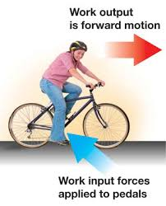
Machines
FORCES
Consider the bicycle as a simple machine:
A bicycle moves because the road pushes it forward (right). This happens because the tires of the bicycle push the road backwards (left). This is the action-reaction pair that moves the bike.
The rider does work on the bicycle equal to the force they exert on the pedals times the distance the pedals move (W = F₁d₁).
The useful work output of the bicycle is the force of the road on the bicycle times the distance the bike travels. (W=F₂d₂)
Assume the work done by input forces is equal to the work done by output forces (i.e. there is no friction).
Suppose the rider exerts a force of 1,000 N on the pedals. The pedals move a distance of 1.0 m along a circular path.
Questions:
If the bicycle moves 10 m, what was the size of the force pushing the bike forward?
Suppose the output force you just figured out stayed the same, but the bicycle only traveled 5 m when you test it in the real world. How can you explain this?
WORK

Slide 2
Catch-up Week
No new assignments.
Check Edmodo & ck12 to find any missing work.
Today’s topics include material from last week’s ck12 assignment.

Slide 3
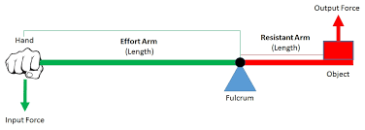
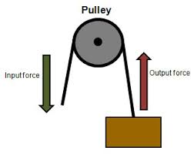
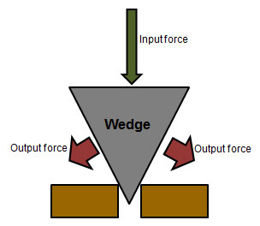

Slide 4
Back to the Bicycle: Mechanical Advantage
The mechanical advantage (MA) of a machine is the ratio of the input and output forces.
MA = F _{output} / F _{input}
In the bicycle example, the input force on the pedals = 1,000 N, and the output force on the bike = 100 N
This bicycle as a complete system has a mechanical advantage of 0.1.
The output force is 0.1 times the size of the input force.
The input force is 10x bigger than the output

Slide 5
Our bicycle example is actually a Compound Machine
A compound machine is a combination of several simple machines.
In the bicycle example, the “axl” is actually the chain.
A bicycle with different gears can change how large the “axl” is, making the ratio between the wheel and “axl” size different.

Slide 6
Big Mechanical Advantage: Jacks
MA = F _{output} / F _{input}
A bicycle uses a larger input force to produce a weaker output force (but greater distance). Because the output force is < input force, MA is < 1.
A jack is used to lift heavy objects. A jack lets the user do work with less force over a greater distance to produce a bigger force over a small distance. Because the output force is > input force, MA > 1.

Slide 7
Efficiency = W_{o}/W_{i}
Efficiency is the ratio of output work to input work.
In the 1st question, input work and output work were equal:
F₁d₁ = F₂d₂
1000 N * 1 m = 100 N * 10 m
Efficiency = 1,000 J / 1,000 J = 1.0 = 100%
In the 2nd question, output work was smaller:
F₁d₁ = 1000 N * 1 m = 1,000 J
F₂d₂ = 100 N * 5 m = 500 J
Efficiency = 500 J / 1,000 J = 0.5 = 50%
Efficiency measures what proportion of the input work comes out of the machine as useful output.

