Slide 1
Do Now 5.1 (HW Check 15.1,2,5)
Objective: Describe the leading hypotheses of abiogenesis, which describe how life most likely began on Earth.
Task: 1. Pass forward Week 34 Do Nows
2. Complete the timeline we began previously:
1. Big Bang 13.7 BYA
2. Formation of Earth & Moon 4.5 BYA
3. First Cells 3.8 BYA
4. Endosymbiosis 2.7 BYA
5. Cambrian Explosion 543 MYA
6. Land Plants & Fishes 480 MYA
7. Reptiles 350 MYA
8. Permian Extinction 250 MYA (Largest)
8A. Dinos & Mammals 220 MYA
9. Birds 150 MYA
10. K-T Extinction 65 MYA (asteroid kills dinos)
11. Hominids diverge from apes 6 MYA
12. Homo sapiens evolve 0.2 MYA
PRECAMBRIAN SUPEREON
PALEOZOIC ERA
MESOZOIC ERA
CENOZOIC ERA

Slide 2
Do Now 5.1
Objective: Describe the leading hypotheses of abiogenesis, which describe how life most likely began on Earth.
TASK: Consider the following diagram
Before
After
6% glucose
3% glucose + 3% galactose
6% glucose
3% lactose
Enzyme Added
Semi-permeable
membrane
Semi-permeable
membrane
Which way will water flow before & after?

Slide 3
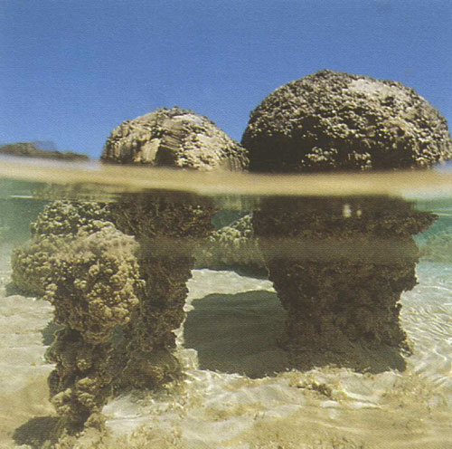
The First Cells: When did it happen?
Carbon dating techniques show that the oldest fossils are about 3.8 BILLION years old.
The oldest fossils are very similar in structure to these stromatolites - rock-like buildups of microbial communities.

Slide 4
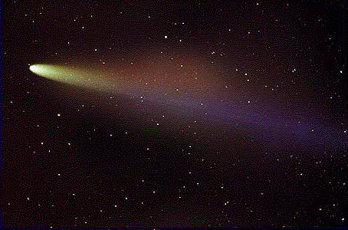
The First Organic Compounds
Complex organic molecules are common in the universe.
Amino acids (the building blocks of protein) can be found on comets and other moons and planets. They can even be made in the lab.
How organic chemicals came together to form the first cells is still under debate, but there are strong hypotheses with supporting experimental evidence.

Slide 5
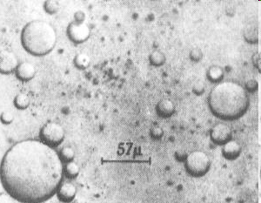
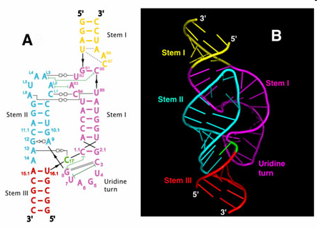
Facts
FACT: Organic chemicals like amino acids and proteins form cell-like spheres called microspheres and coacervates spontaneously
FACT: RNA molecules called ribozymes can act like enzymes and catalyze reactions.

Slide 6
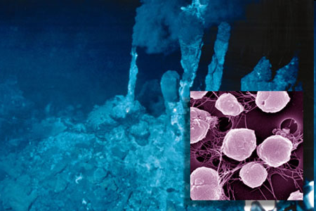
The First Cells – Archaea (prokaryotes)

Slide 7
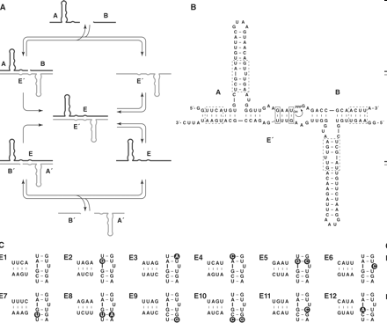
Hypotheses
Many scientists believe all life originated from an RNA molecule that had a special property – it could catalyze its own replication.
UPDATE 2009 – SELF-REPLICATING RNA MOLECULES PRODUCED IN THE LAB!!!!
Although the details are debatable, when ribozymes got into a protective fatty acid membrane, the first proto-cells arose

Slide 8
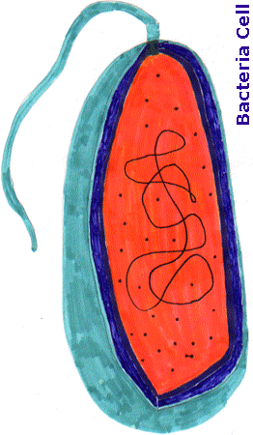
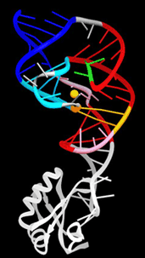
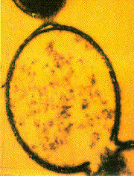
RNA based proto-cells
Self-Replicating Ribozymes
Coacervates & Microspheres
+
Video, anyone?...

Slide 9
The First Cells 3.8 BYA = Box 4
The very first cells were heterotrophs, and soon used up all of the organic chemicals around them.
The only way life could continue is if cells started to make their own chemical “food.”

Slide 10
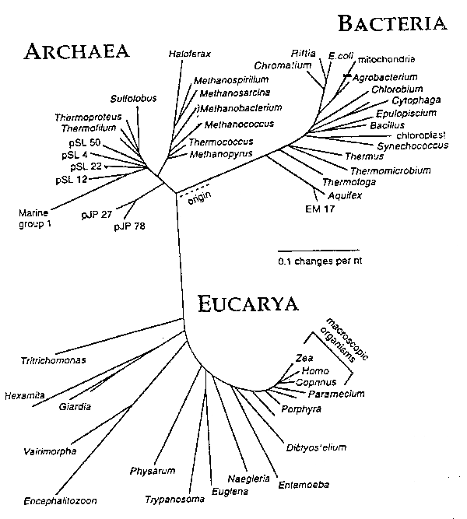
Most Similar to The First Life: Archaea, a group of prokaryotes

Slide 11
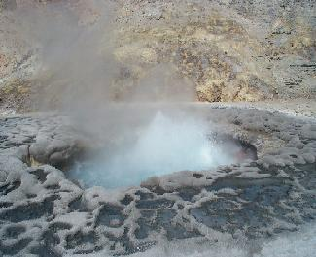

Slide 12
Today’s Plan
We will watch three two very different videos, each of which describes a different aspect of abiogenesis hypotheses.
For each video, please write the title and learning objective given. Take informal notes while watching.
Remember, evolution ≠ abiogenesis.
Evolution theory describes how life changes over time.
Abiogenesis hypotheses describe how life begins.

Slide 13
Carl Sagan Explains the Miller-Urey Experiment
Describe the significance of the 1953 Miller-Urey experiment.

Slide 14
How Life Began – Abiogenesis – Dr. Jack Szostock
Explain how lipids and nucleotides present on early Earth most likely developed into the first protocells

Slide 15
Tenacious DNA (A History of Life on Earth)
Explain how the DNA molecules in every organism are the current endpoint of an information chain that extends back almost four billion years.

Slide 16
Discussion and Homework
HW: 16.1-16.3
Thoughts on the three videos?

