Slide 1
Do Now 3/13
Objectives:
Describe the importance of PCR.
Explain how PCR works
Tasks:
Given the coding DNA sequence:
5’ AAT-CCG-ATA 3’
Determine the associated template strand and mRNA

Slide 2
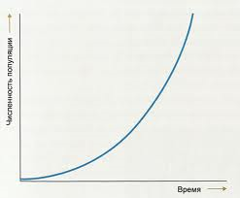
Exponential
Growth

Slide 3
Key Ideas from Last Night’s Homework
Transformation: prokaryotes acquire DNA from the environment.
Transduction: phages transfer DNA between prokaryotes
Conjugation: prokaryotic cells exchange genetic material.
Plasmid: tiny bonus chromosome in some prokaryotic cells

Slide 4
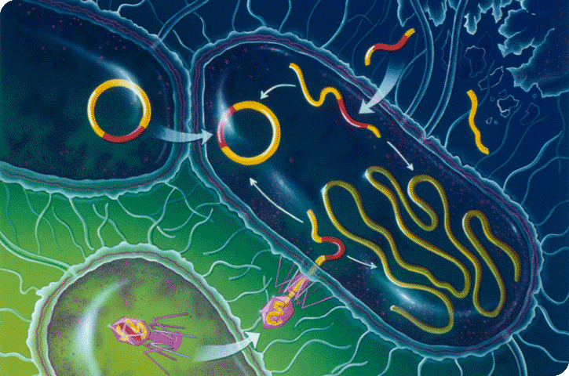
Transformation by environmental DNA
Conjugation transfers plasmid DNA
Transduction of phage DNA into chromosome or plasmid

Slide 5
PCR: Polymerase Chain Reaction
WHAT IT IS: A way to make a large number (billions) of copies of a DNA sequence in a few hours.
WHY IT MATTERS: provides enough DNA to do research with.
WHEN: 1986. Totally revolutionized biology.

Slide 6
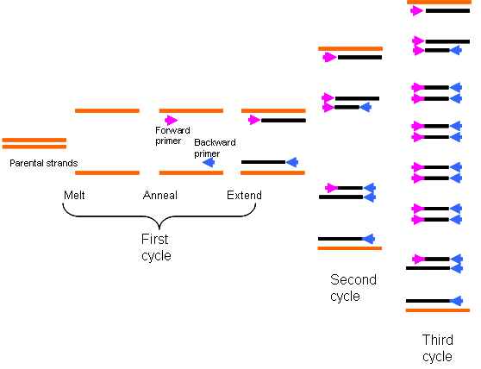
How it Works

Slide 7
Virtual PCR
http://learn.genetics.utah.edu/content/labs/pcr/
Youtubes…

Slide 8
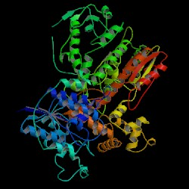
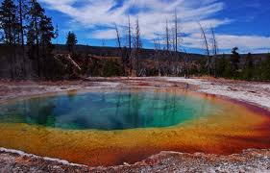
One last note… Thermus aquaticus
The ability to perform PCR is predicated on a thermostable DNA polymerase that functions at a high temperature.
Taq is a prokaryote from hot springs.
Biotech = prokaryotes!!! ☺

Slide 9
Your Assignments
Reading on syllabus
ADD: PCR questions on back of diagram.

