Slide 1
Bioenergetics:
OBJECTIVES:
1. Define energy
2. Define the 1st and 2nd laws of Thermodynamics, including entropy.
3. Describe photosynthesis and respiration in thermodynamic and redox terms.
TASK:
1. Task:
A jelly donut contains about 1 x 10⁶ J of energy.
A gallon of gasoline contains about 1 x 10⁸ J of energy.
How many jelly donuts would provide the same amount of energy as a 20 gallon tank of gasoline?`

Slide 2
Energy and society
Claim: It is not a coincidence that large-scale human slavery in the Western world ended around the same time fossil fuels were rapidly expanding.
A human doing physical work for 8-hours a day can produce about 5 x 10⁵ J of useful work.
A gallon of gasoline produces about 2 x 10⁶ J of useful energy when burned in an engine.
How many gallons of gasoline produce the same amount of work as 50 humans working all day?

Slide 3
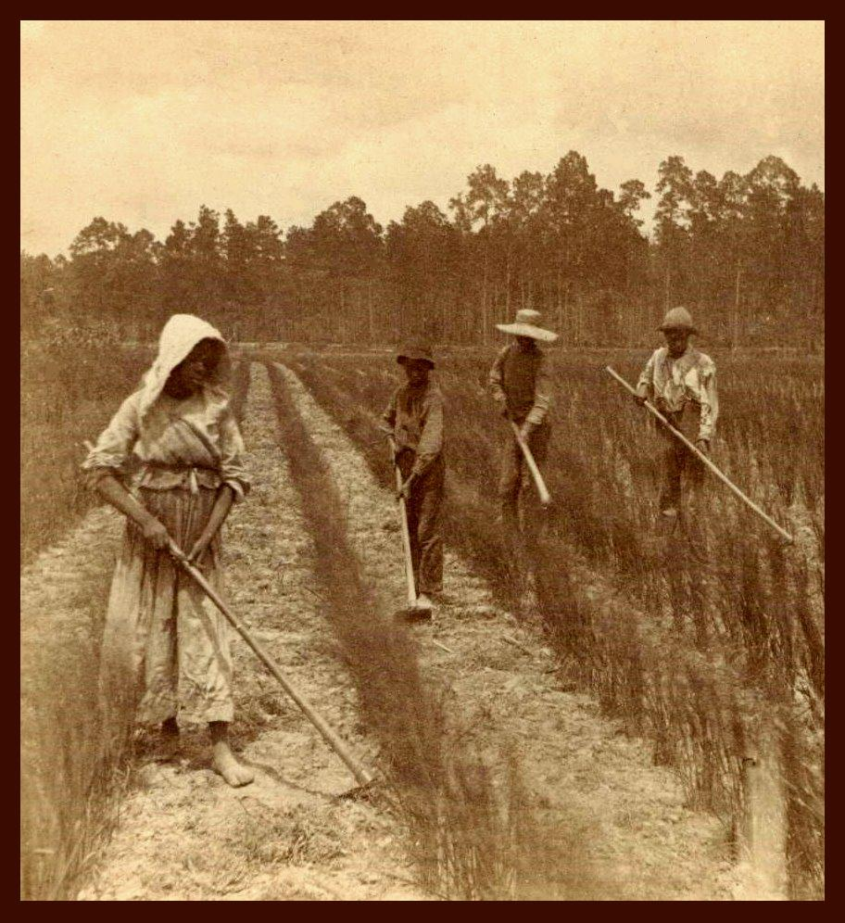
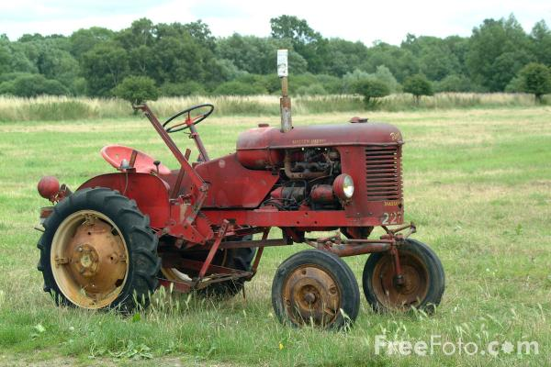
Solution
(2 x 10⁶ J) [gasoline] / (5 x 10⁵ J) [human] = 4.
1 gallon of gasoline produces as much work as 4 humans working all day.
50 [humans] / 4 = 12 ½
Evidence: the same amount of work can be done by 50 day-laborers or about 13 gallons of gasoline.

Slide 4
Take-home message
The amount of energy produced by burning fossil fuels is huge in comparison to human labor.
Example: You could not power a large TV by riding a bicycle… but coal can.

Slide 5
What is Energy?
The ability of something to cause a change in itself or its environment.
The ability to do work.

Slide 6
Laws of Thermodynamics
1st Law: Energy can neither be created nor destroyed.
2nd Law of Thermodynamics: In an isolated system, entropy (disorder) increases
So how do living things remain so organized, and in fact increase the organization in and around themselves?
ENERGY. Living things use energy to prevent entropy from destroying them.
Living things are “negative entropy machines”

Slide 7
Entropy and Energy
ORDER
Nonspontaneous
Spontaneous
Chaos
Energy Released
(ΔG < 0)
Energy Required
(ΔG > 0)

Slide 8
Photosynthesis & Respiration
C₆H₁₂O₆
+ 6 O₂
Photosynthesis
Respiration
6 CO₂ + 6 H₂O
ATP Energy Produced
Light Energy Required

Slide 9
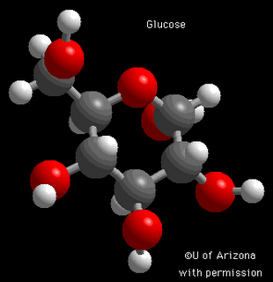
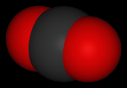
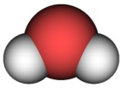
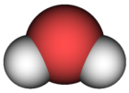
Order vs. Chaos
Photosynthesis
Respiration
ATP Energy Produced
Light Energy Required

Slide 10
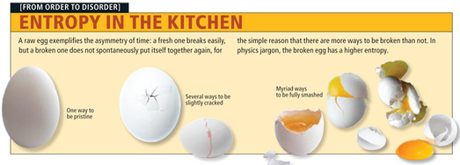
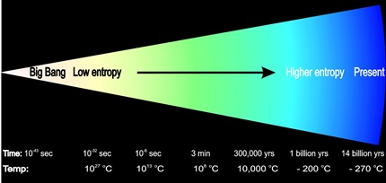
Entropy Directs the “Arrow of Time”

Slide 11
… MC Hawking…

Slide 12
Key Bio-energetic Processes
Photosynthesis : the process by which plants and other photoautotrophs store the energy of light as chemical energy in carbohydrates.
(Cellular) Respiration: the process by which animals and other chemotrophic organisms transform chemical energy stored in carbohydrates (or other sources) into available energy (ATP).

Slide 13
Chemistry II Students…
Make a connection:
ΔG = ΔH – TΔS
Remember: Gibbs Free Energy always decreases in spontaneous reactions.
S = entropy. Note that big entropy increases (disorder) tend to make a chemical reaction spontaneous!
In other words, when ΔG is negative, reactions happen without the input of work.
Gibbs Free energy change when breaking down glucose = -2870 kJ/mol

Slide 14
Redox Reactions: It’s About Electrons
Reducing carbon (adding more H to it)
requires energy
e.g. photosynthesis.
This increases the chemical potential energy stored by electrons in the chemical system
Oxidizing carbon (adding more O)
releases energy
e.g. combustion, aerobic respiration
This releases some of the chemical potential energy stored in the electrons of the chemical system
How to remember?
L.E.O. the lion says G.E.R.
Bottom line? Food is food because it has high-energy electrons you can use to make ATP.

Slide 15
Bioenergetic Chemistry
Photosynthesis | Respiration
Requires energy | Releases energy
Carbon is reduced | Carbon is oxidized
Entropy decreases (produces order) | Entropy increases (produces disorder)
Nonspontaneous | Spontaneous
Phototrophs | Chemotrophs

Slide 16
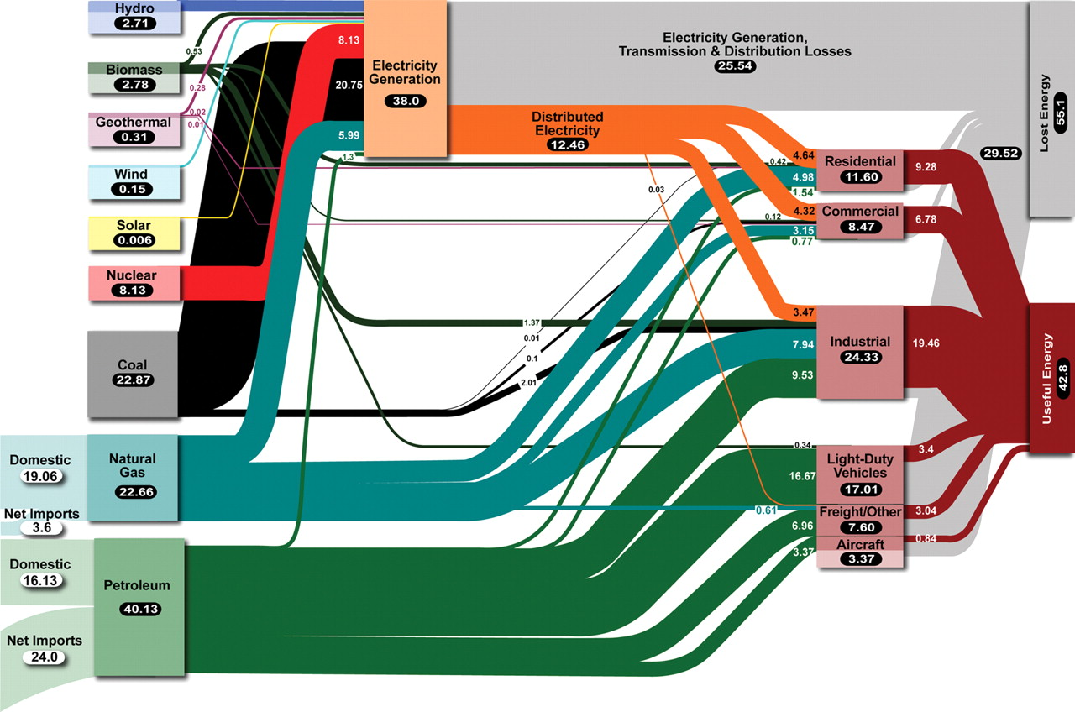
Human Energy Use

Slide 17
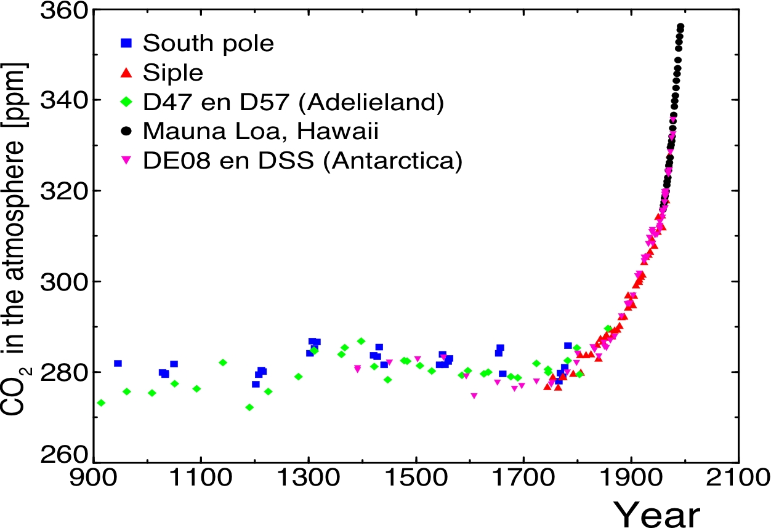
Consequences

