Slide 1
Do Now 11/17 (week 13):
OBJECTIVES:
1. Describe the structures and functions of the animal nervous system
TASK: 1. Do NOT pass forward week
12 Do Nows. Begin new week 13
2. Syllabus Update: today, 11.17:
Nervous System / no homework.
Tomorrow 11.18: The Nucleus & The
Endomembrane System / 4.6-4.10

Slide 2
Before we get to the Nervous System…
Why the nervous system? I thought this was the “cells & transport” unit.
The nervous system is composed of specialized cells called neurons.
The electrochemical signals sent from neuron to neuron have EVERYTHING to do with transporting chemicals into and out of cells.

Slide 3
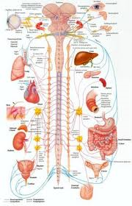
Divisions of the Nervous System
CNS = Central Nervous System. Command & Control: Brain & spinal cord
PNS = Peripheral Nervous System. The neurons that carry signals to and from the CNS

Slide 4
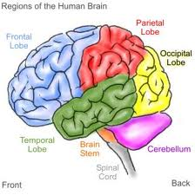
Parts of the CNS
Cerebrum: thinking, emotions, etc.
“Reptile brain” below:
Cerebellum: regulates action of the brainstem
Brainstem (incl. medulla oblongata) controls involuntary muscle
Hypothalamus: controls homeostasis (body temperature, hunger, thirst, fatigue, sleep, and circadian cycles.)

Slide 5
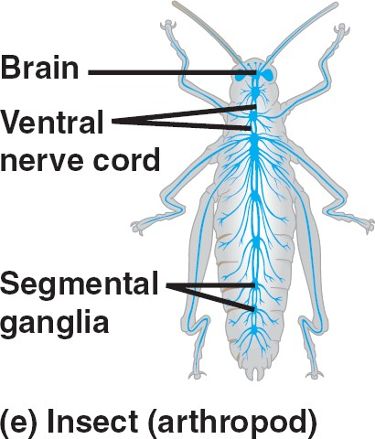
Ganglia: Not quite a brain
Singular: ganglion
Cluster of neurons. For example, in arthropods, each segment has a ganglion, and the brain is composed of 6 fused ganglia

Slide 6
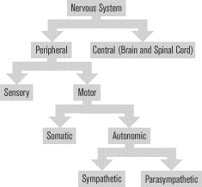
Types of Nervous Tissue
automatic movement
Conscious movement
Rest & digest
emergency

Slide 7
3 Types of Neurons
Motor neurons fire to control muscle. (CNS → muscle)
Sensory neurons fire in response to environment (sense organ → CNS)
Interneurons control signals between motor and sensory neurons. i.e. YOUR BRAIN.

Slide 8
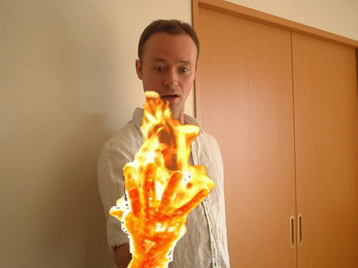
Don’t try this at home
HOT!!!
Better pass this along to the motor neurons!
Sensory neurons send signal to CNS
Interneurons transmit signal to motor neurons
Motor neurons make you jump around like your hand is on fire.
MOVE!

Slide 9
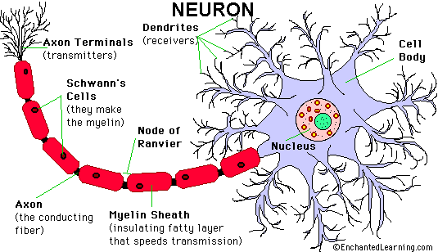

Slide 10
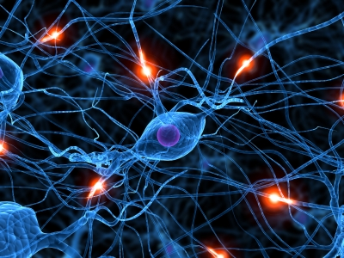

Slide 11
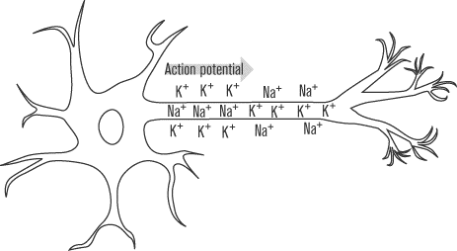
Neurons Transmit Signals
When a neuron receives a chemical message at one of its dendrites, it may send the signal through it’s axon to another neuron.
The electrochemical signal travelling along an axon is called an action potential.
Axon

Slide 12
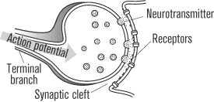
When the Action Potential Reaches a Synapse, Neurotransmitters are Released
Axon
Dendrite
Some neurotransmitters are chemicals that direct the action of the post-synaptic cell.
Excitatory – continue propagation; Inhibitory – stop signals.

Slide 13
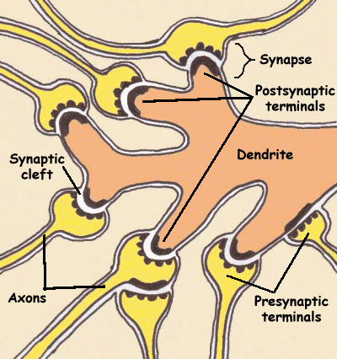
Synapse: Neural Junctions
Synapse: The tiny space between a dendrite and axon of two different neurons.

Slide 14
So How Do We “Think?”
Your brain has billions of neurons.
Each neuron has thousands of connections to other neurons.
The adult human brain has about 500 TRILLION unique connections.
In other words, it’s pretty complicated! But on a cellular level, it’s simply individual cells sending and receiving electrochemical messages which can be propagated to a neighboring cell, or ignored.

Slide 15
Stuff You NEED to Know
Neuron
CNS vs. PNS
Motor neurons vs. interneurons vs. sensory neurons.
Dendrite (receivers)
Axon (transmitter)
Action potential
Neurotransmitter
Synapse

Slide 16
Action Potential: How a Neuron “fires”
A neuron not sending a signal is at “rest.” it has an electrical voltage of about -70mV (it’s negative)
A neuron is activated when excitatory neurotransmitters from a cell it is in contact with cause part of it to depolarize (become less negative).
If the neuron dopolarizes enough, (i.e., reaches it’s threshold potential) special voltage-gated Na+ ion channels will open.
Na+ ions are concentrated outside the cell, so when the gated channels open, sodium rushes in by diffusion. This causes a further decrease of the cell’s negative charge.
This positive charge is called an action potential, and it flows down the dendrite to the synapse.
The positive charge causes K+ voltage-gated channels to open, allowing K+ ions to return to the cell.
The whole process takes only 0.001 S (1 mS) to complete.

Slide 17
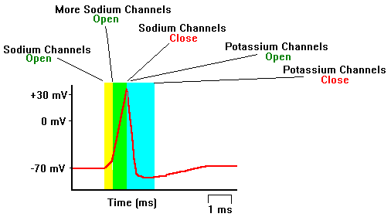
Following an Action Potential

